Slide 1


Slide 2
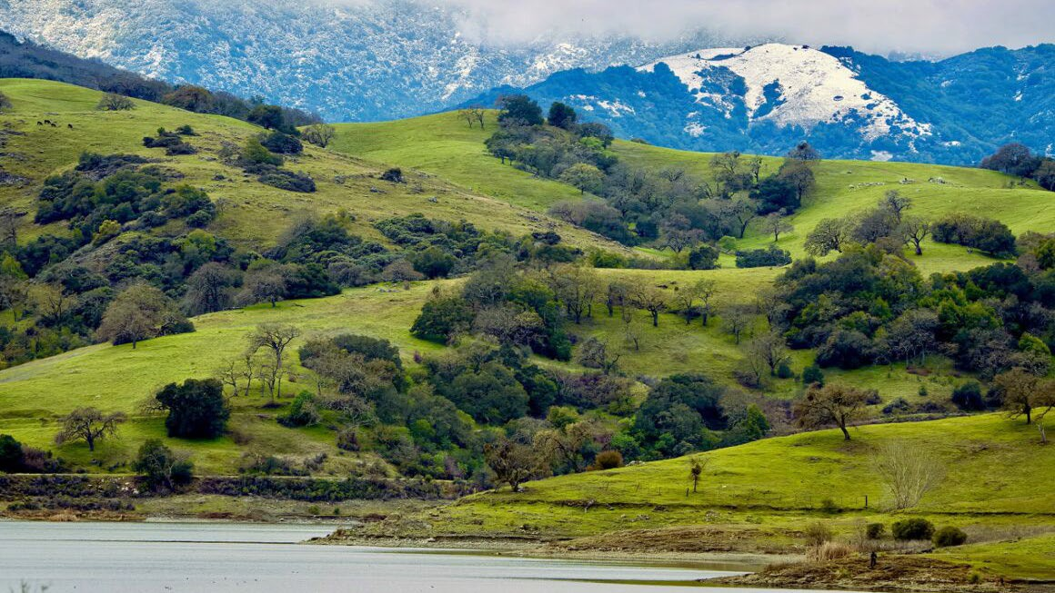

Guadalupe and Upper Pajaro Watershed Plans
Board of Directors
April 9, 2024
Notes:
Good afternoon Board
Lisa Bankosh AO
Presenting two watershed plans for adoption, with adoption the Board concurs with the priority actions included the plans.
Plans are result of a two year process, many contributors, led by Brian Mendenhall, with project managers katie muller and nick Mascarello.

Slide 3
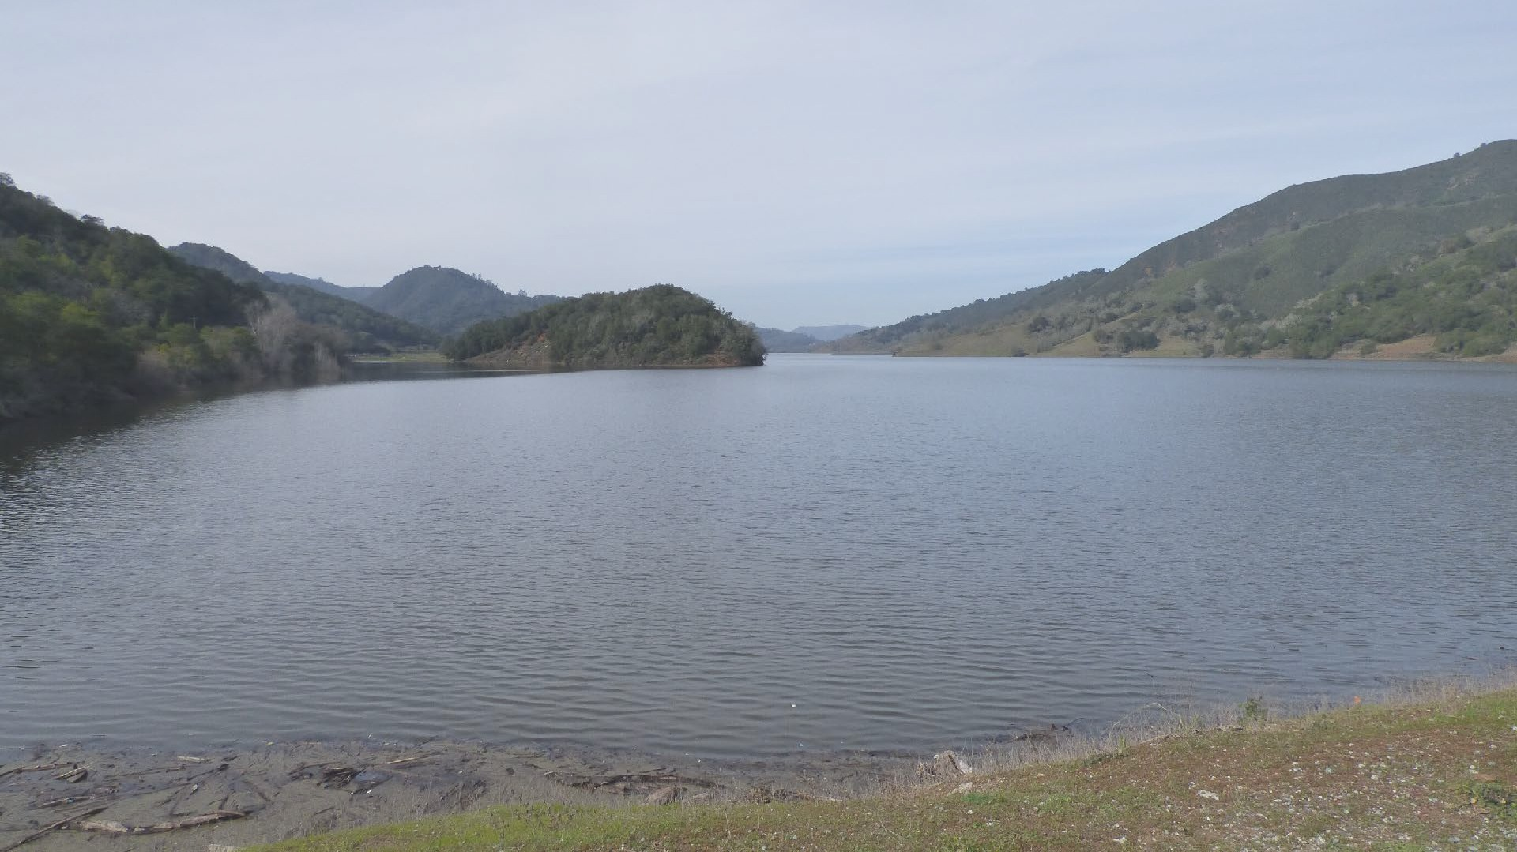

Presentation Outline
3
Watershed planning process
Flood vulnerability assessment
Priority actions
Notes:
Brief presentation to highlight master planning process and focus on the results which are the priority actions

Slide 4

4
Watershed Master Planning engages the community and uses equitable metrics to identify flood protection and stream stewardship priority actions for a sustainable future.
1. One Water Planning Process
Notes:
Like other master planning processes at Valley Water, watershed master planning read the slide
However, One water plans are comprehensive, pulling in actions from water supply and asset management so they function as integrated long-range plans for the agency

Slide 5
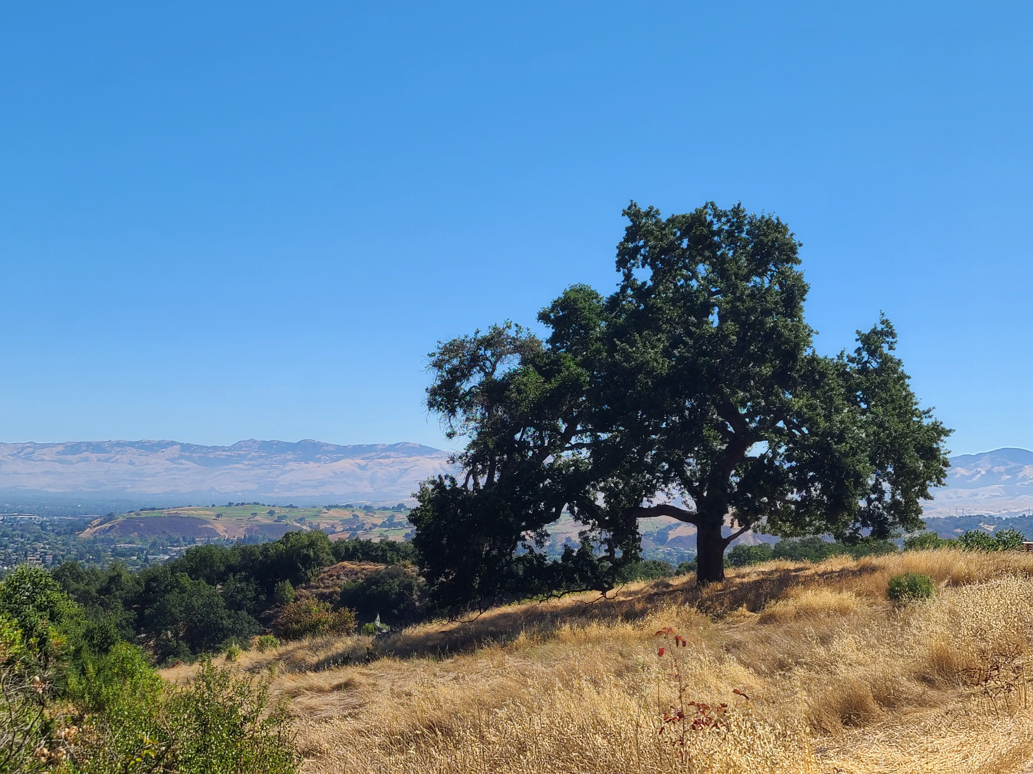






Planning Framework: Objectives and Metrics
6
6
g r o
.
r
ate
w y
e l l
a
v
Flood Risk Reduction
Asset management
Emergency action plans
Flood forecasts
Parcels subject to frequent flooding
Flood risk in disadvantaged communities
Natural Ecosystems
California Rapid Assessment Method (CRAM) scores
Protected stream buffers
Wildlife corridor enhancements
Natural habitat area
Invasive plant coverage
Fish passage barriers
Riparian corridor connectivity
Climate Change
Net GHG emissions
Green stormwater infrastructure
Annual water conservation
Critical facilities subject to severe floods
Stream channel length and connectivity
Water Supply
Reservoir capacity
Recycled water production
Managed recharge capacity
Annual water conservation
Water Quality
Chemical integrity (e.g., pH, dissolved oxygen (DO), nutrients, pesticides, regulated contaminants)
Biological integrity (e.g., bacteria, harmful algal blooms, invasive species, toxicity, fish tissue, mercury)
Physical integrity (e.g., temperature, turbidity, trash)
1. One Water Planning Process
Notes:
The watershed planning process is data driven. There are 5 measureable objectives, each with a series of metrics with baseline and targets are established to identify gaps and measure progress towards each objectives.

Slide 6
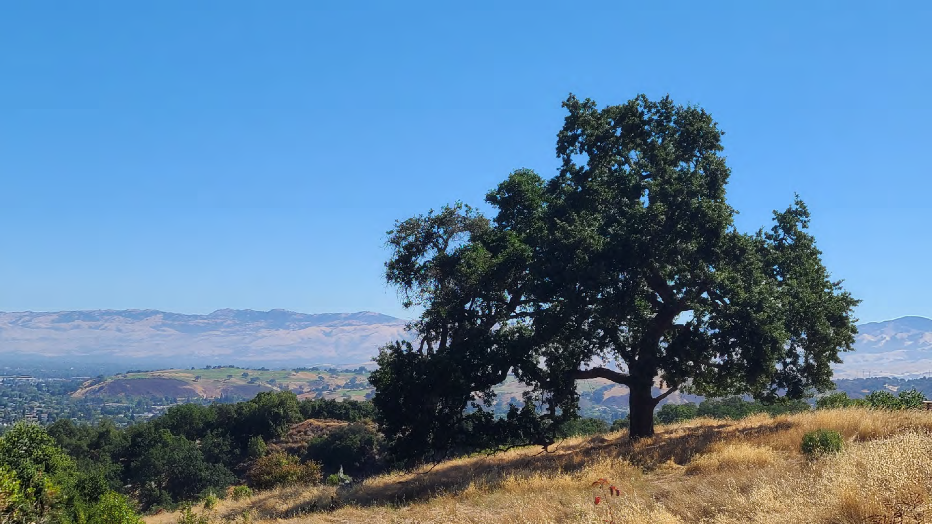
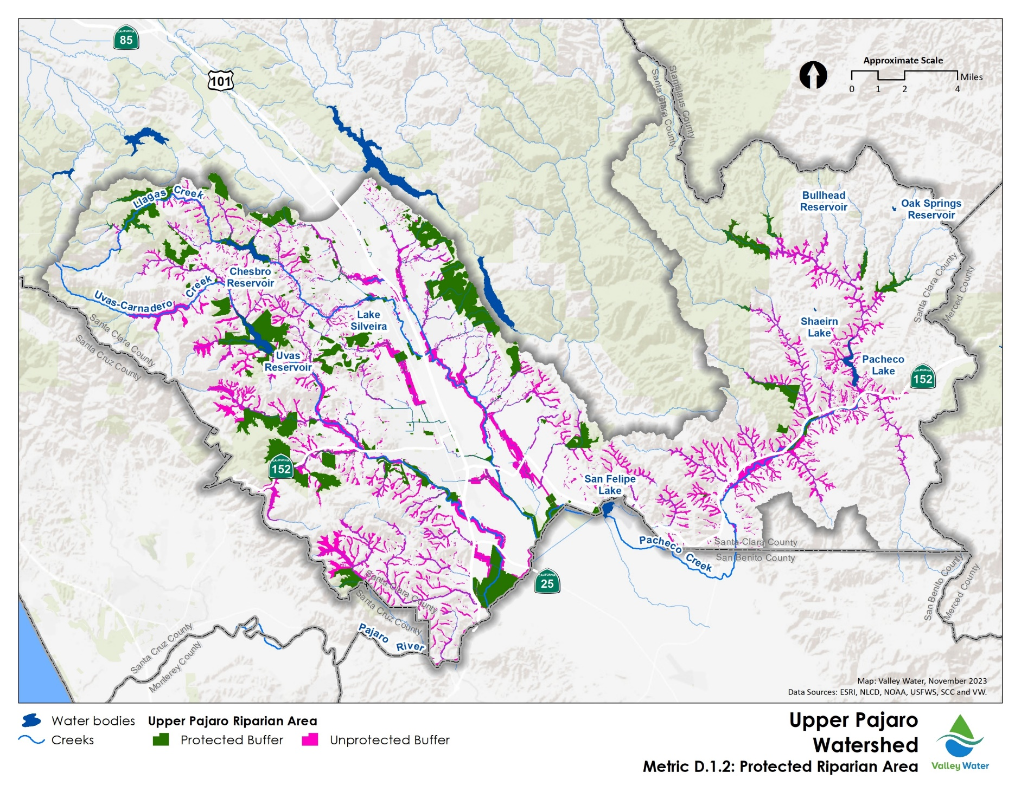
Example Metric: Stream buffers
Target: Achieve 50,000 acres of protected land for the mainstem and tributary channels
32% Complete
1. One Water Planning Process
Notes:
This map shows unprotected portions of the upper pajaro watershed’s stream buffer lands. It is an example of how data is used to identify watershed priorities, in this case, to develop partnerships to protect the buffer lands.

Slide 7
FLOOD VULNERABILITY ASSESSMENT
¹⁵
7
Notes:
The flood vulnerability assessment is another way data is used to identify watershed management priorities.

Slide 8
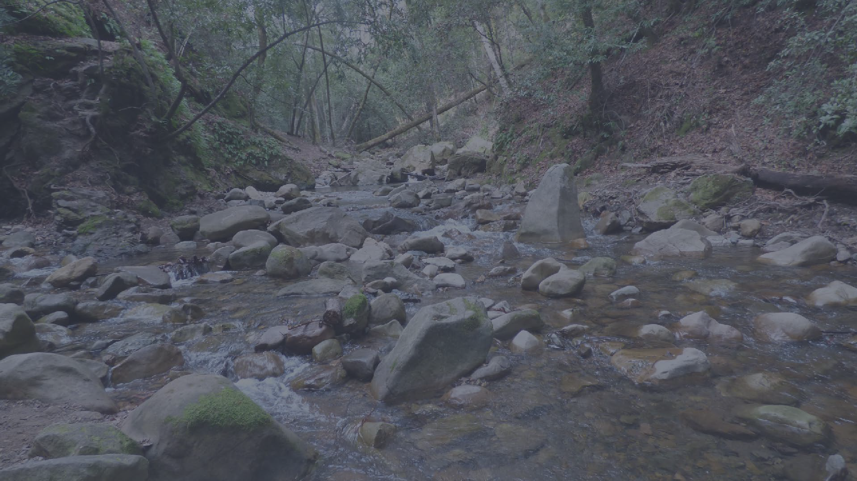

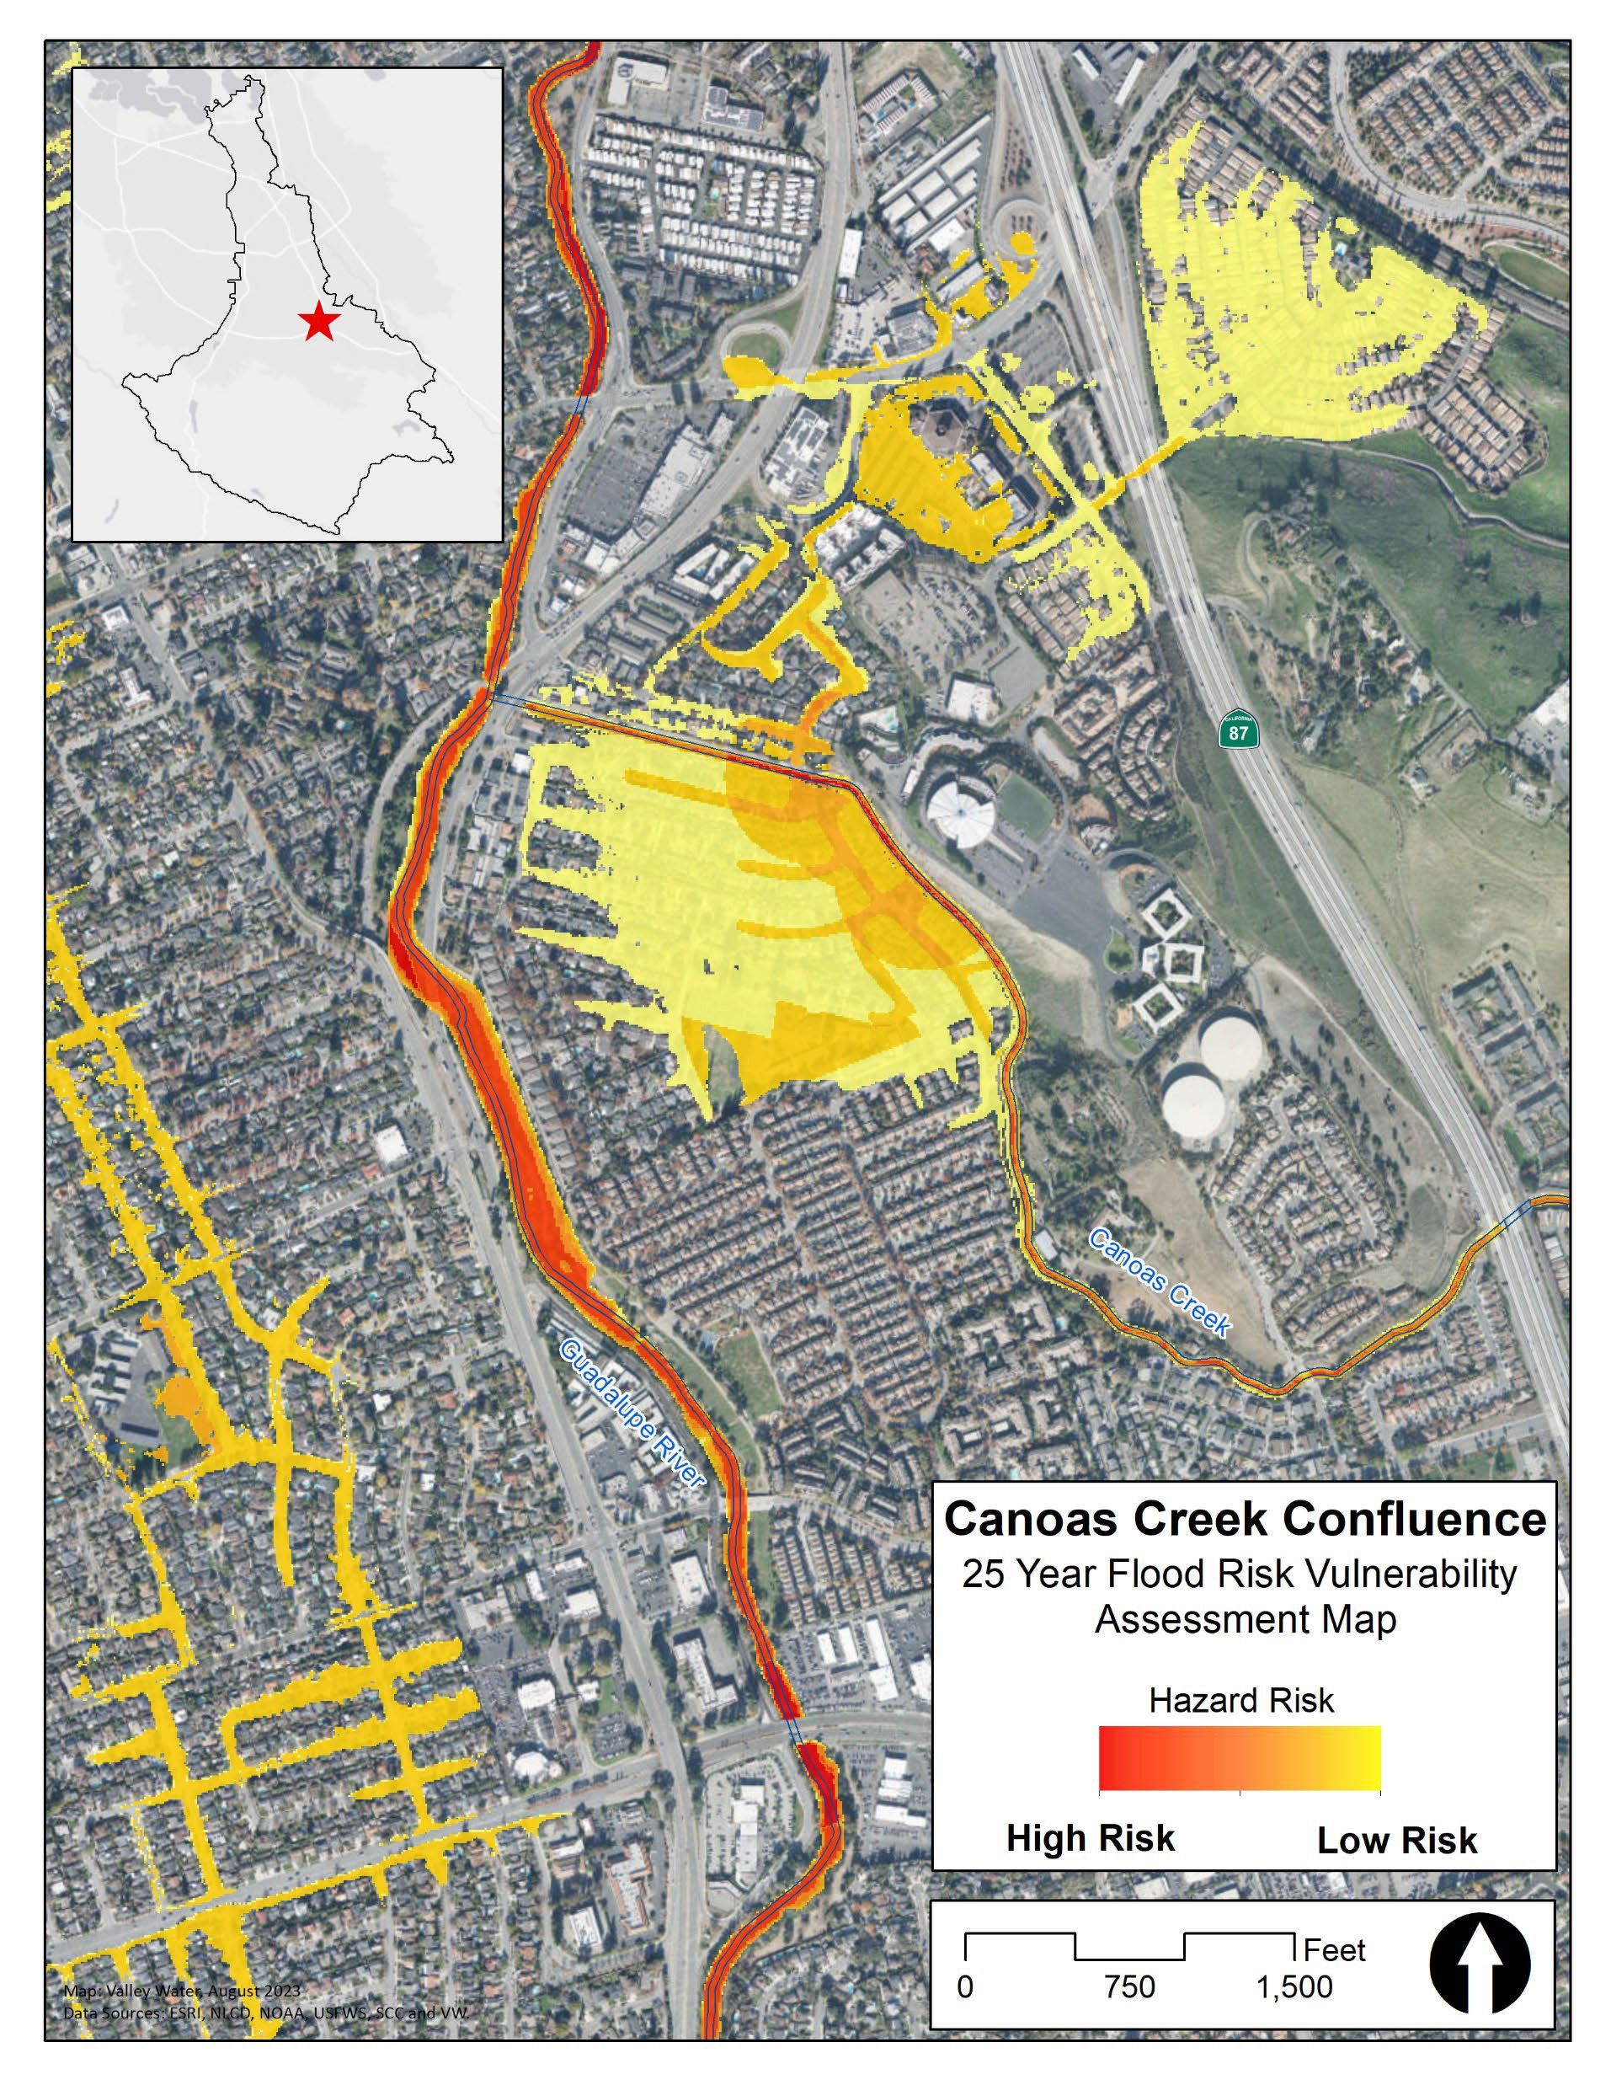


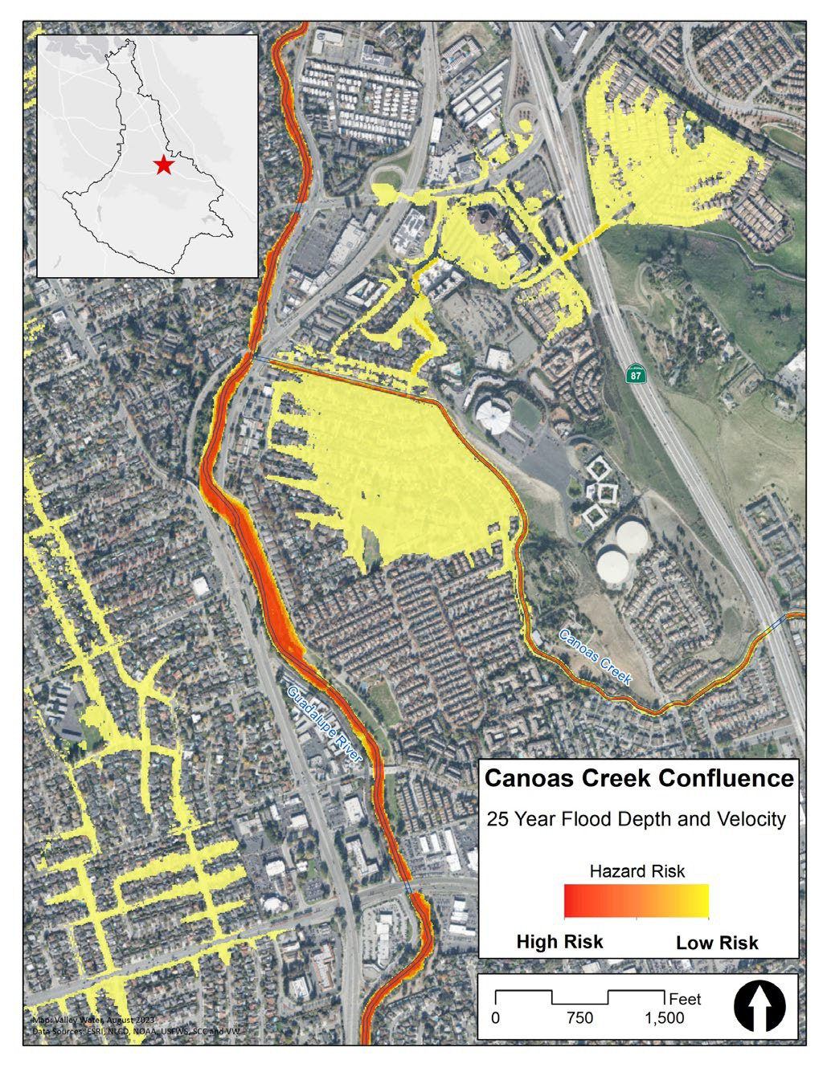
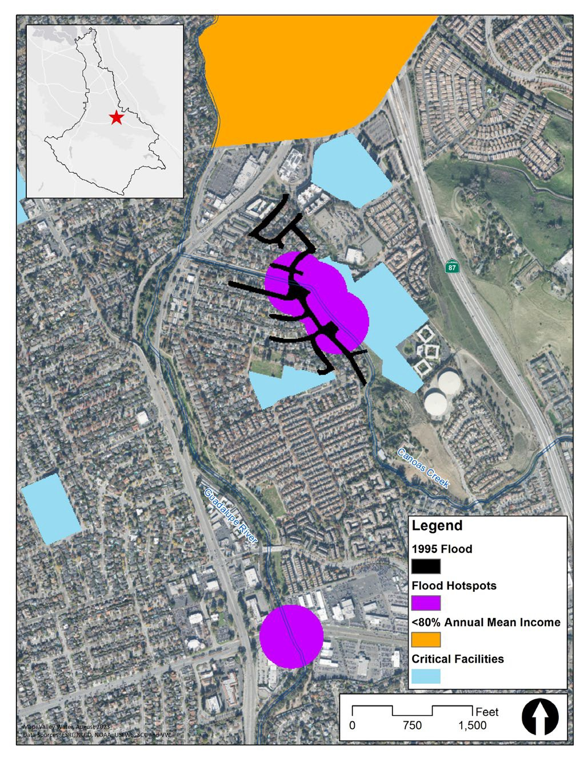
Physical
8
Statistical and Social
Combined Vulnerability Map
2. Flood Vulnerability Assessment
Notes:
Flood vulnerability is a combination of community characteristics and the physical extent of frequent flooding, defined as a 25 year event. The goal is to provide health and safety to the entire county, prioritizing underserved communities.

Slide 9
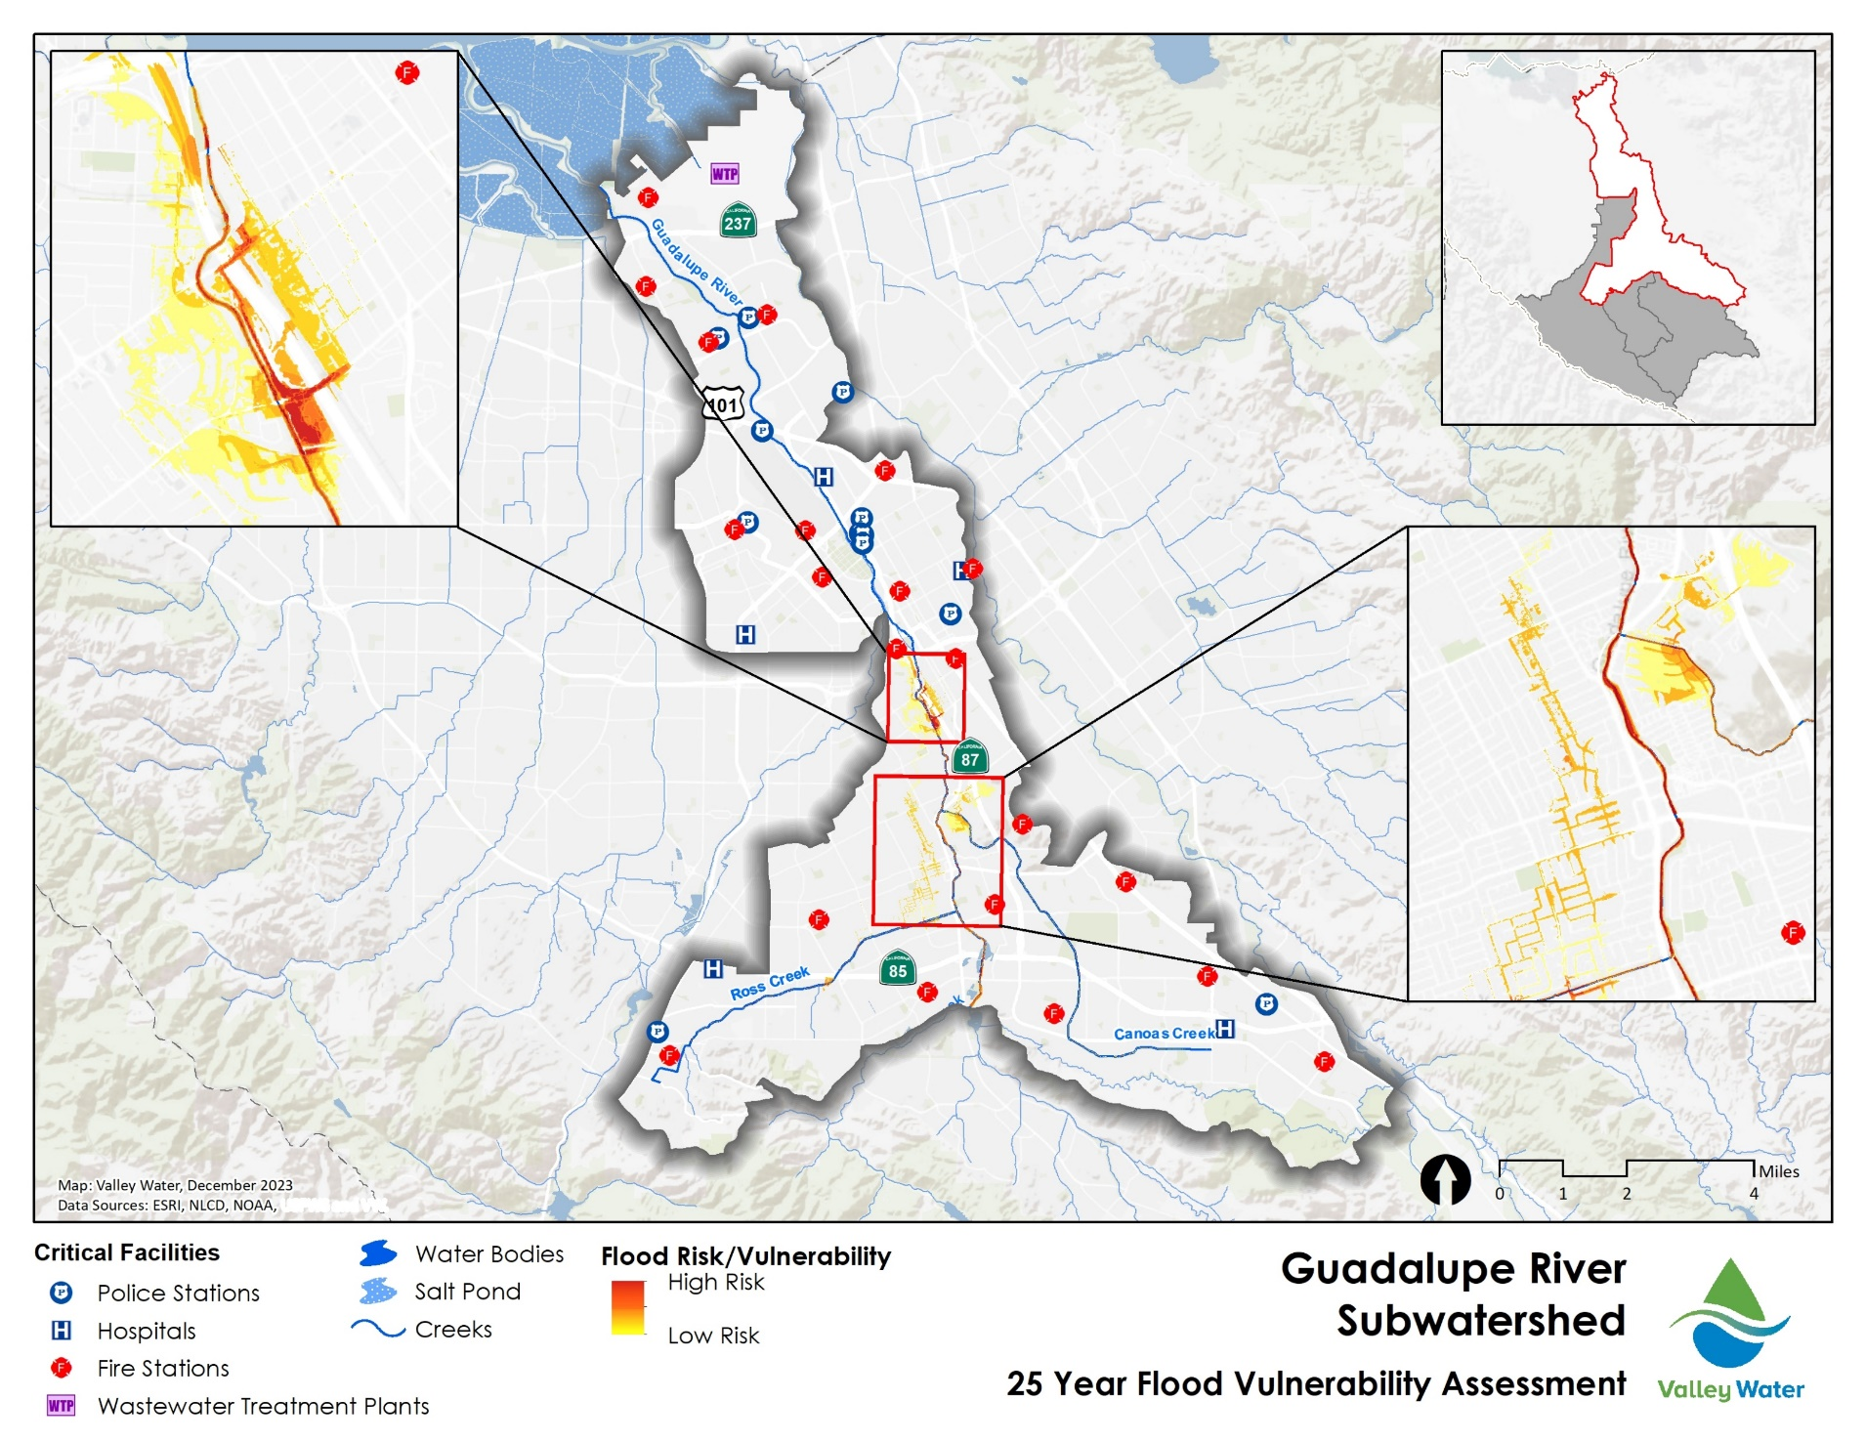

Flood- Vulnerable Areas
24
Guadalupe
watershed
2. Flood Vulnerability Assessment
Notes:
This map shows results in the Guadalupe watershed. As you can see several areas of risk are identified. including Ross, Canoas, and Upper Guad

Slide 10
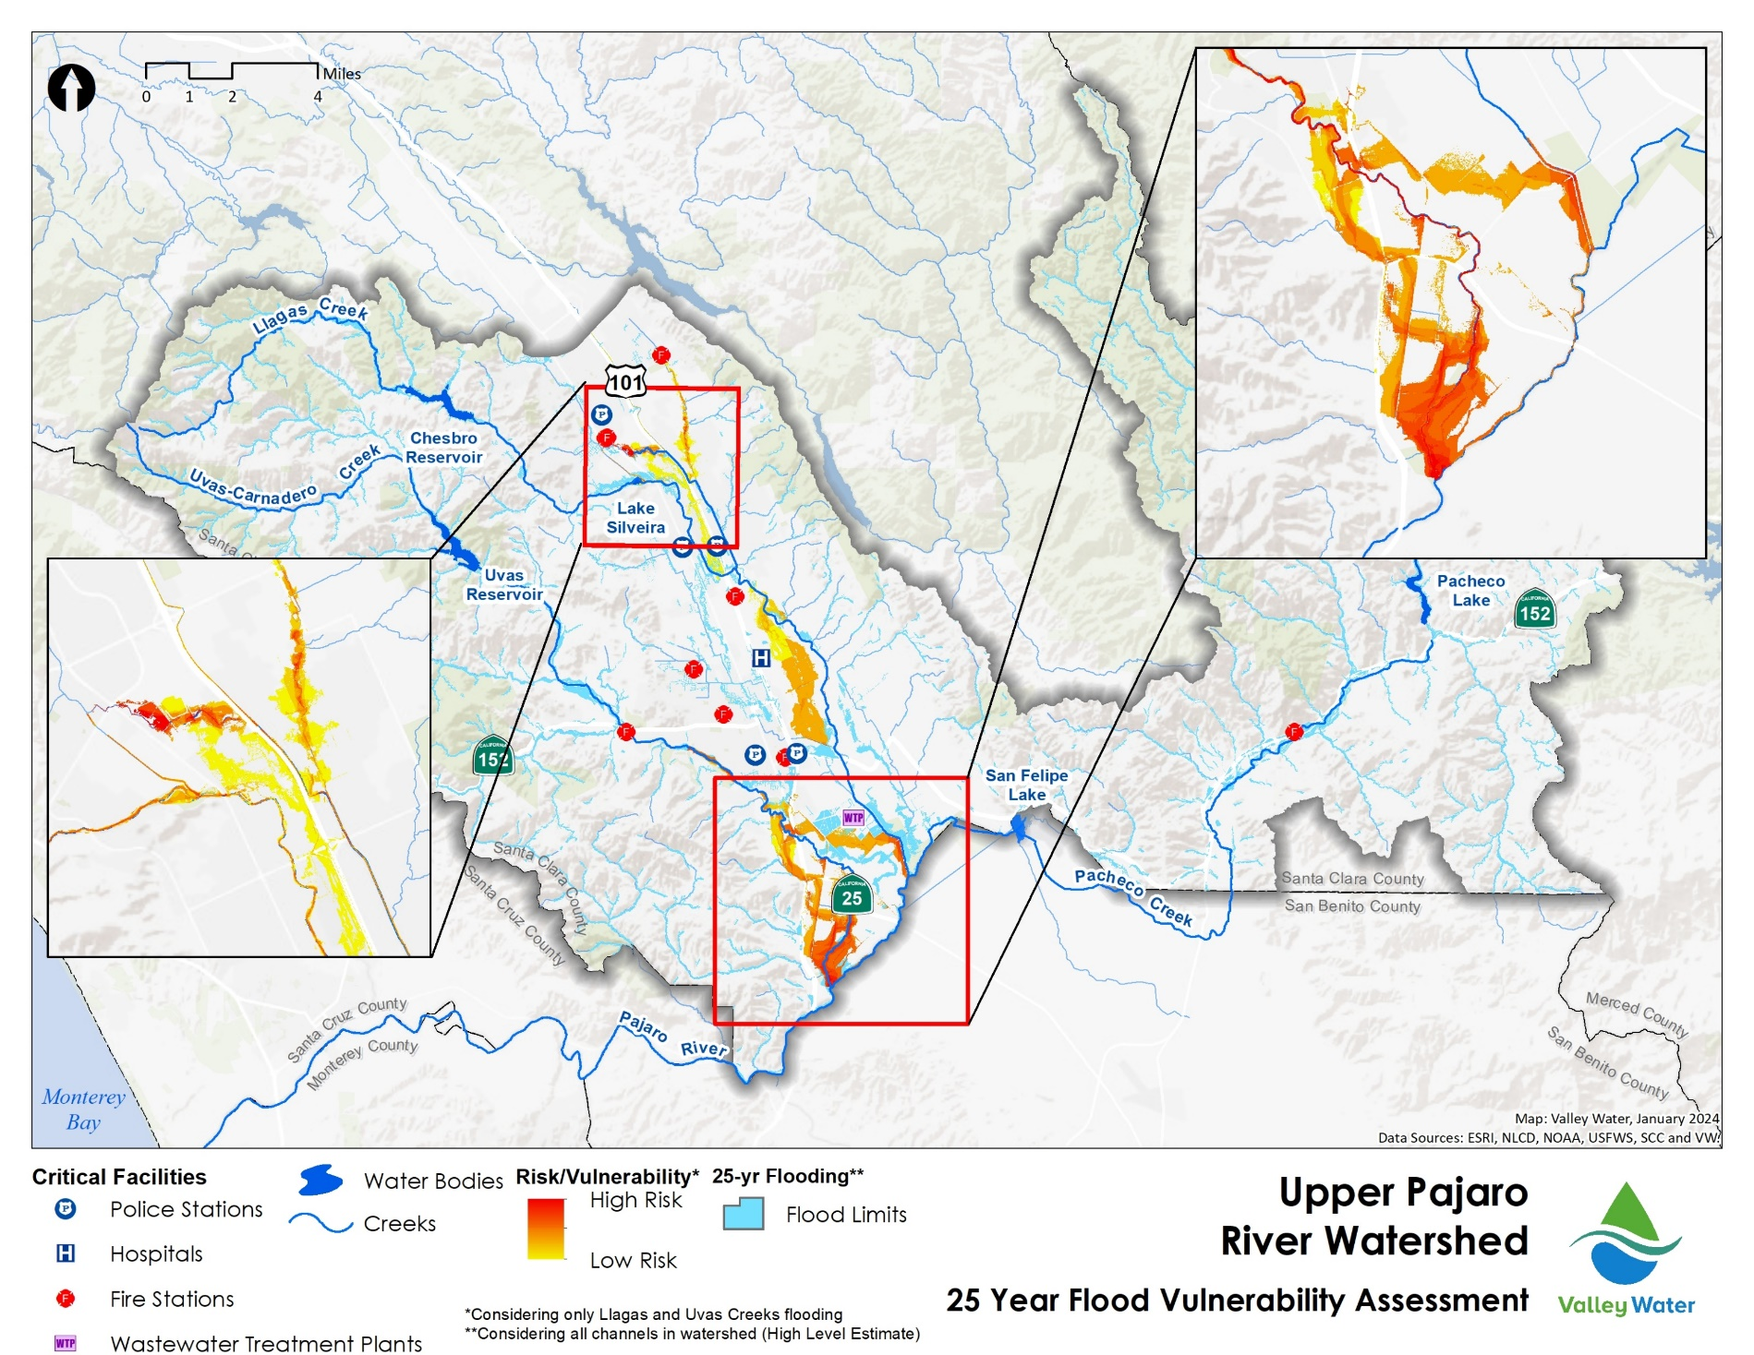
Flood- Vulnerable Areas
Uvas and Llagas Creeks
2. Flood Vulnerability Assessment
Notes:
And here is the map for the Upper Pajaro watershed. For this watershed, additional hydraulic modelling needed, but you will see a number of vulnerable areas including, and the east/west little llagas areas outside morgan hill and san martin. As well the uvas flood of the highway 101 area.
Please keep this map in mind as I’ll be coming back to recommendations.

Slide 11
PUBLIC INPUT PROCESS
11
Notes:
Watershed management needs to involves the entire community in order to be effective at addressing priorities. So the public input process is very robust. It is the core of the planning process.

Slide 12
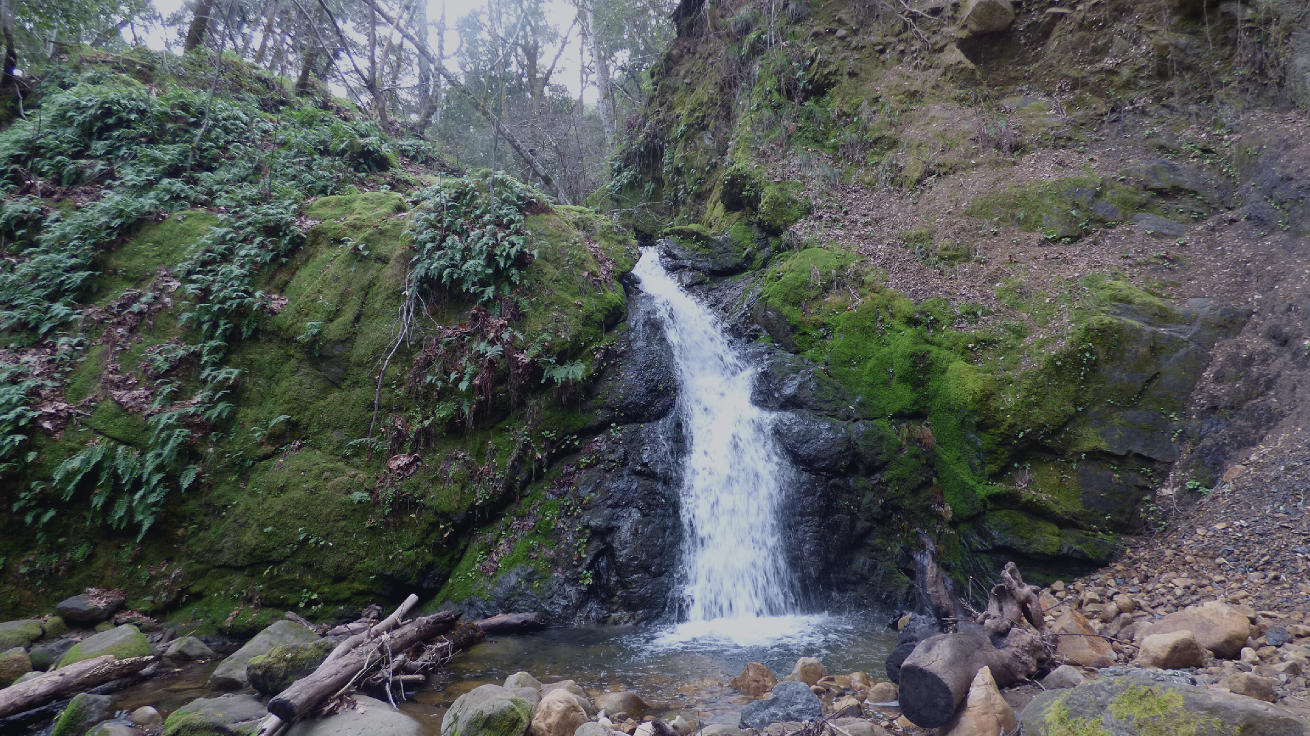
Community
Input
11
Subject Matter Experts
Local & County Governments
Community Based Organizations
Special Districts
Regulatory Agencies
Residents/Municipal Organizations
Businesses
Environmental Groups
Farmers/Ranchers
11
COHORTS
104
ORGANIZATIONS/ AGENCIES/ BUSINESSES
~200
INDIVIDUAL CONTACTS
3. One Water Planning Process
Notes:
Each watershed plan involved outreach to numerous organizations, neighborhood groups, and individuals, as well as to the Board Advisory committees both at the beginning of the planning process and to present the draft priority actions in the last several months following review by the then Boad PPc.

Slide 13
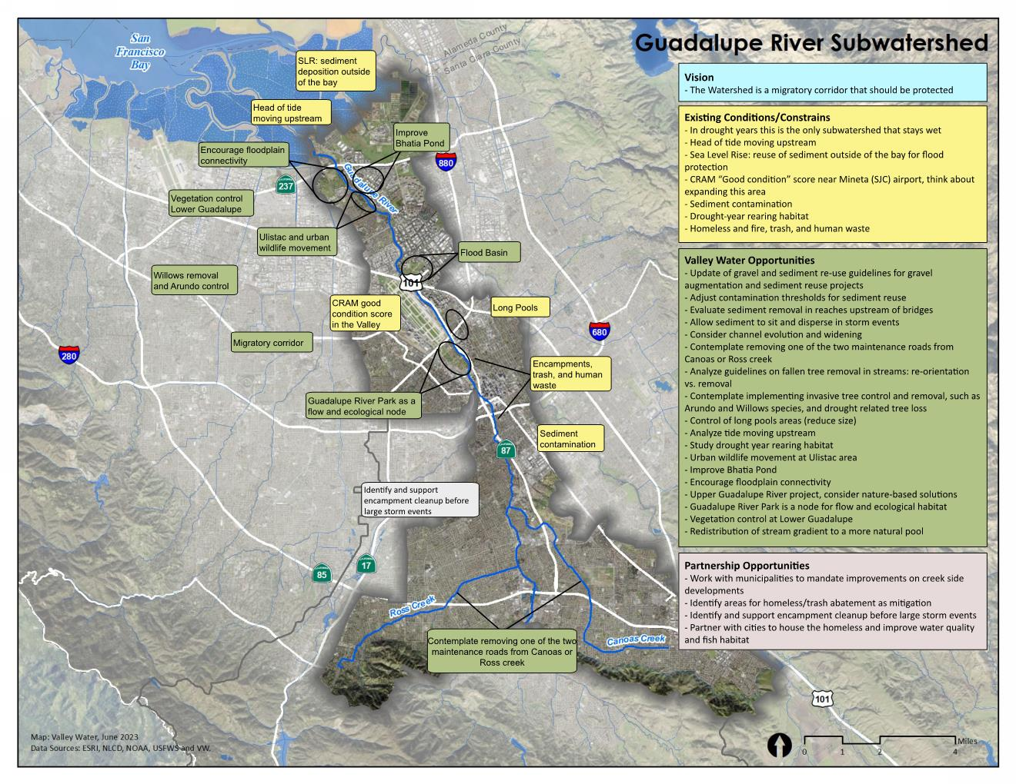
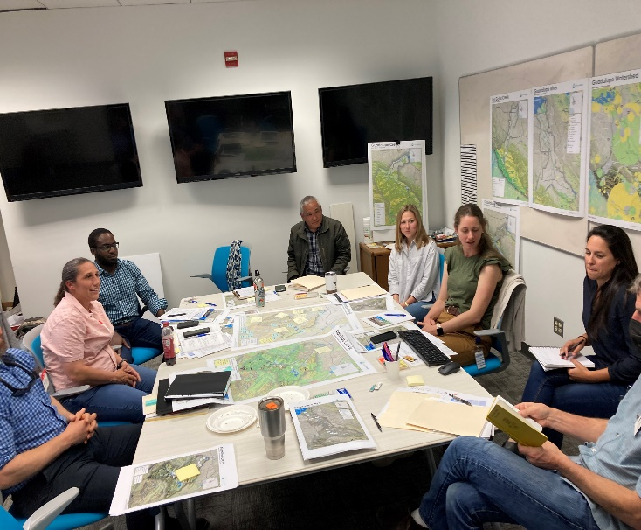
Focus Workshop:
Fish Habitat
Vision
Constraints
Opportunities
Notes:
Here is an example the focused stakeholder outreach. This workshop was held with members of the Guadalupe Adaptive Management Team and stakeholders such as Cal Trout to develop a ecological vision for each subwatershed in the Guadalupe. This resulted in targeted recommendations for fish habitat improvement, which generally align with the FAHCE implementation plan but can also serve as objectives for adaptive management.

Slide 14
PRIORITY ACTIONS
11
Notes:
Now I will highlight watershed management priority actions. There are a lot so I don’t cover all the actions. Watershed plan includes a comprehensive table grouped into short (0-10 years) med (11-20) and long term (21-30) actions, rough order of magnitude costs are estimated for financial forecasting purposes.

Slide 15
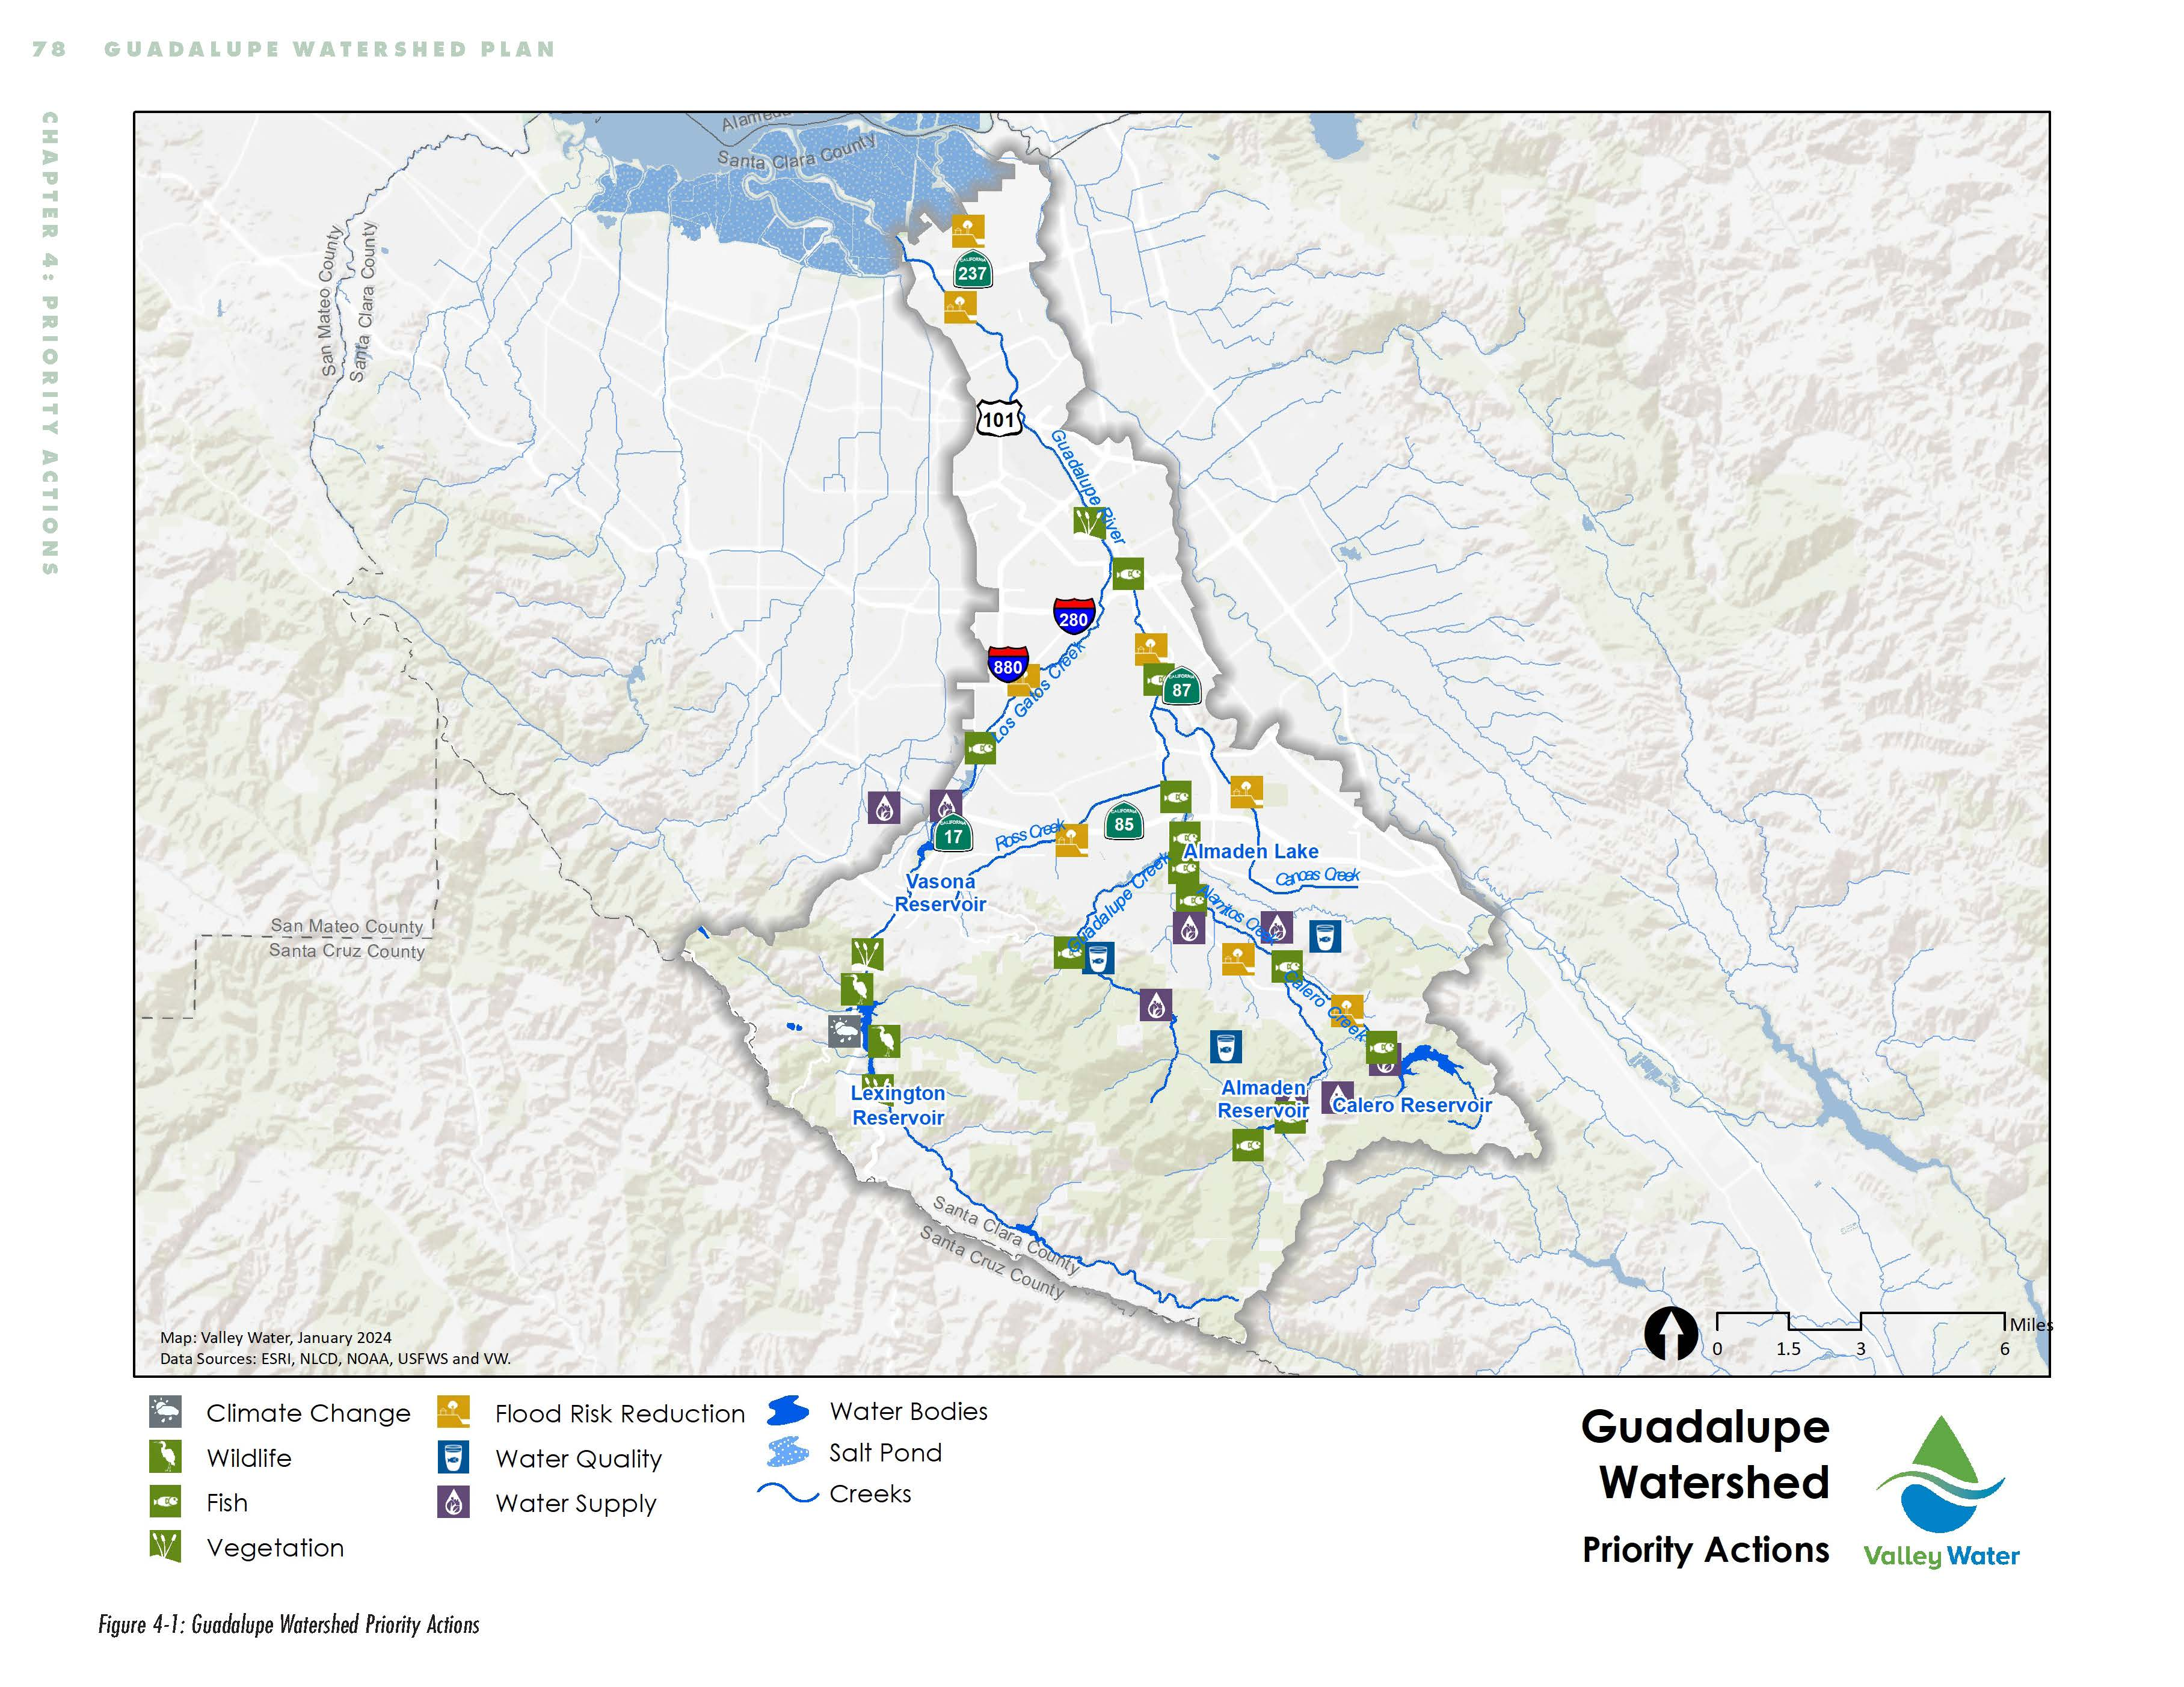
20
Guadalupe Watershed
Priority Actions
3. Priority Actions
Notes:
This map shows the distribution of priority actions across the guad watershed, in addition to some actions which are watershed-wide. There are 65 priority actions in the Guadalupe plan.

Slide 16
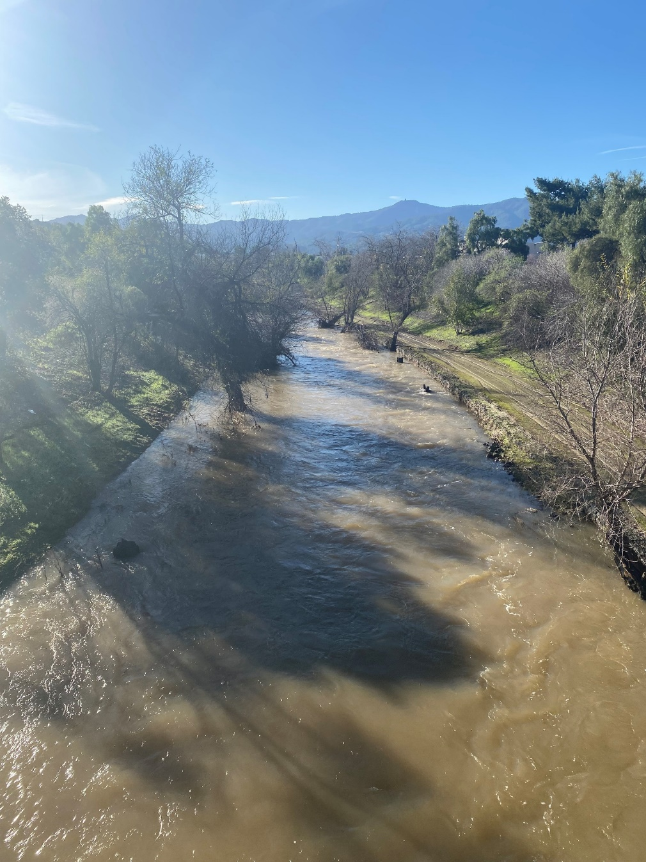
20
Flood Risk Reduction
  FRR-01: Conduct engineering assessment of rodent damage to levees
  FRR-04: Conduct Planning Study for Canoas Creek flood risk reduction
  FRR-05: Conduct engineering study to assess and repair Los Gatos Creek (asset management)
  FRR-06: Complete Guadalupe River Tasman Dr – I-880 Capacity Restoration Project
  FRR-11: Conduct Planning Study for Calero Creek flood risk reduction
Upper Guadalupe high flows
3. Priority Actions
Notes:
Short-term Flood priorities in the Guadalupe Watershed include conducting 2 planning studies at flood vulnerable areas, canoas and calero, goal of which is to define a feasible project, as well as critical asset management projects. Total short term costs for flood risk reduction is projected to be up to about $22M. This does not include funds that are already budgeted, such as the current CIP project FRR -06. (lower guad).

Slide 17
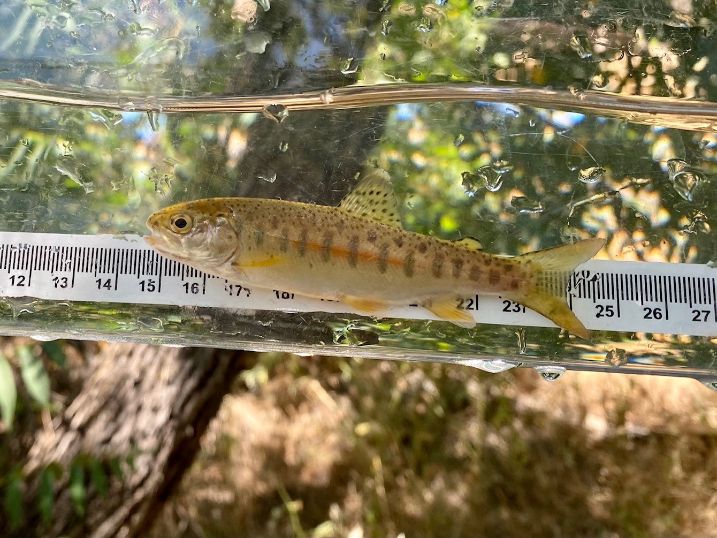
20
Ecological Resource Actions
  ECO-01, 02: Improve suitable spawning and rearing habitat for steelhead and salmon on Guadalupe, Calero, and Alamitos Creeks
  ECO-03: Complete Feasibility Study of fish passage at Almaden Dam
  ECO-04: Assess feasibility of modifying Alamitos drop structure to enhance habitat
  ECO-05: Coordinate with partners to improve fish passage at priority barriers owned by others
  ECO-07: Partner to support the Highway 17 Wildlife and Trail Crossings Project
Steelhead juvenile rearing surveys, Guadalupe watershed
3. Priority Actions
Notes:
Short-term Ecological priorities include improving habitat for steelhead and salmon on Guadalupe, Calero, and Alamitos Creeks, assess feasibility of fish passage at Almaden Dam, and of modifying Alamitos drop structure to enhance habitat, partner to address other priority barriers for both fish and wildlife, notably, the HWY 17 wildlife and trail crossings project.
The total Environmental Stewardship short term recommendations is up to about 100 M, some of which is currently budgeted in the CIP for FACHE implementation.

Slide 18
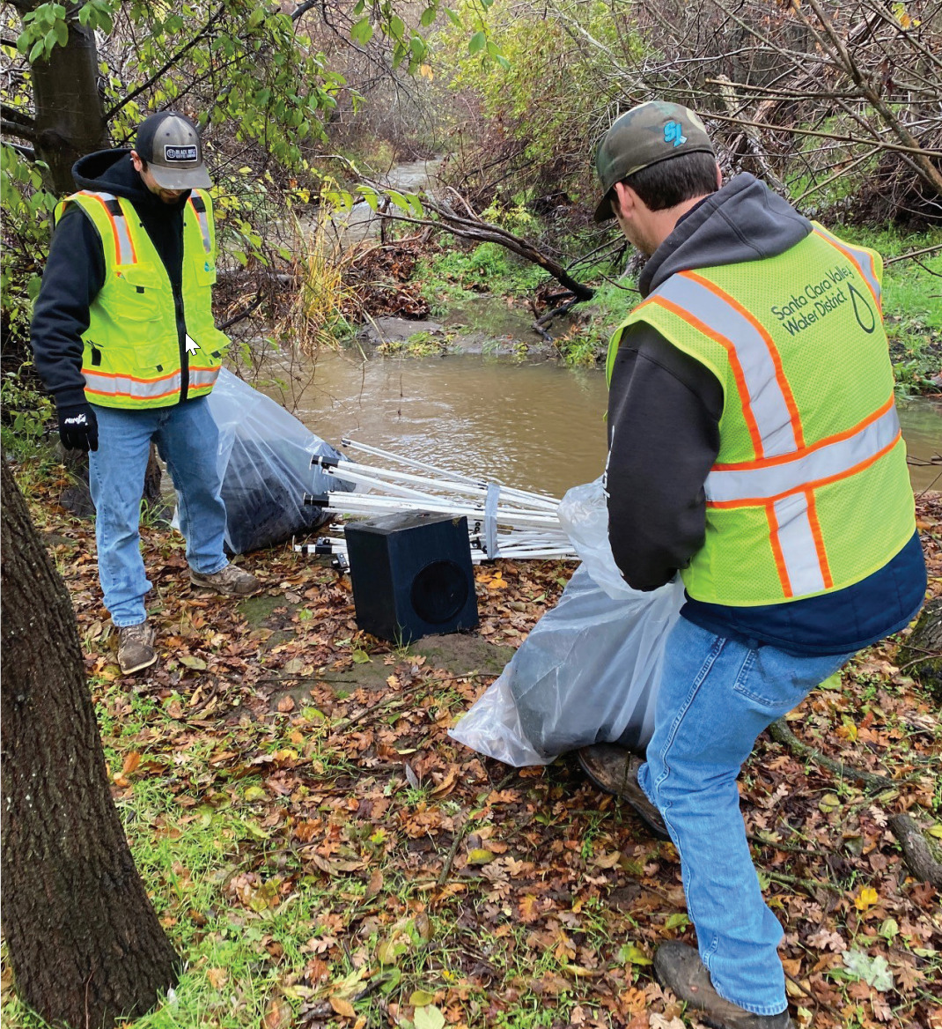
20
Water Quality Actions
  WQ- 02 Partner to support Santa Clara County Parks in the remediation of legacy mercury mine waste at twenty-three high priority sites designated by the San Francisco Bay Regional Water Quality Control Board in Almaden Quicksilver County Park
  WQ-04: Create or expand existing water quality monitoring program
  WQ-05: Partner with Santa Clara County, cities, and other organizations to reach a functional zero number of unsheltered people residing on Valley Water lands along waterways.
Creek cleanup crew
3. Priority Actions
Notes:
Water Quality improvement is focused on addressing impacts of encampments. Up to 100m was included in the cost estimate for this work. This is not currently budgeted. Another critical action is to expand the water quality monitoring program, since some types of monitoring that cities used to do is no longer a requirement as part of their stormwater permits

Slide 19
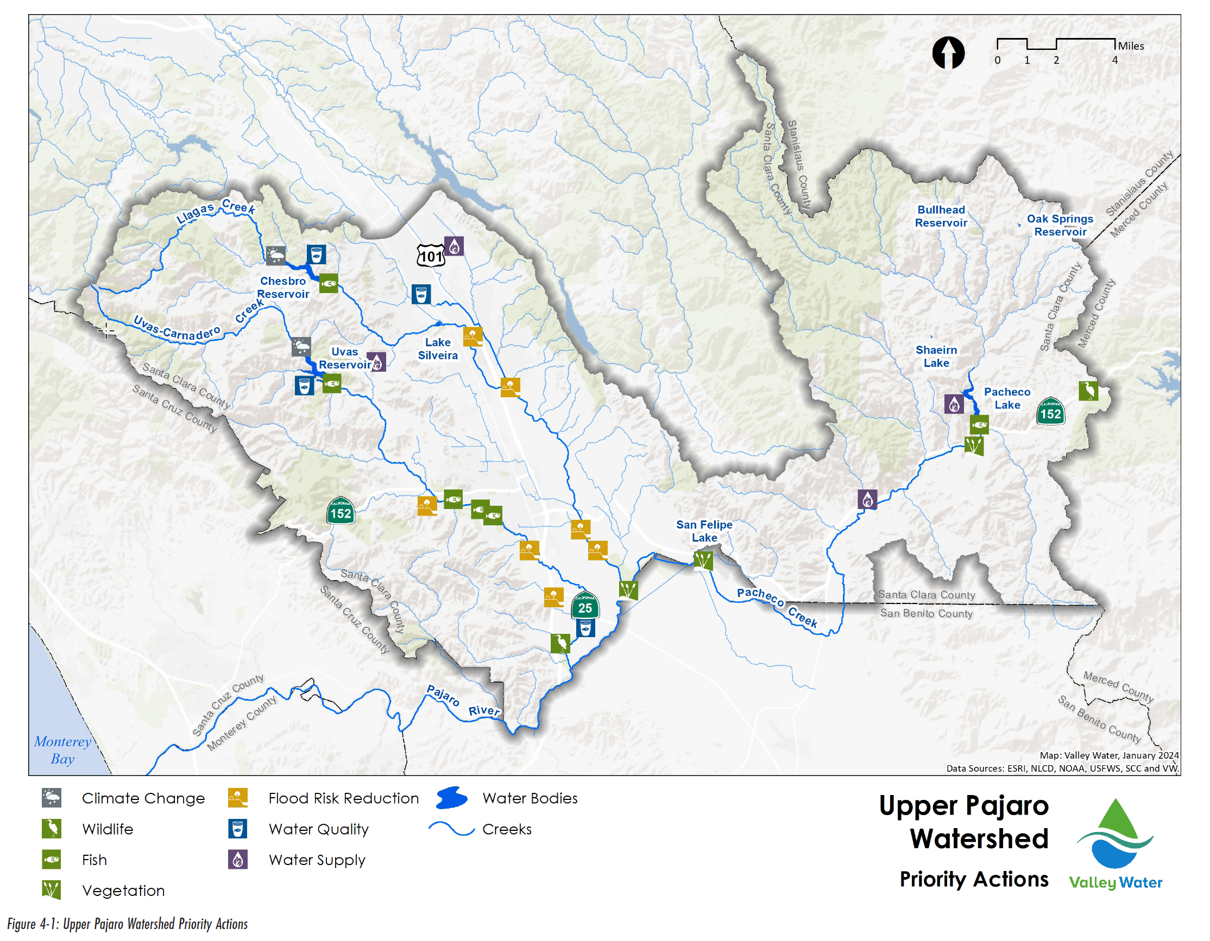
20
Upper Pajaro Watershed Priority Actions
3. Priority Actions
Notes:
There are 48 priority actions recommended in the Upper Pajaro watershed.

Slide 20
20
Flood Risk Reduction Actions
  FRR-01: Assess open space areas compatible with flood detention
  FRR-04: Complete hydraulic modeling throughout watershed
  FRR-11: Complete Planning Study for Uvas/ Carnadero Creek from Luchessa Ave to HWY 25
  FRR-12: Complete Planning Study for East/West Little Llagas Creek
Lake Silveria aerial image, August 2023
3. Priority Actions
Notes:
Key short term flood actions in the Upper Pajaro shown here. Costs could be up to $110, which includes the lower llagas capacity restoration project, which is a current CIP project but is unfunded. Actions include new planning studies as well as multibenefit projects.

Slide 21
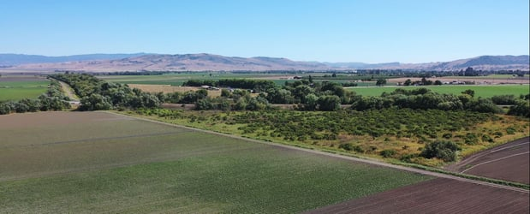
20
Ecological Resource Actions
  ECO-01: Partner to expand and enhance floodplain at Pajaro River Agricultural Preserve
  ECO-02: Partner to conserve and enhance San Felipe Lake
  ECO-10: Assess fish passage barriers and impediments throughout watershed and prioritize their remediation
  ECO-16: Restore creeks impacted by encampments through Stream Maintenance Program
Pajaro River Agricultural Preserve
3. Priority Actions
Notes:
Key Ecological Actions in the watershed focus on partnerships with agricultural and other rural land managers such as a the PRAP and San Felipe Lake

Slide 22
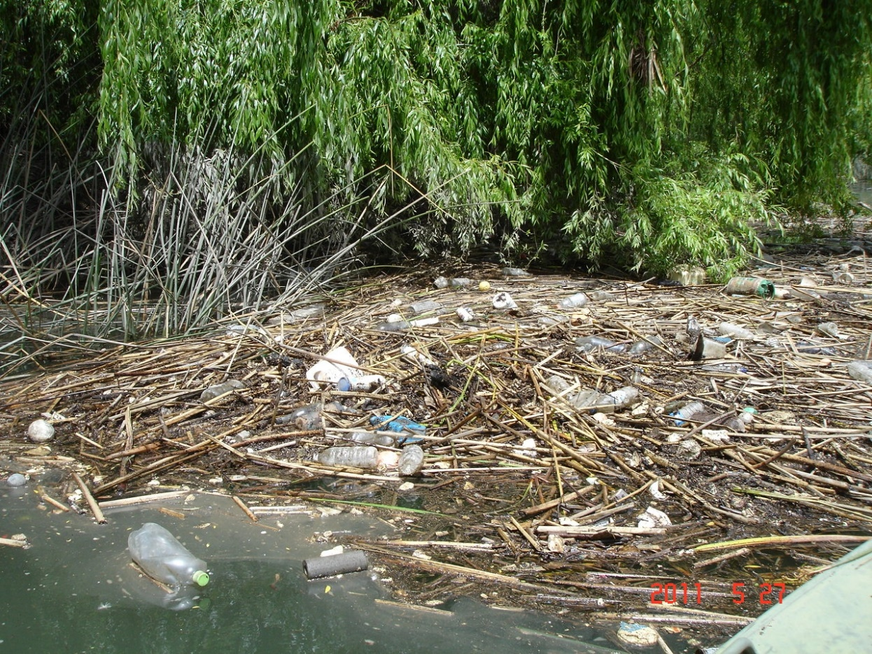
20
Water Quality Actions
  WQ-01: Support efforts led by University of California Cooperative Extension, RCDs, NRCS, and County Division of Agriculture to educate and assist farmers and landowners in implementing land management practices to improve water quality.
  WQ-04: partner with the Cities of Gilroy and Morgan Hill and Santa Clara County to identify opportunities and actions to reduce bacteria and sediment loads within the Llagas and Uvas Creeks.
  WQ-05: Partner with cities to reduce and prevent specific trash dumping areas.
Trash hot spot
3. Priority Actions
Notes:
Water quality actions again focus on partnerships, with the Resource Conservation Districts, the county, and municipalities to address sediment and bacteria impairments in the creeks.

Slide 23
NEXT STEPS
1. Include priority actions into operational and capital programs
2. Integrate ECO actions as conservation measures
3. Complete Lower Peninsula and West Valley plans
4. Conduct countywide flood risk reduction prioritization
11
Notes:
That was a lot about planning process, so here are the results. In the following slides I will highlight some key flood protection, ecological, and water quality priority actions for each watershed. Watershed plan includes a comprehensive table with all actions:

Slide 24

QUESTIONS
Notes:
Next steps tie to CIP, integrating eco actions into capital projects – regulatory support.
Next WS plans
Countywide flood prioritization.
Updates including countywide prioriticaton for flood actions

Slide 25

Attachment 3
Page 24 of 24

