Slide 1
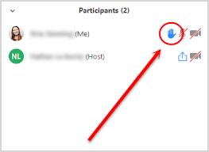
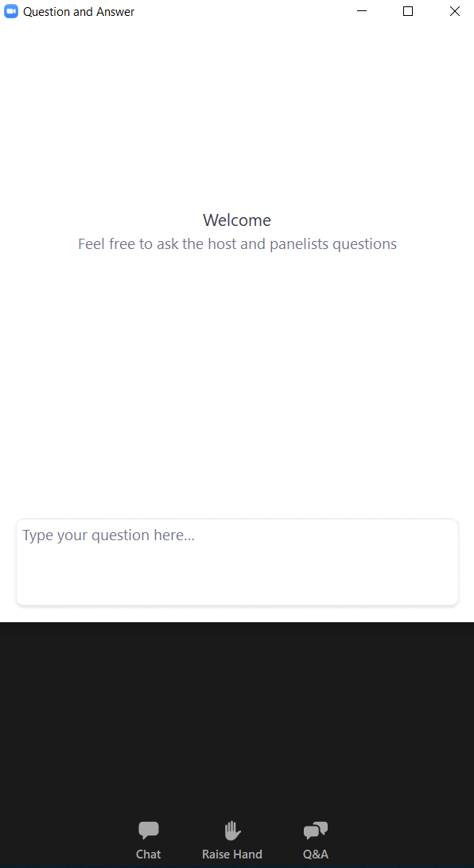
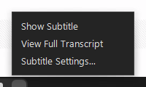

Zoom Webinar Instructions
After we enable your mic,
you have to unmute yourself before
you verbally ask your question.
Join Computer Audio
Ask a Question
If only on phone:
Press *9 to raise your hand if
Press *6 to mute/unmute yourself.
If internet unstable, use Phone Audio
Check your invite/email for call-in number and meeting ID
Dial call-in number: 1-669-900-9128
Enter webinar ID then #.
Enable Closed Captions/
Live Transcript
Notes:
As an attendee to this webinar, you’ll be able to listen in with your computer audio. Alternatively, you can also call-in using the above number and the webinar ID associated with this meeting. This is recommended if your internet feed is unstable or you find yourself fighting for internet bandwidth with family. As an attendee, you won’t see the option to turn on your camera.
Later on, there will be a question and answer segment.
Questions can be submitted throughout the presentation via the Q&A portal and will be queued up on our end.
We don’t recommend entering questions into the chat because it’ll get buried and hard to keep track of.
If you would like to ask your question verbally, please use the “Raise Hand” feature. It will place a hand icon next to your name on our side.
We will call out your name and enable your microphone. You will then unmute yourself so you can verbally ask your questions.
Press *9 to raise your hand if you’re only on the phone. *6 to mute/unmute yourself.
(After host turns on live transcript function) To turn on closed captioning, select on the Live Transcript/CC button.

Slide 2
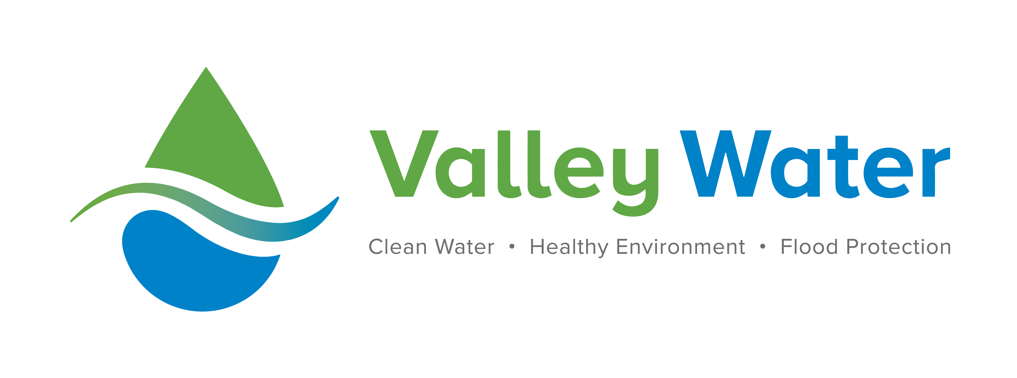

Slide 3
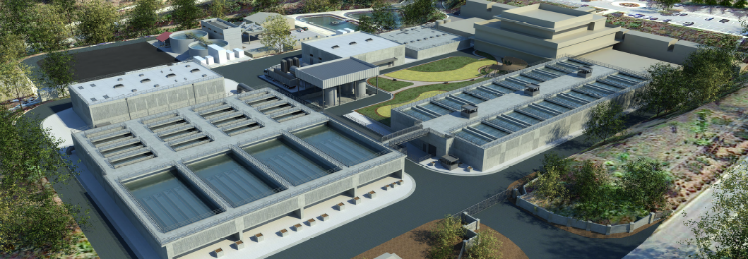
Rinconada Water Treatment Plant
Reliability Improvement Project
Phases 3-6

Slide 4
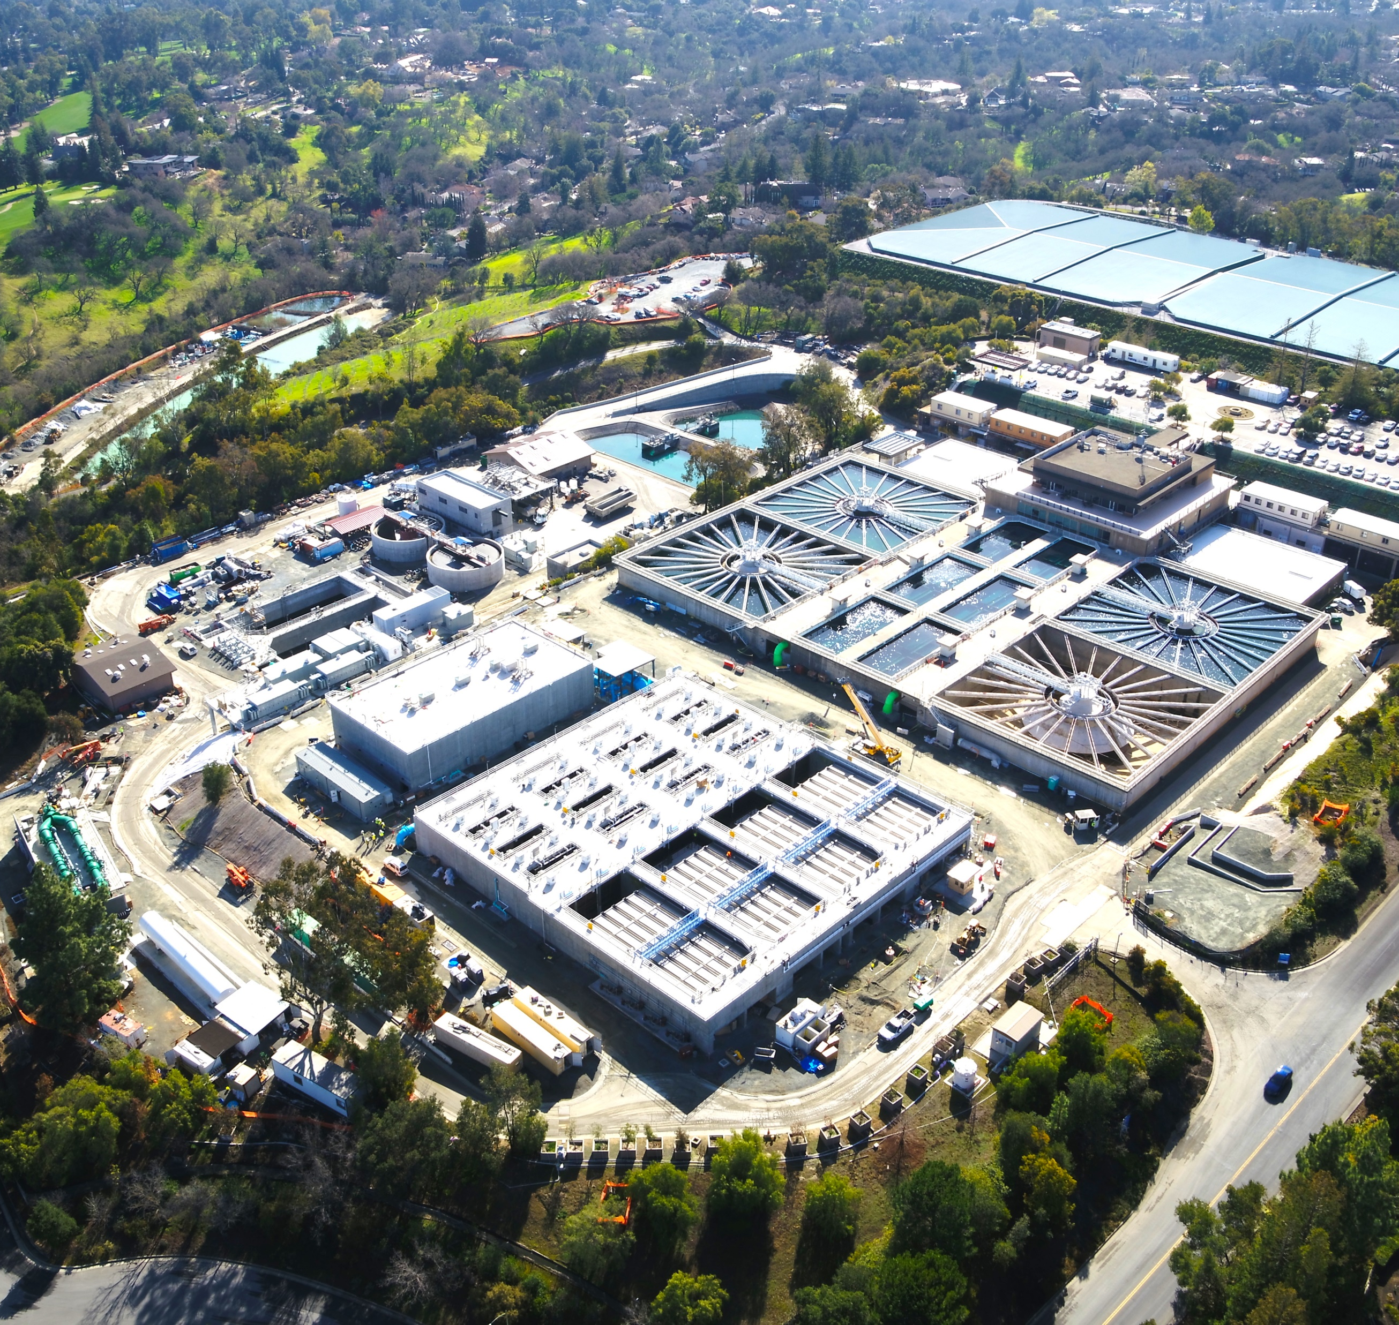
Agenda
Background
Project Objectives
Project Phases
Phases 3-6 Work
Demolition of Clarifiers
New Facilities
Timeline
Project Information
Notes:
The purpose of this presentation is to inform you about the Rinconada Reliability Project Phases 3-6

Slide 5
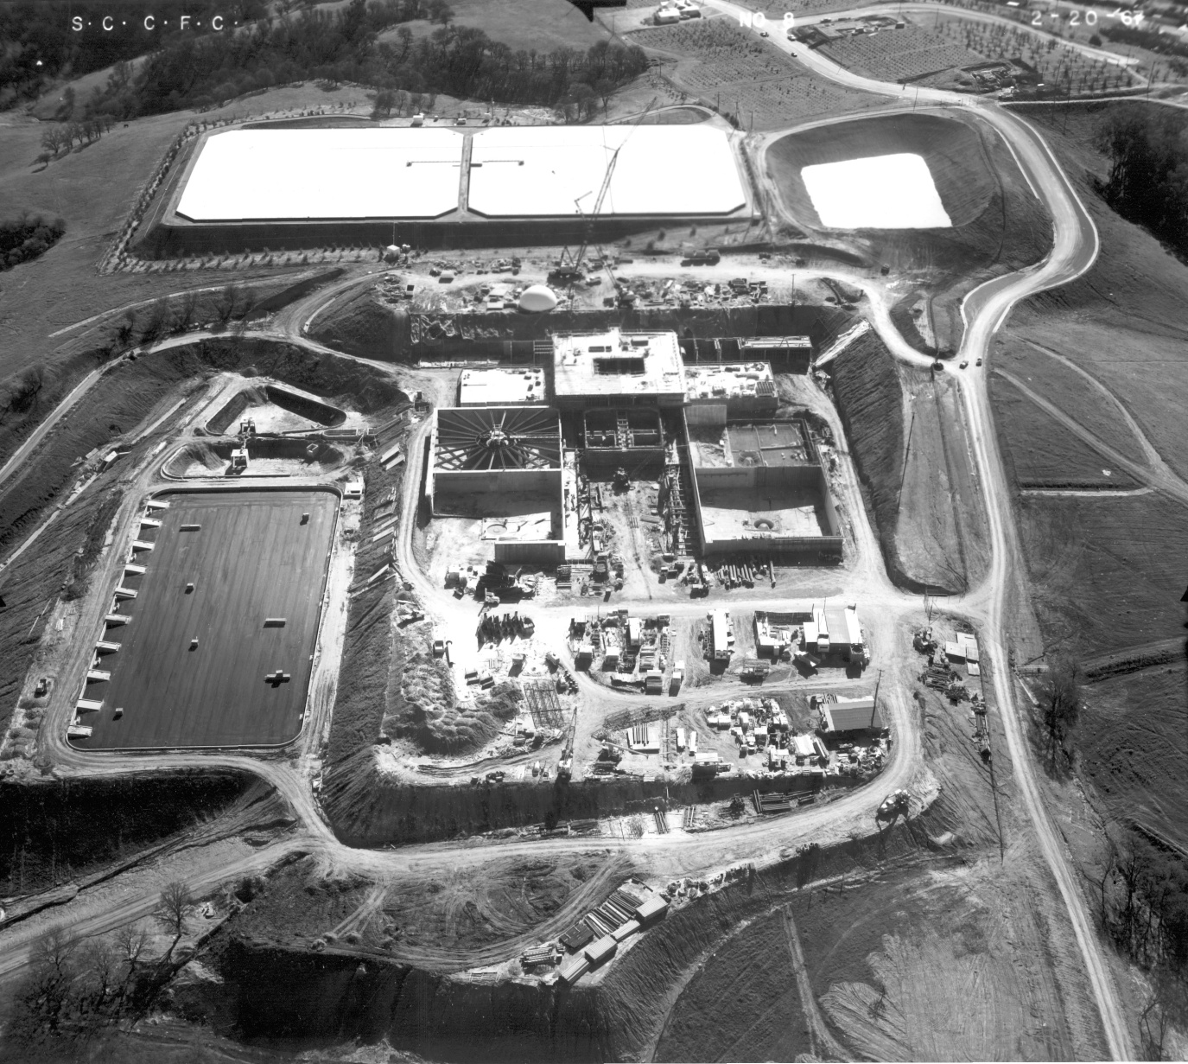
Background - Rinconada Water Treatment Plant (RWTP)
Second-largest of Valley Water’s Treatment plants
RWTP was originally constructed in 1967
Valley Water’s sole plant that provides Treated water to the West Valley (Los Gatos, Saratoga, Los Altos, etc.)
Plant Original Construction
Notes:
The Rinconada Water Treatment Plant traces its roots to 1967 as Santa Clara County’s first water treatment plant. Built by the predecessor to today’s Valley Water, the Santa Clara County Flood Control and Water Conservation District, Rinconada is the second largest such facility in Valley Water’s system
The Rinconada Water Treatment Plant is the only provider of treated surface water in the West Side service area consisting of Santa Clara, Campbell, Sunnyvale, Cupertino, Mountain View, Saratoga and the towns of Los Gatos and Los Altos Hills.

Slide 6
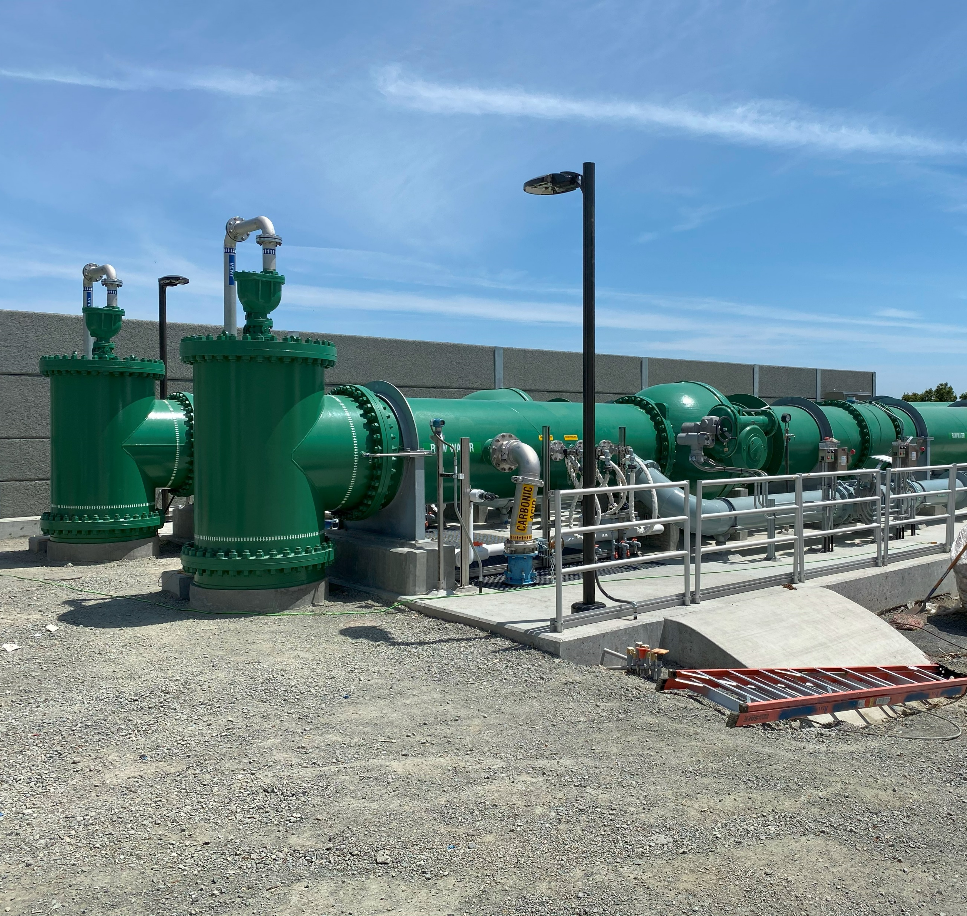
Project Objectives
Upgrade aging equipment
Comply with updated seismic codes
Meet current water quality standards
Improve plant safety
Increase water production
80 million gallons per day (MGD) to 100 MGD
Improvement to the reliability of water supply
Raw Water Flow Control and Metering Facility
Notes:
At 57 years old, it has allowed the Valley Water to serve the Westside without interruption.
Like any mid-century facility, it needs to be upgraded as many of its parts are at the end of their design life More importantly, we have new water quality and seismic standards that have to be met to ensure you and everyone in the West valley will have water after an earthquake or another regional disaster.
The District is improving the plants production capacity to 100 million gallons a day, up from 80 mgd.
This means we have that much more water available to you when other parts of the system are offline.
Rinconada will then be in line with improvements made at Valley Water’s Penitencia and Santa Teresa water treatment plants in San José

Slide 7
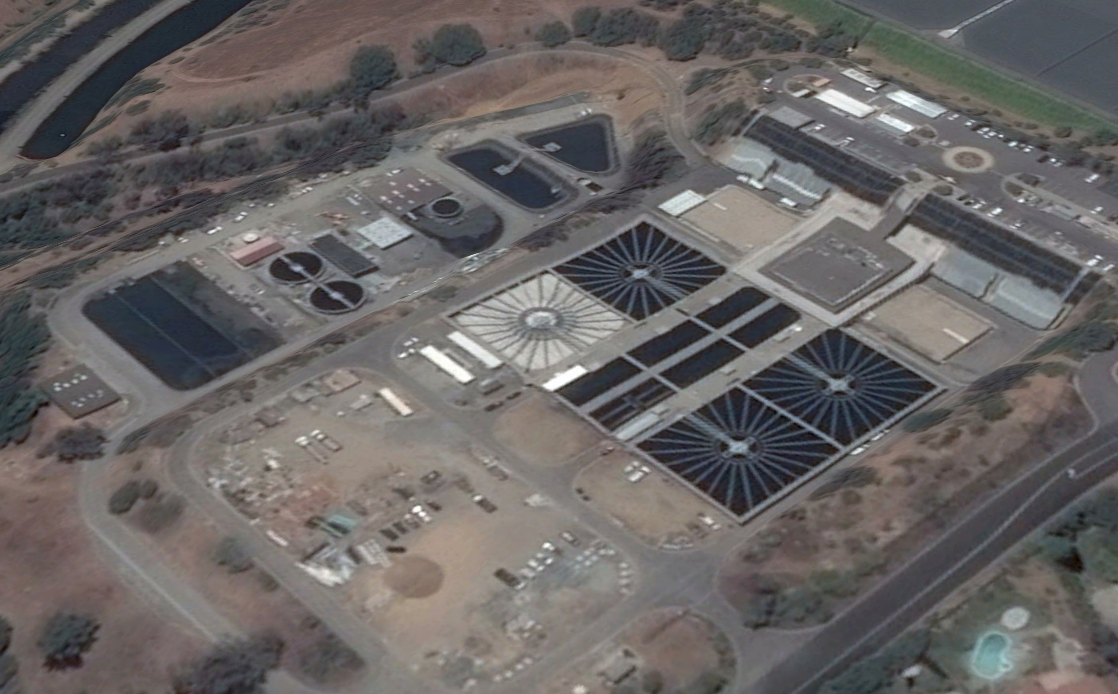
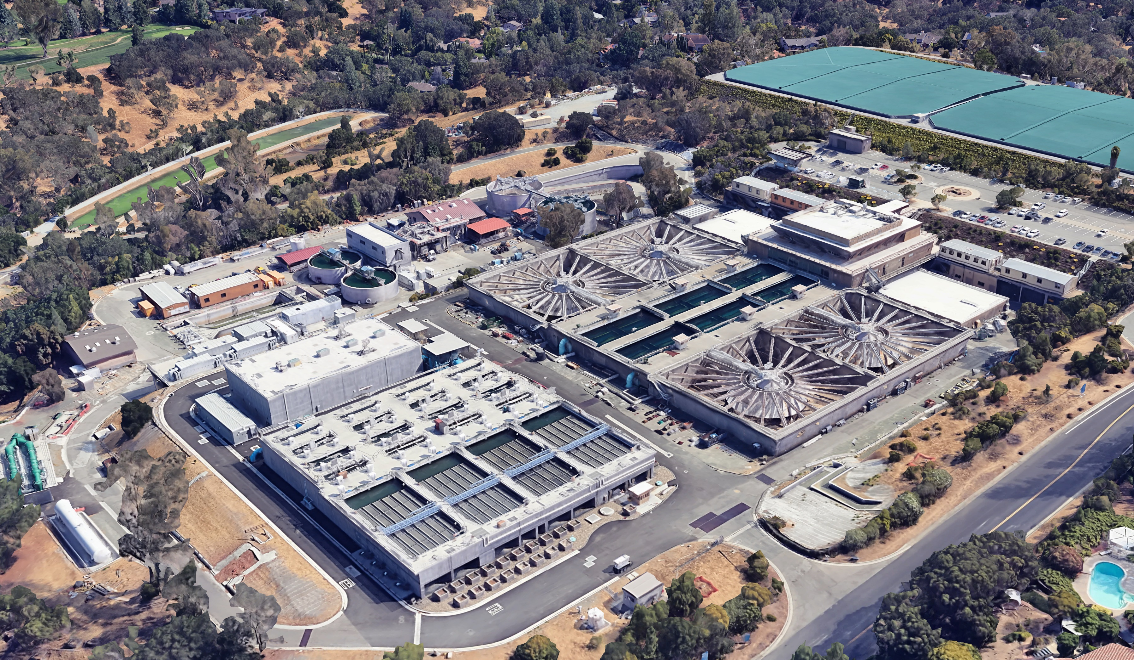
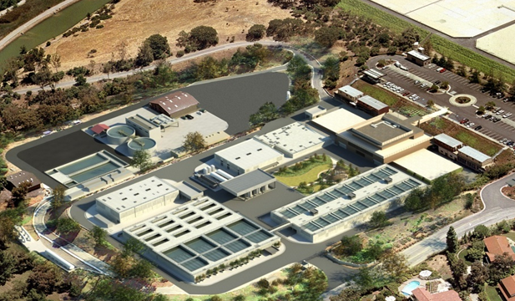
Overview of Project Phases
Original
Phases 1-2 (Completed)
Phases 3-6 (Current)
Notes:
Original photo is from 2015, prior to the start of construction of the Reliability Improvement Project Phases 1-2.
Phases 1-2 construction started Summer 2015 and ended Fall 2020. Construction consisted of the
Raw Water Flow Control and Metering Facility. Raw water first enters the Plant at this facility delivered from the Rinconada force main (72-in raw water pipe).
Ozone Contactor Building that removes contaminants
Flocculation sedimentation building that removes solids from our water
Electrical Equipment Pad
Wash Water Recovery facility
Phases 3-6 construction began Fall 2023 and will be complete in late 2029. This photo shows an artist rendering of what the plant will look like once completed. A look at the new Rinconada Water Treatment Plant.

Slide 8
Phases 3-6 Work
Phase 3
Phase 4
Phases 5-6
Clarifier Demolition
Surveying
Potholing
Traffic Control
New Ozone Generation Building
New Liquid Oxygen Facility
New Dual Media Filters
Chlorine Contact Basin
Chemical Facilities
Demolition of Existing Filters
Demolition of Wash Water Recovery Basin
Demobilization
Project Closeout
Notes:
In Phase 3, work will consist of Clarifier Demolitions, Traffic Control, Surveying, and Potholing.
In Phase 4, work will consist of constructing the New Ozone Generation Building, New Liquid Oxygen Facility also known as LOX, 12 New Dual Media filters, and Chlorine Contact Basin.
In Phase 5, work will consist of constructing the new Chemical Facilities, Demolition of the Existing Filters, Wash water Recovery Basin Demolition, and Demobilization.
Phase 6 will consist of Project closeout.

Slide 9
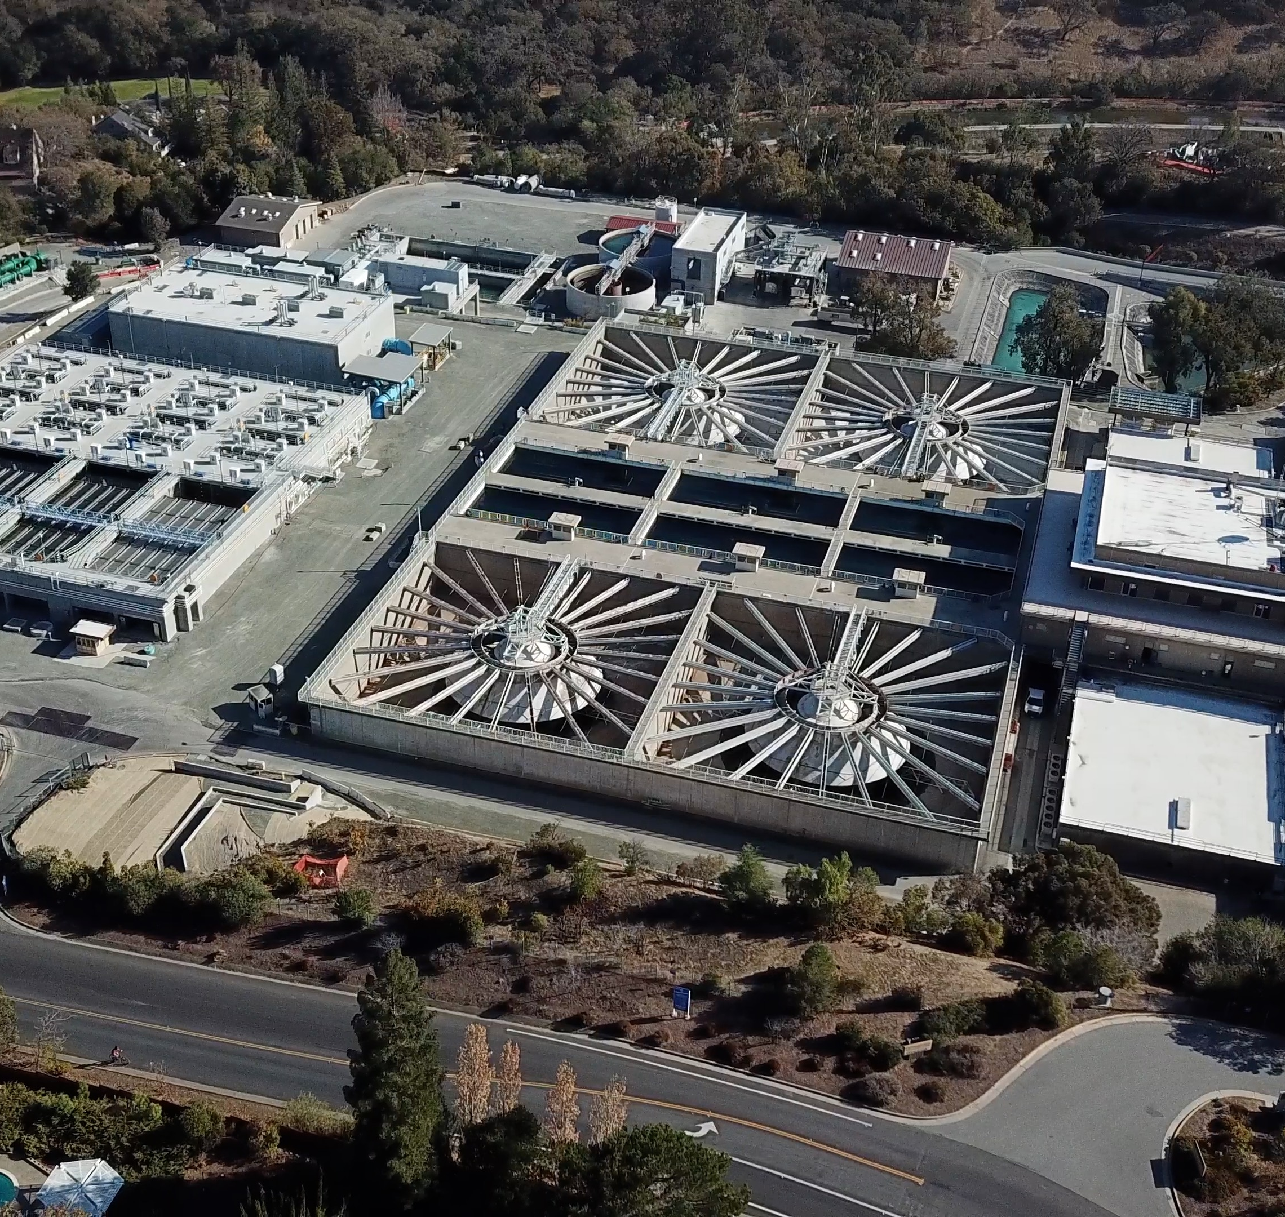
Demolition of Clarifiers (Phase 3)
Clarifiers, previously used to remove suspended solids are the largest feature at the plant
Demolition is set to take place mid-March during Phase 3 of the project
clarifiers
Each tank is approximately 20 ft deep and 117 ft square
Notes:
This plant has 4 clarifiers that were previously used to remove suspended solid from the water.
These clarifiers have been out of service since the completion of the flocculation and sedimentation basins in phases 1-2.
The demolition of these clarifiers will take place during phase 3 which will last up until Spring 2025
We are working on minimizing impact on the neighborhood by
Noise Control. In addition, we will have 4 noise monitors located around the construction site to help minimize exceedances.
Dust Control. Contractor will be misting the concrete with water to control dust flying up
Traffic Control. We will be controlling the stacking trucks of trucks on adjacent streets around the site, waiting to enter the site.

Slide 10
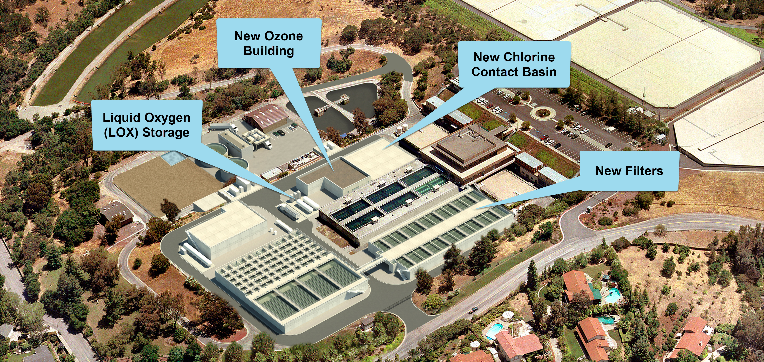
New Facilities (Phase 4)
Notes:
This photo shows an artist rendering of the plant once Phase 4 is completed.
Where the clarifiers were previously, we have
12 new dual media filters, these filters remove dissolved particles and germs, such as dust, chemicals, parasites, bacteria, and viruses
New Ozone building, that will enhance the removal of particulates from the water, improve the taste of water, and accelerate removal of other contaminants that might be present in the water sources.
New Liquid Oxygen (LOX) Facility that will store liquid oxygen in two 15,000-gallon tanks before it’s converted into gaseous oxygen which is then used to produce ozone.
And the chlorine contact tank to provide primary disinfection in the water prior to distribution

Slide 11
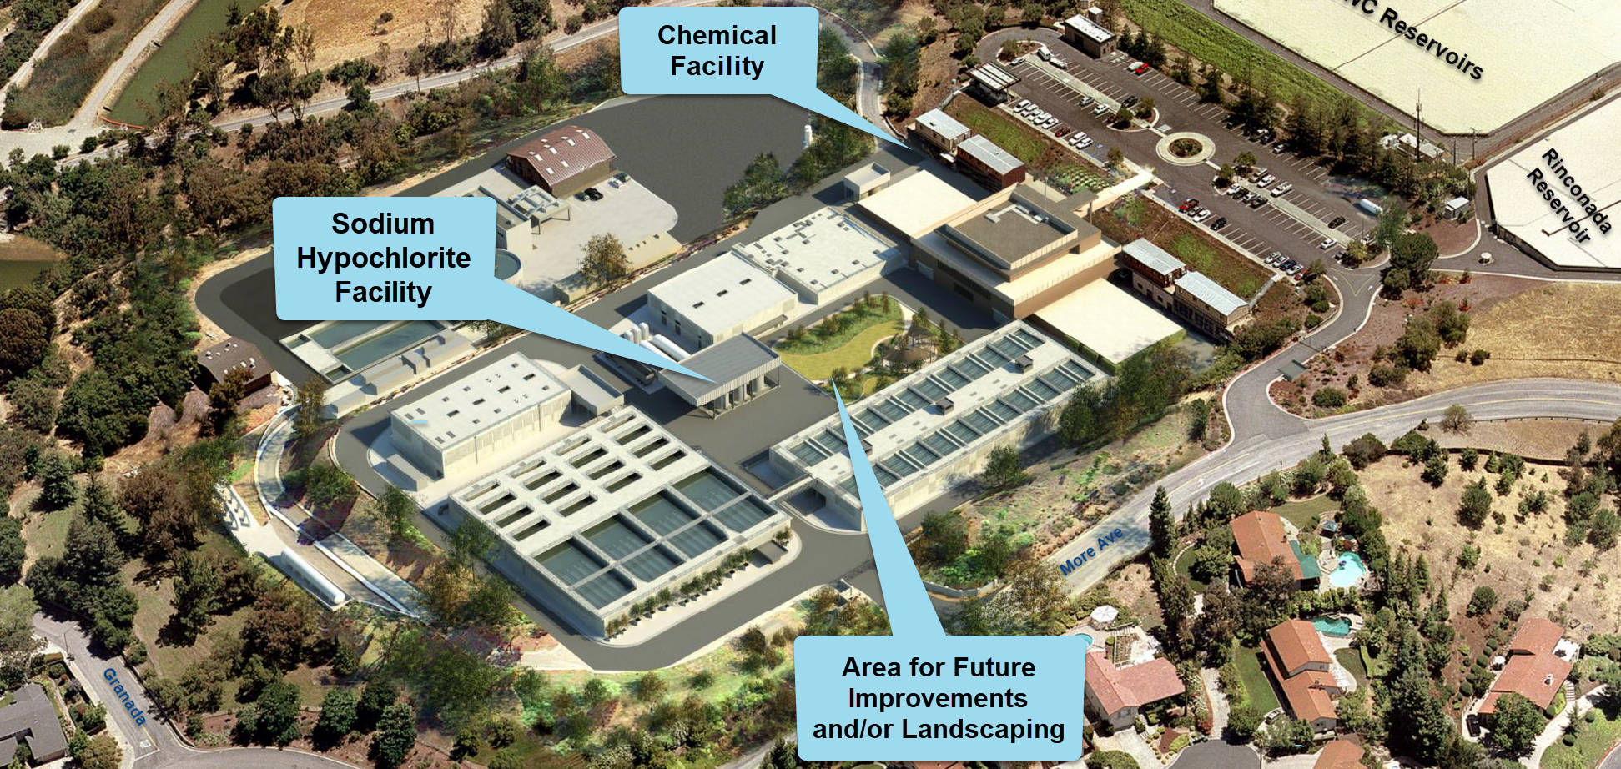
New Facilities (Phases 5-6)
Notes:
This photo shows an artist rendering of the plant once the Project is completed after phases 5-6.
Where the existing filters were previously, we have a new waterwise educational garden that can be used for future improvements.
The existing wash water recovery basin is demolished
The new facilities constructed are the sodium hypochlorite facility and chemical facility which will remove the toxins in our water, it was also proven to kill bacteria and contaminates.

Slide 12
Project Timeline (Phases 3-6)
Phase 3
Fall 2023 – Spring 2025
Spring 2025 – Summer 2027
Phase 4
Phases 5-6
Summer 2027 – Late 2029

Slide 13
Project Information
Visit Valley Water’s website and blog at valleywater.org/project-updates/rinconada-water-treatment-plant-reliability-improvement
Public Affairs Representative Tony Mercado
Telephone number: 408-630-2342 E-mail address: Tmercado@valleywater.org

Slide 14
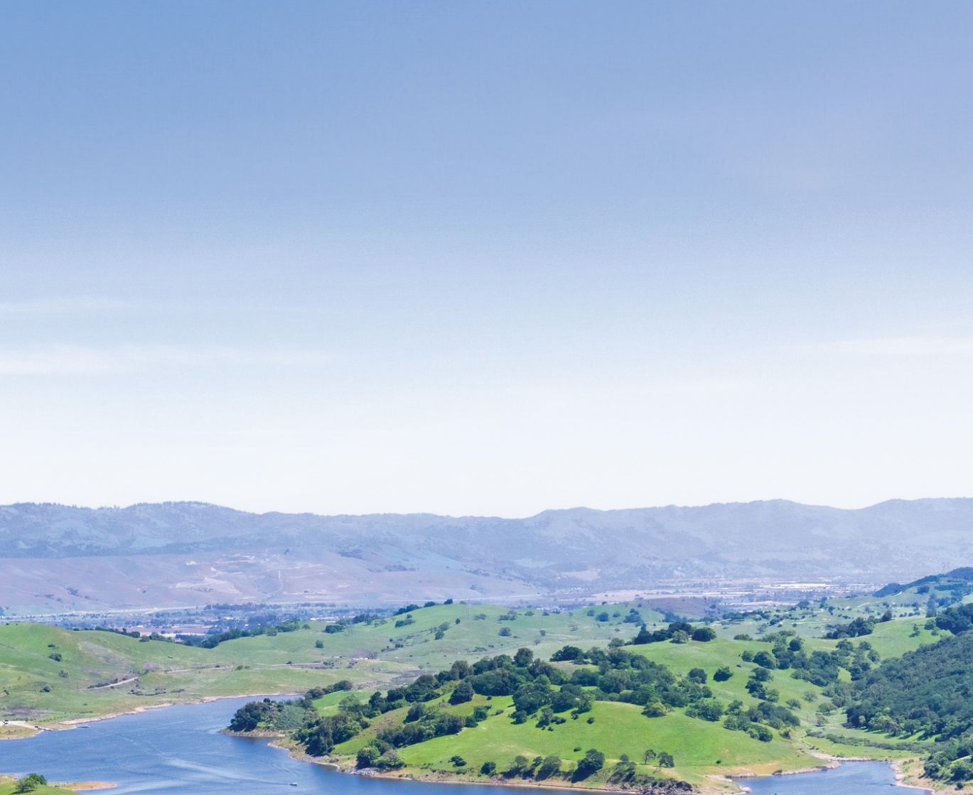

More information on the Capital Improvement Program can be found at https://delivr.com/26bys.
CAPITAL IMPROVEMENT PROGRAM
The Capital Improvement Program (CIP) contains Valley Water’s capital projects, which includes flood protection, water quality and infrastructure maintenance efforts. Valley Water's annual review of projects for potential placement or removal from our 5-year CIP is underway.
You're encouraged to participate in our process and share your feedback regarding which projects should be prioritized by Valley Water.

Slide 15
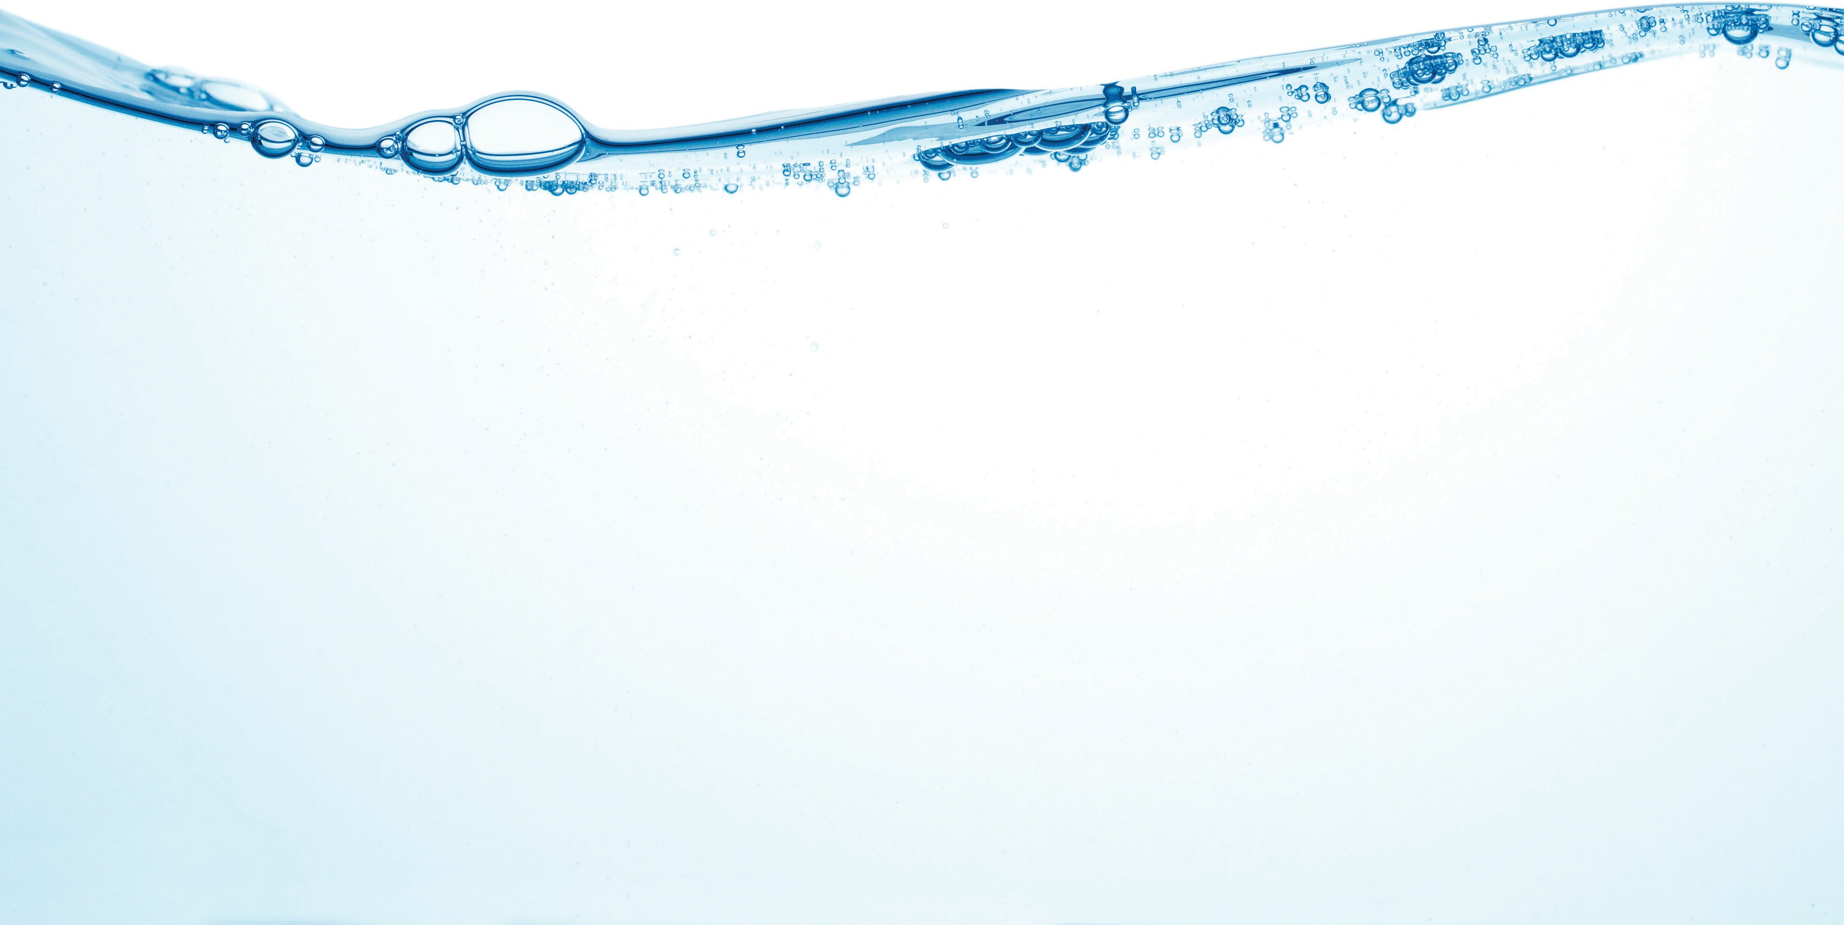

WATER SUPPLY
More information on the Water Supply Master Plan can be found at https://delivr.com/2st85.
MASTER PLAN 2050
The Water Supply Master Plan is Valley Water’s guiding document for long-term water supply investments to ensure water supply reliability for Santa Clara County. Updated about every five years, this long-range plan assesses future countywide demands and evaluates and recommends water supply and infrastructure projects to meet those demands to achieve Valley Water’s level of service goal through the planning horizon. The Water Supply Master Plan 2050 extends the planning horizon to 2050. Once developed, the plan will detail Valley Water’s investment strategies to provide a safe, clean, and reliable water supply for Santa Clara County.
For any questions please contact Jing Wu at jwu@valleywater.org.

