Slide 1

CHANGES:
Slide 4 – new slide on cost & funding
Slide 5 - changes
Slide 7 – new slide on diverse collaboration
Handout: Agenda Item 5.1.

Slide 2
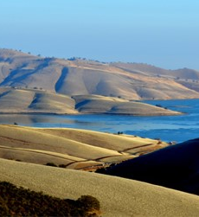
Water Storage Exploratory Committee
March 29, 2023
Los Vaqueros Expansion Project Update
Presented by: Michael Martin, Associate Water Resources Specialist

Slide 3
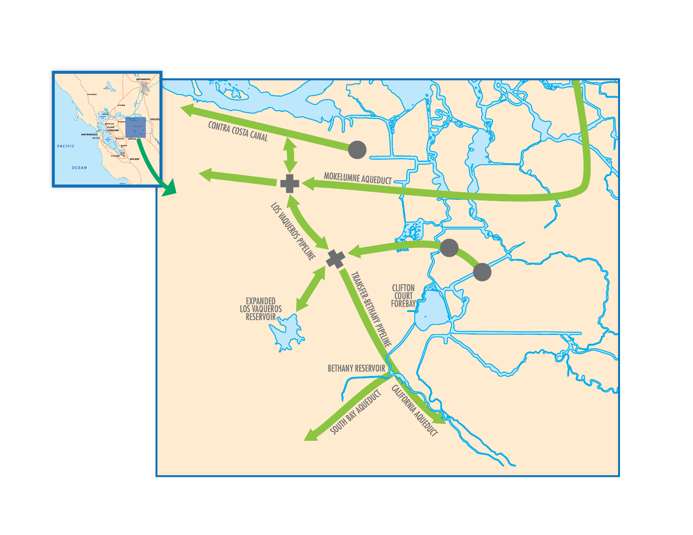
Project Description
Expansion of Los Vaqueros Reservoir to add 115 TAF of storage
Use of three existing CCWD intakes and Freeport (EBMUD)
Construction of Transfer Bethany Pipeline will connect the CCWD system to the California Aqueduct

Slide 4
Cost & Funding
State - $477M
Federal Funding
  Up to 25% cost share authorized in 2020
  $164M appropriated for construction to date
Local - $300M
  WIFIA Loan
  Other financial instruments
Total Development & Construction Cost - $980M (2022 dollars)
Slide courtesy of the Los Vaqueros Joint Powers Authority, provided to Valley Water on March 27, 2023
8

Slide 5
JPA Organization
JPA Board
Finance Committee: Operations and Engineering Committee
Communications and Outreach Committee
Valley Water Board Representation
Director Rebecca Eisenberg: JPA Board Director, Finance Committee
Director Richard Santos: JPA Board Alternate Director
JPA Staff
Taryn Ravazzini – Executive Director
James Ciampa – Legal Counsel
Rosemarie Perea – Clerk
Program Management Services TBD
Partner Staff Workgroups
Legal Workgroup
Financial Workgroup
Design Review Team

Slide 6
Local Agency Partners
Alameda County Water District
Contra Costa Water District
  City of Brentwood
East Bay Municipal Utility District
Grassland Water District
San Francisco Public Utilities Commission
  Bay Area Water Supply and Conservation Agency
San Luis & Delta-Mendota Water Authority
  Byron Bethany Irrigation District
  City of Tracy
  Del Puerto Water District
  Panoche Water District
  Westlands Water District
Valley Water
Zone 7 Water Agency

Slide 7
Diverse Collaboration
Urban and agriculture represented
Big and small agencies
Geography: Coastal/Bay + Inland, North + South Delta
Many water types: CVP, SWP, Tuolumne, Mokelumne

Slide 8
JPA Agreements
Service Agreement (all partners and JPA)
Usage Fee Agreements
Contract for Administration of Public Benefits
Operations and Maintenance Agreements
WIFIA Loan Agreement
Resource Agency Permits
Water Rights Changes

Slide 9
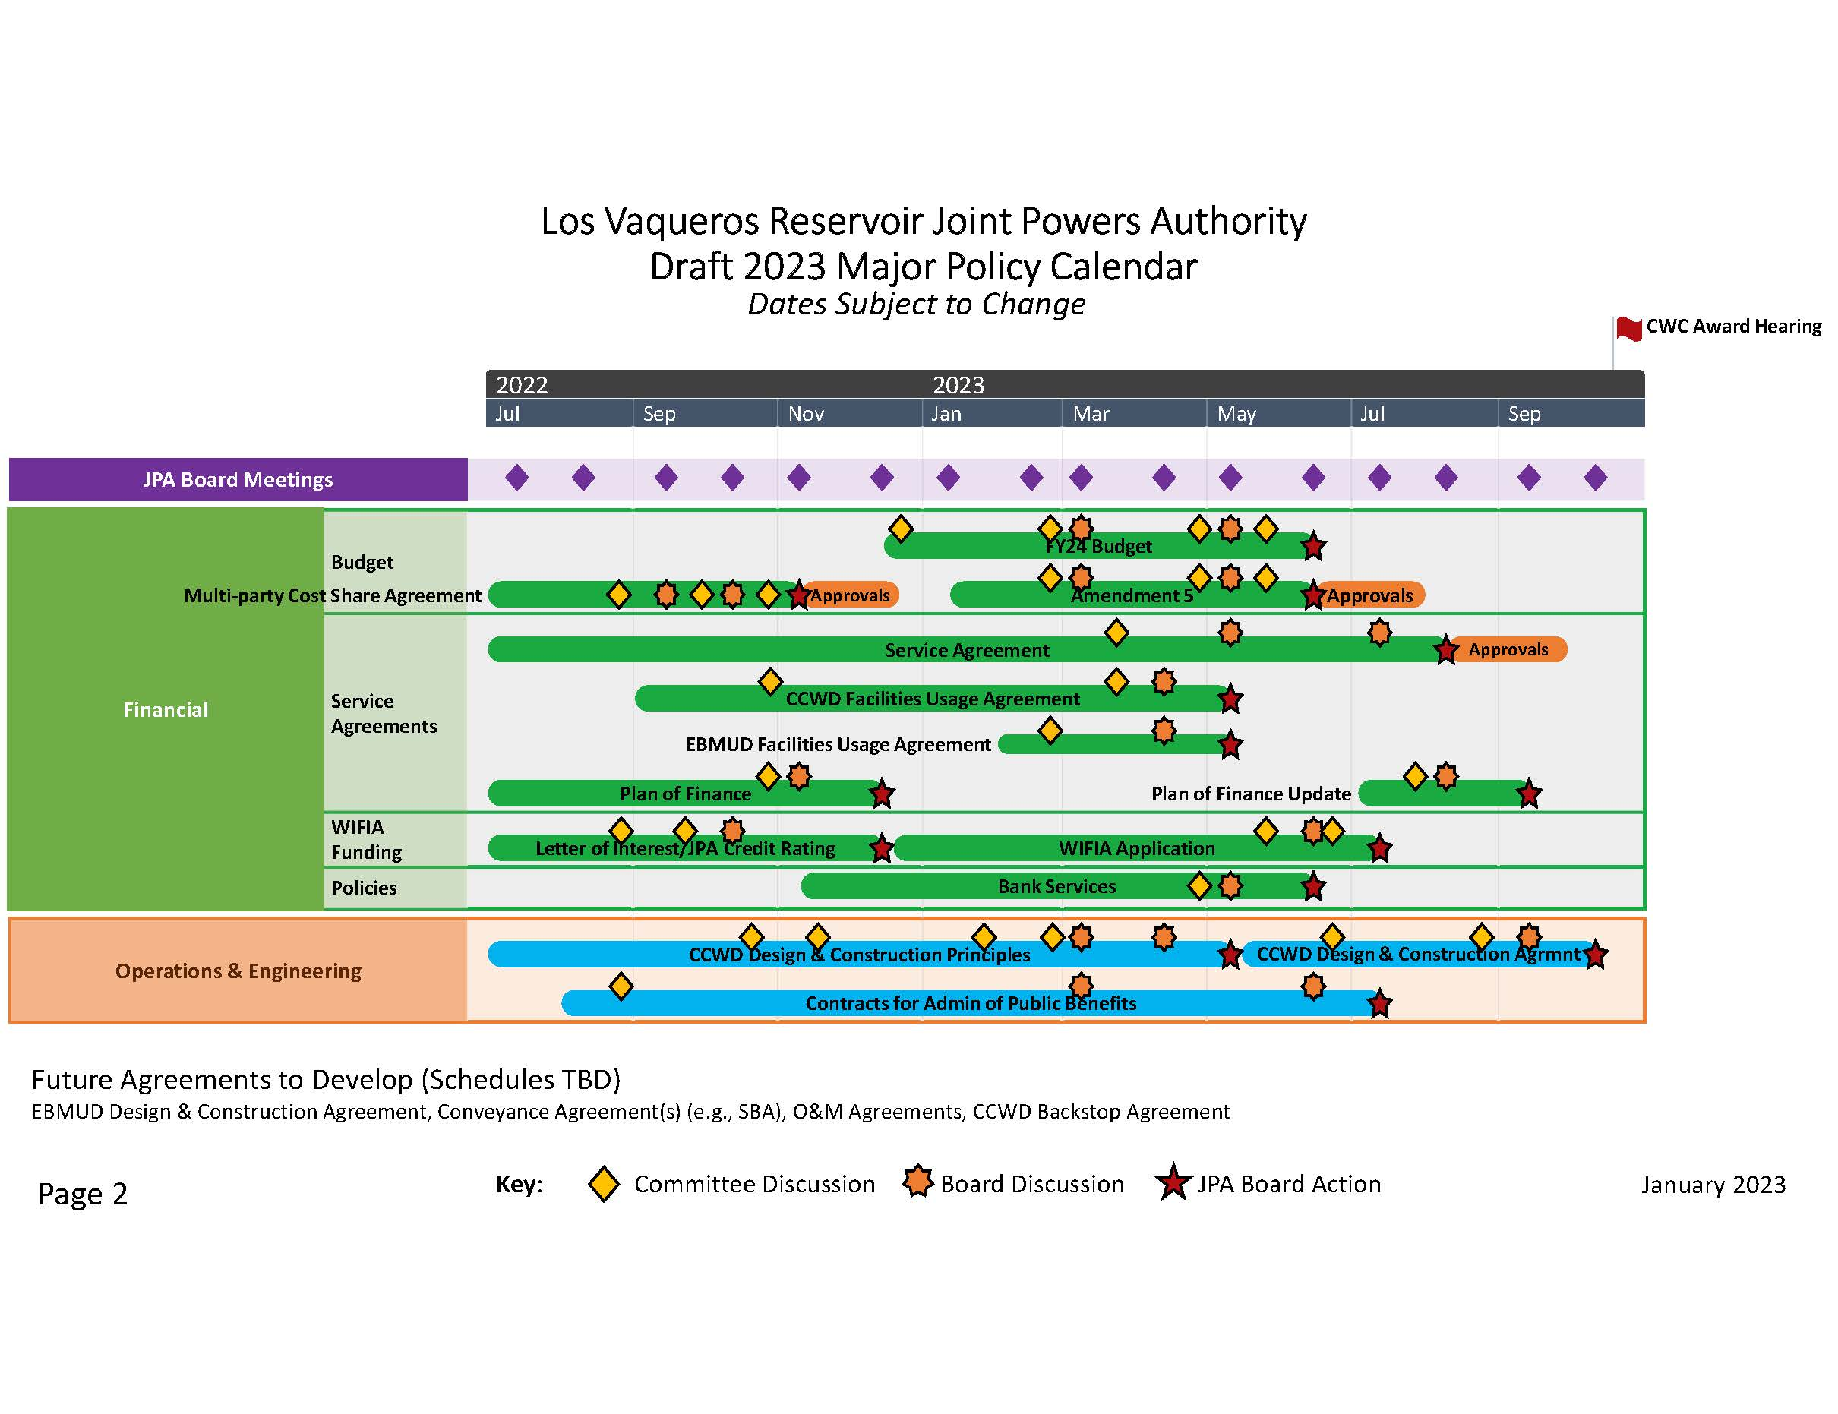
JPA Policy Calendar

Slide 10
Off-Ramps
Service Agreement
Engineer’s estimate is too high,
Other partners withdraw,
Unacceptable funding or permit conditions,
Cannot obtain a long-term water supply.
Once the Service Agreement is completed and Final Funding Agreement is awarded by the CWC, withdraw from the LVE Project must be approved by the JPA Board.

