Slide 1
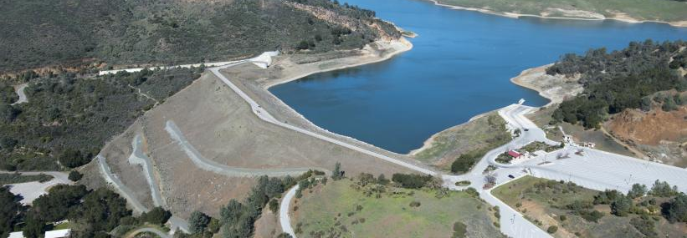
Anderson Dam Seismic Retrofit Project Update
October 28, 2019

Slide 2
Anderson Dam Project Goals
Public Safety: Expeditiously complete the project to safeguard against loss of life and reduce property damage due to earthquake and/or subsidence.
Water Supply: Ensure a resilient water system to benefit the community’s access to safe, clean, and reliable water while supporting a healthy groundwater basin.
Environmental Enhancements: Protect the creek habitat during construction and provide improved habitat after construction.
Financial Sustainability: Use resources prudently to build a reliable, long lasting project for the community.

Slide 3
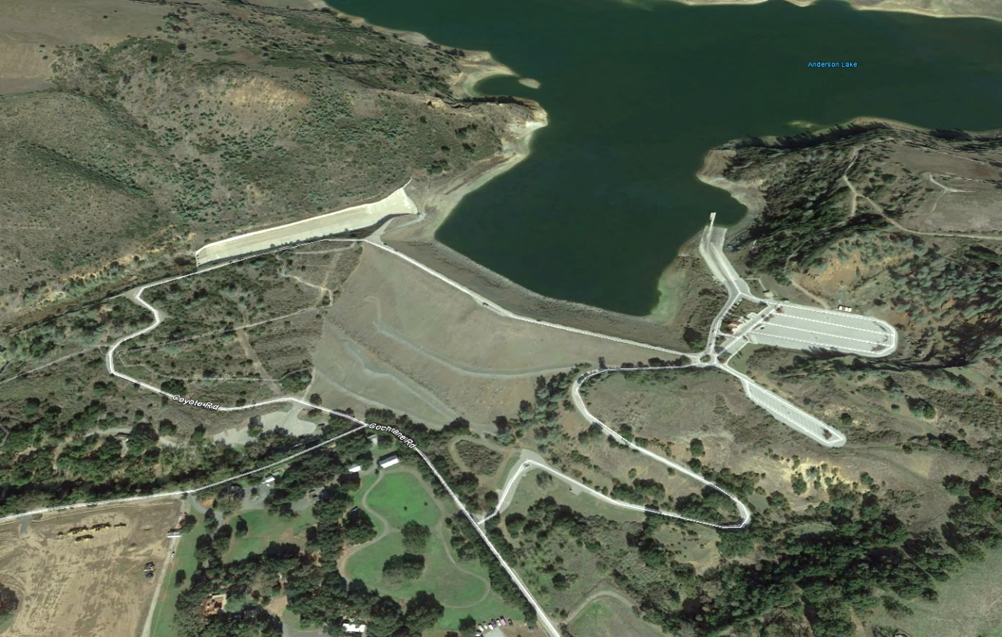
Anderson Dam Existing Components
Spillway
Outlet Pipe
Dam Crest
Dam Embankment

Slide 4
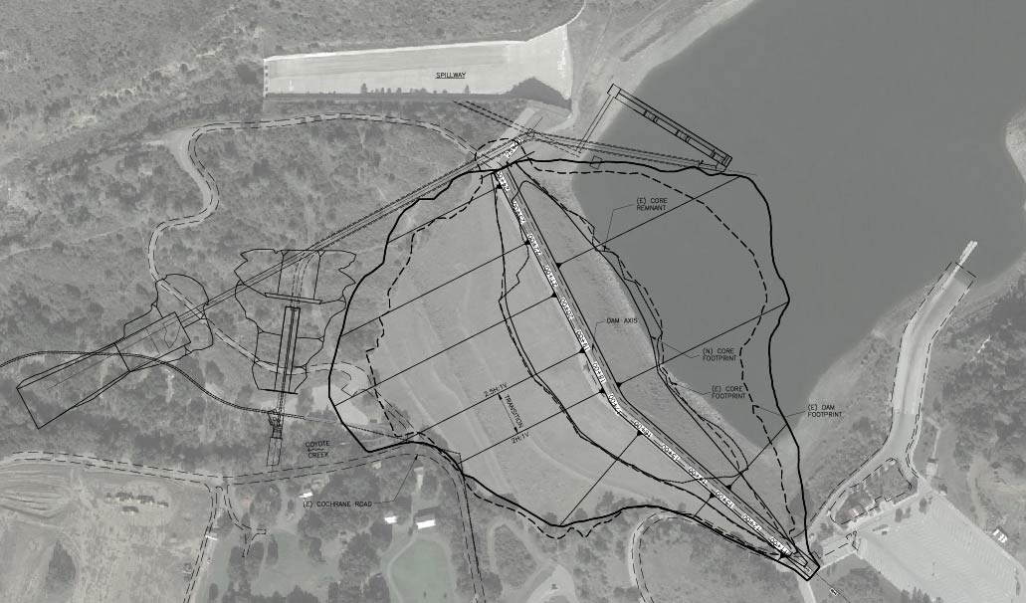
Anderson Dam Seismic Retrofit Project Components
Replace Spillway
High Level Outlet Pipe
Temporary Diversion System
Low Level Outlet Pipe
Remove all liquefiable material and reconstruct embankment

Slide 5
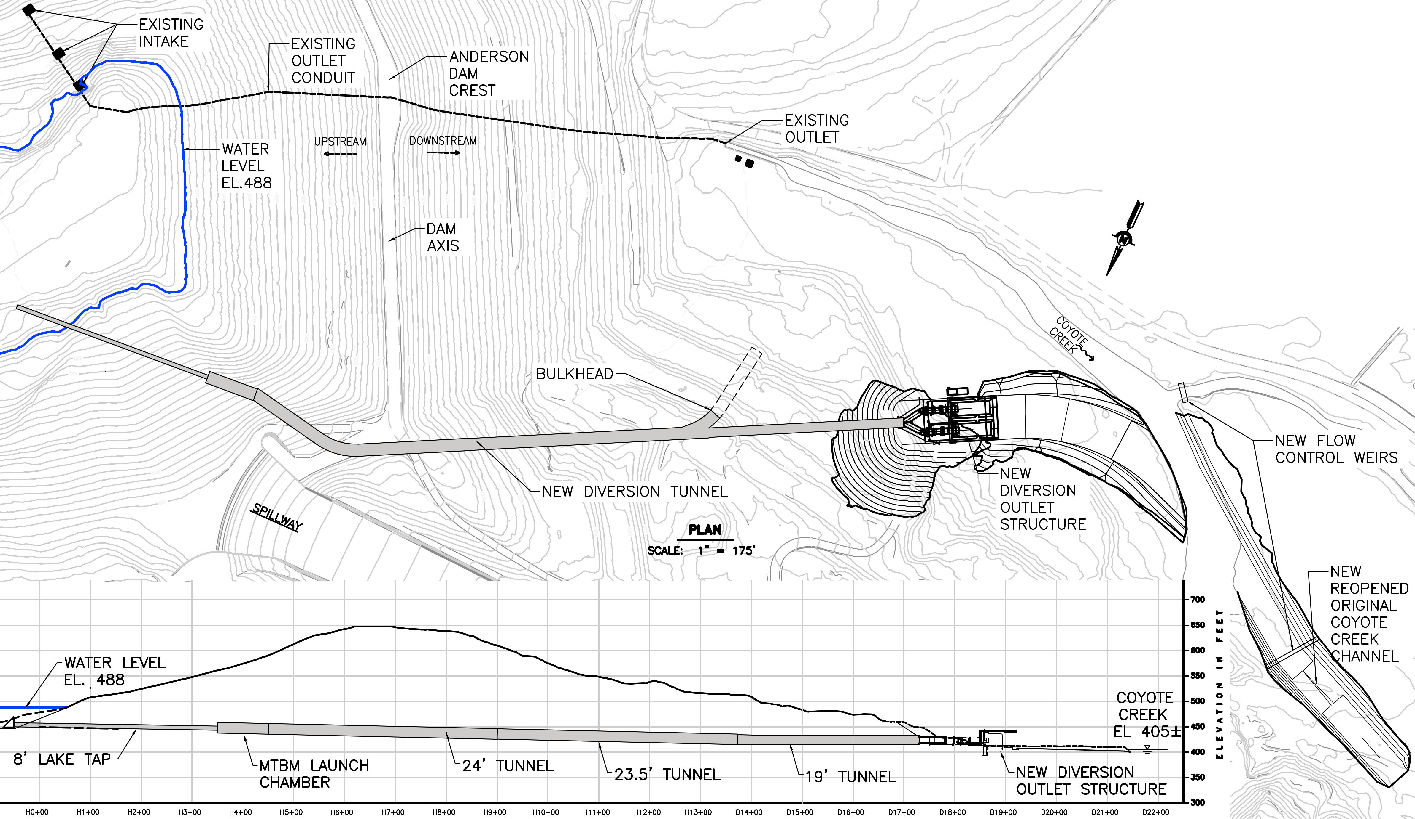
February 20, 2020 FERC Directive - Interim Risk Reduction Measures
Lower reservoir to new restriction (El. 565’)
Take all necessary measures to safely prepare and drain the reservoir to El. 488’
Oct. 1 - Begin draining reservoir to dead pool (El. 488’)
Develop plan to maintain dead pool elevation in event of significant inflow
Expedite design and construction of new Outlet Tunnel
Secure permits and complete design of larger Seismic Retrofit Project

Slide 6
Valley Water Response
Ensure immediate compliance with new reservoir level restriction
Create Anderson Dam Tunnel Project (ADTP) to expedite design and construction of the outlet tunnel
Create Federal Energy Regulatory Commission Order Compliance Project (FOCP) to safely drain and maintain the lowest practicable reservoir operating level while minimizing water supply and environmental impacts
Board of Directors approval of FOCP preliminary project description

Slide 7
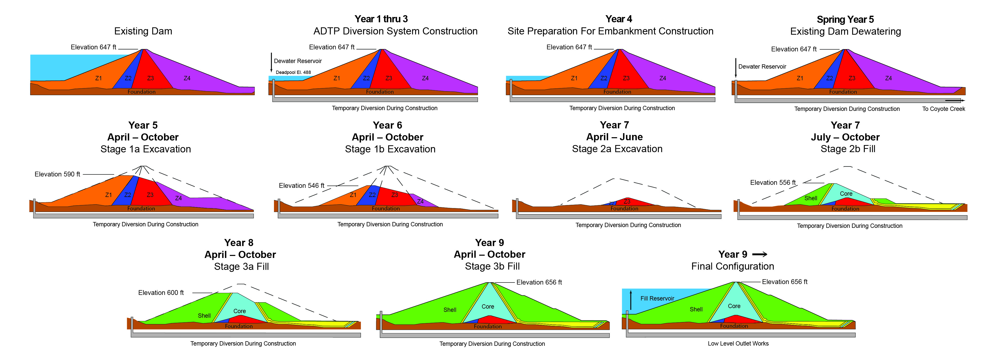
FOCP - Initial Reservoir Lowering
Existing Sloping Intake
Elevation 565 ft
Elevation 488 ft
Lower Reservoir to Elevation 565’ – In compliance
October 1 – Begin draining reservoir to Elevation 488’
  Dewatering Plan to accomplish order and address impacts underway.

Slide 8
FOCP– Expedited Outlet Construction (ADTP)
Elevation 488 ft
Expedite Construction of New Outlet Tunnel - ADTP
    Plan for design and construction submitted to FERC 3/20/2020
    Begin construction in early 2021
    Tunnel construction 18-24 months from commencement
Other Measures to Draw Down Safely
    Downstream flood protection mitigation
    Embankment and outlet monitoring until outlet tunnel complete
    Enact necessary mitigation measures to minimize water supply and environmental impacts

Slide 9
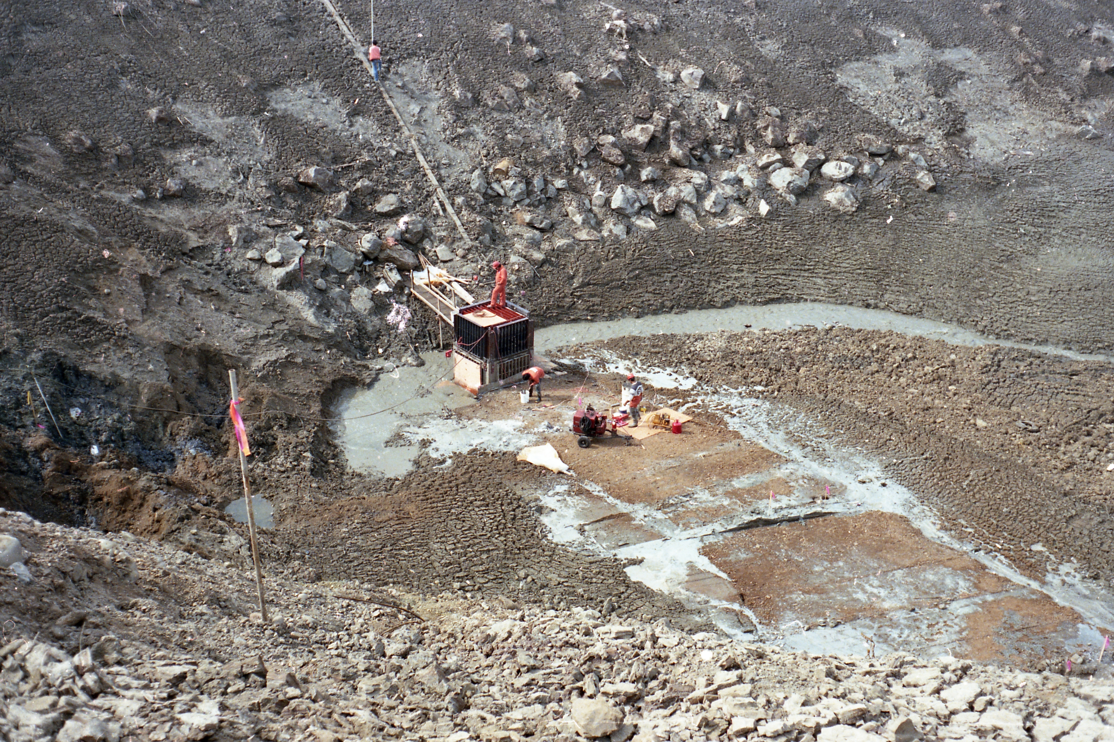
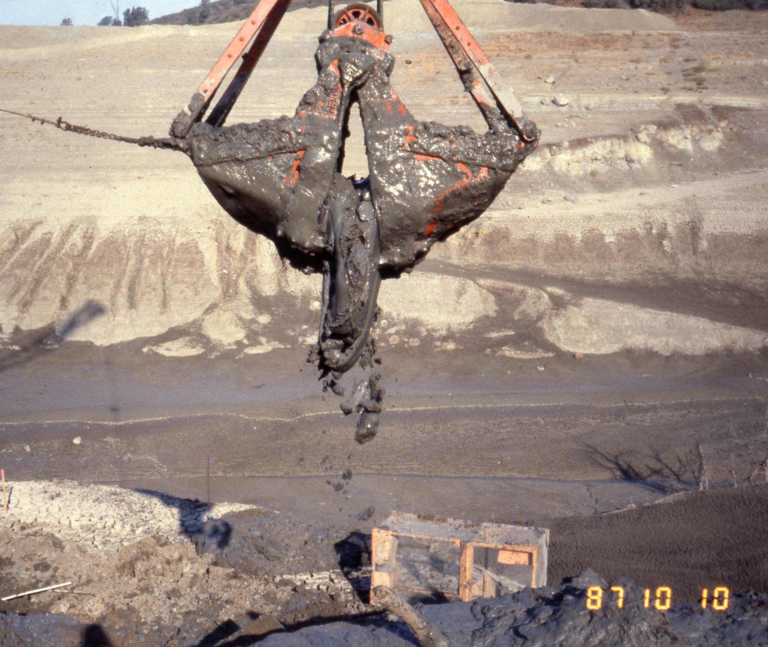
1987 Dewatering Photos
Top: Excavating sediment and debris
Right: Turbid water flowing into original intake to the outlet structure
Insert your secondary topic here
DRAFT – FOR INTERNAL USE ONLY

Slide 10

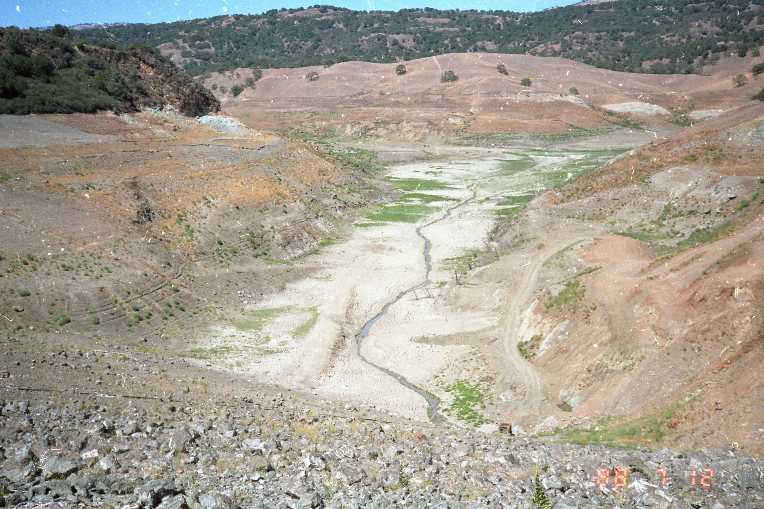
Boating Limitations
DRAFT – FOR INTERNAL USE ONLY

Slide 11
Necessary Permits
Federal
  FERC: Amendment to Exemption for Licensing
  USACE: CWA Section 404 Permit
  USFWS: Incidental take permit (VHP – see below)
  NMFS: Incidental take permit (steelhead trout)
State
  DSOD: New dam application
  CDFW: LSAA
  VHP: Incidental take authorization (covered species for state and federal ESA)
  SWRCB: General Construction NPDES Stormwater Permit
  SWRCB/SFRWQCB: CWA Section 401 Water Quality Certification
  SHPO: Section 106 of the NHPA
Local – municipal approvals, encroachment permits, temporary rights of way.

Slide 12
Construction Sequence
FERC Order Compliance Project
ADTP Construction

Slide 13
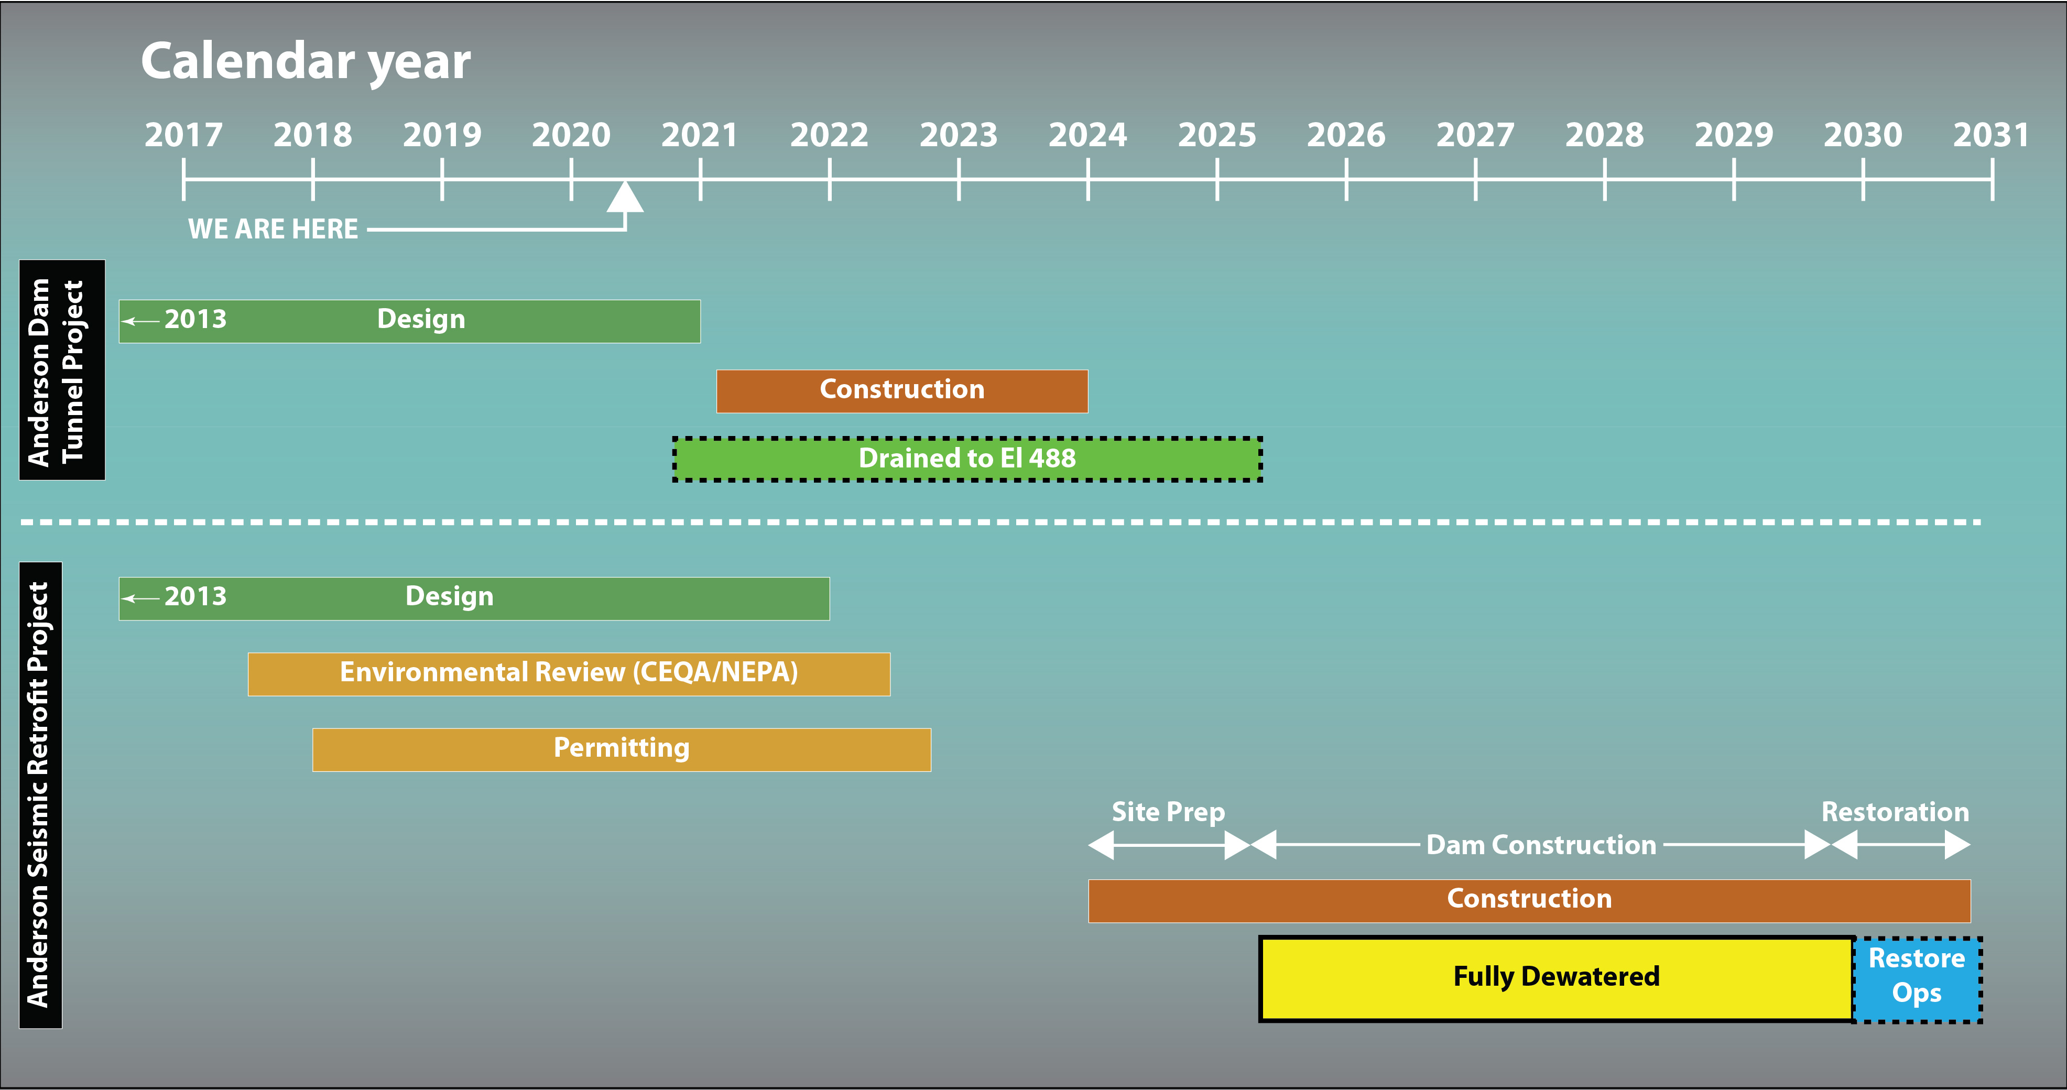
Project Schedule

Slide 14

Subscribe and Follow
@valleywater
Questions?
@valleywater
@valleywater
Social
media

