Slide 1
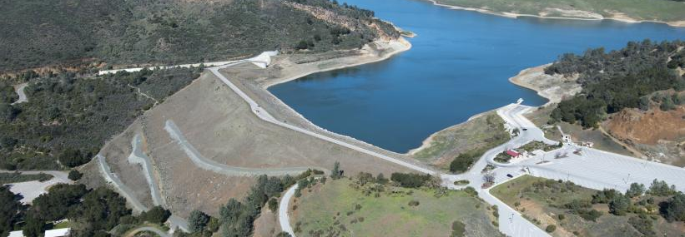
Anderson Dam Seismic Retrofit Project Update
September 17, 2020

Slide 2
Anderson Dam Seismic Retrofit Project
Background
Anderson Dam forms Anderson Reservoir, holding 90,000 acre feet of water when full and the largest of Valley Water’s reservoirs.
In 2012, following a seismic stability analysis, Valley Water began plans to retrofit the dam to meet current safety standards, creating the Anderson Dam Seismic Retrofit Project (ADSRP)
On February 20, 2020, the Federal Energy Regulatory Commission (FERC) issued an order to Valley Water to undertake early implementation interim risk reduction measures associated with ADSRP immediately.

Slide 3
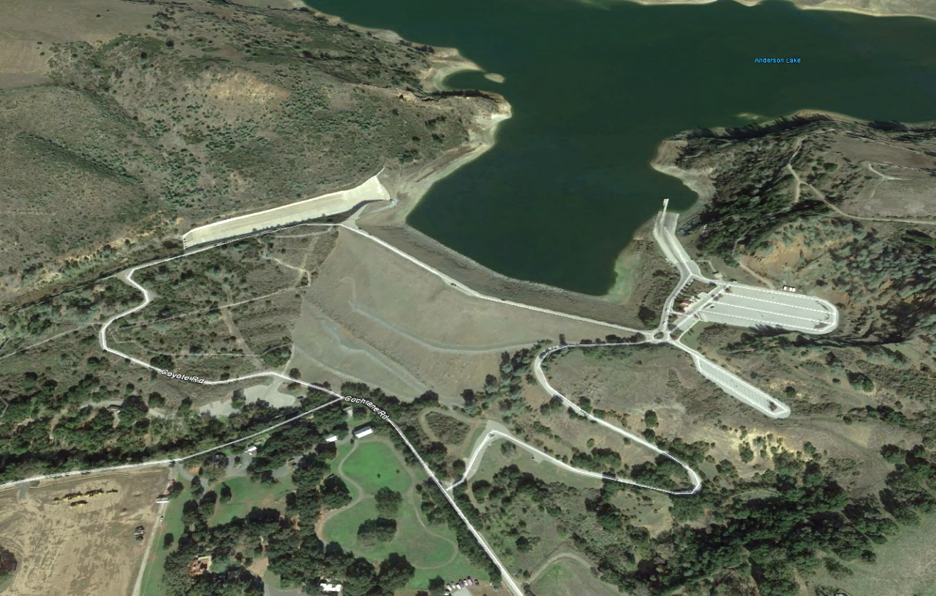
Anderson Dam Existing Components
Spillway
Outlet Pipe
Dam Crest
Dam Embankment

Slide 4
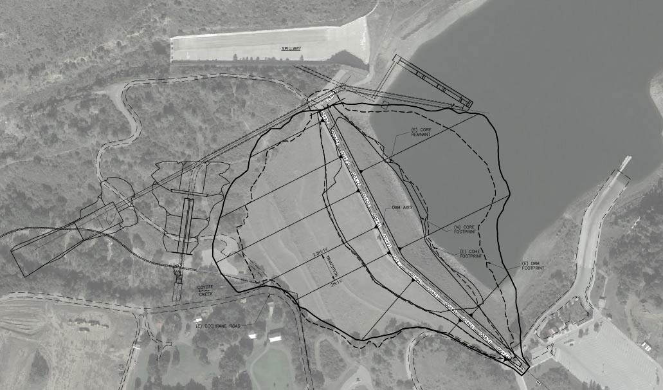
Anderson Dam Seismic Retrofit Project Components
Replace Spillway
High Level Outlet Pipe
Temporary Diversion System
Low Level Outlet Pipe
Remove all liquefiable material and reconstruct embankment

Slide 5
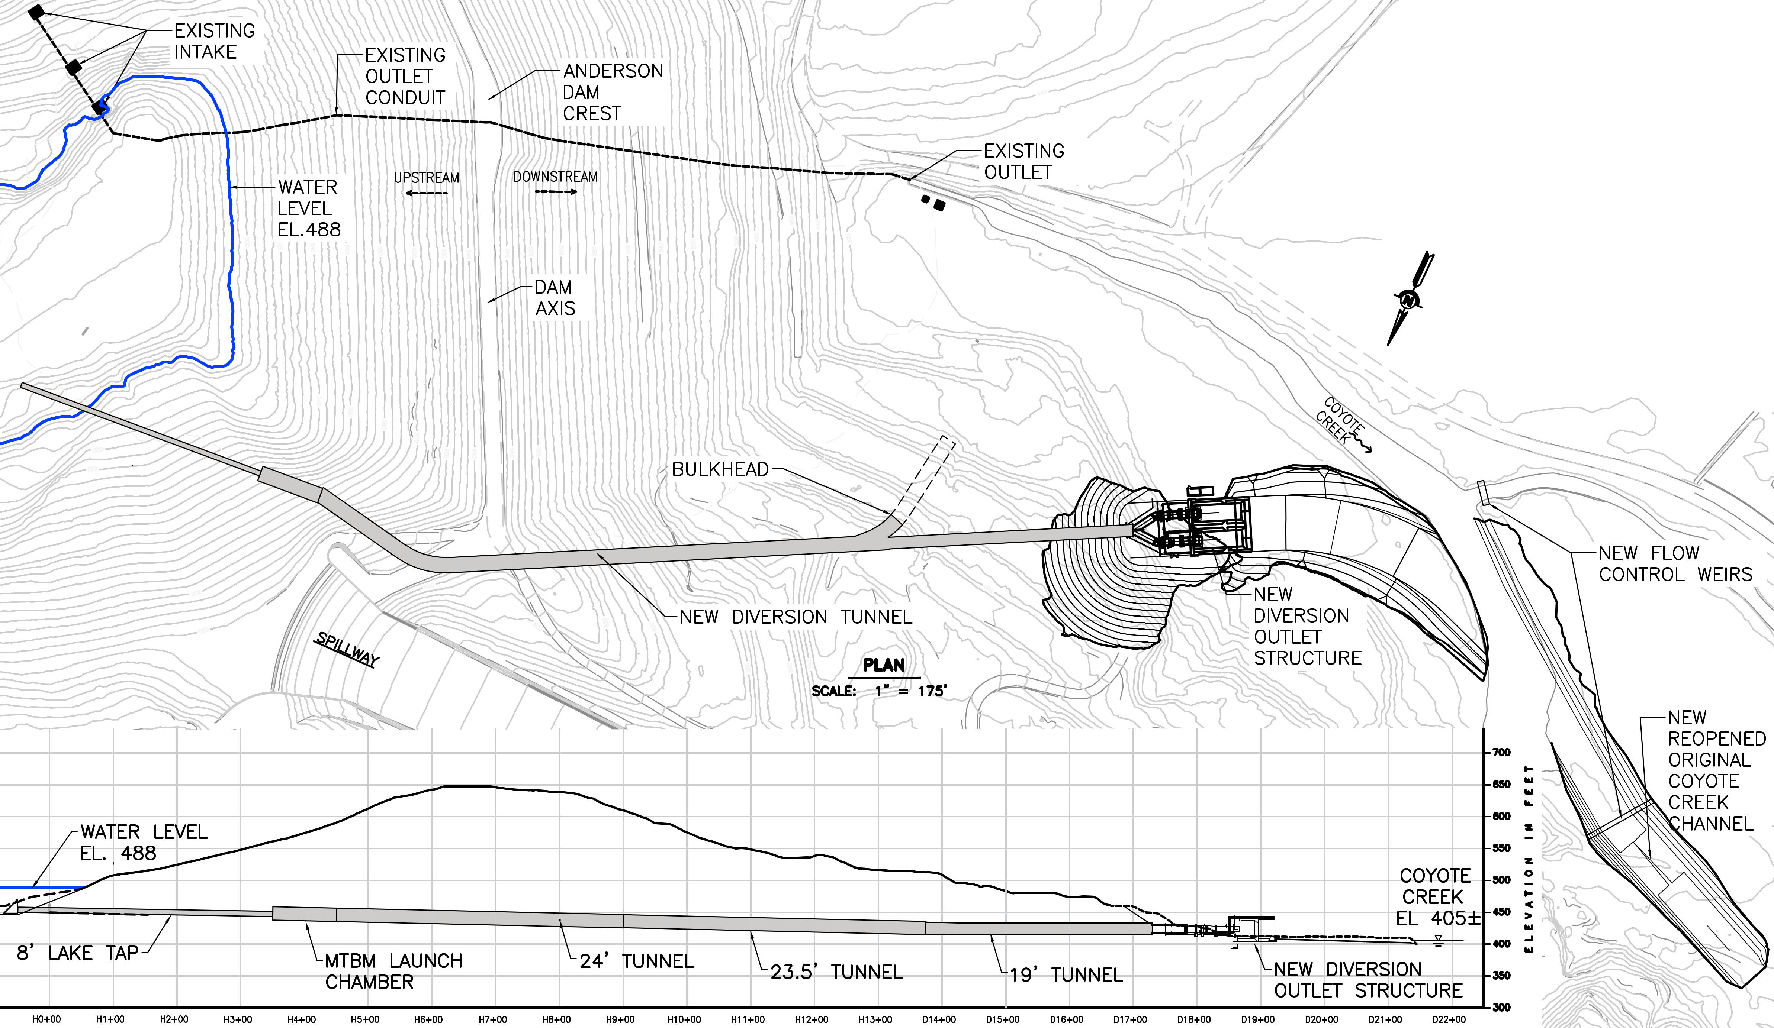
February 20, 2020 FERC Directive - Interim Risk Reduction Measures
Lower reservoir to new restriction (El. 565’)
Take all necessary measures to safely prepare and drain the reservoir to El. 488’
Oct. 1 - Begin draining reservoir to dead pool (El. 488’)
Develop plan to maintain dead pool elevation in event of significant inflow
Expedite design and construction of new Outlet Tunnel
Secure permits and complete design of larger Seismic Retrofit Project

Slide 6
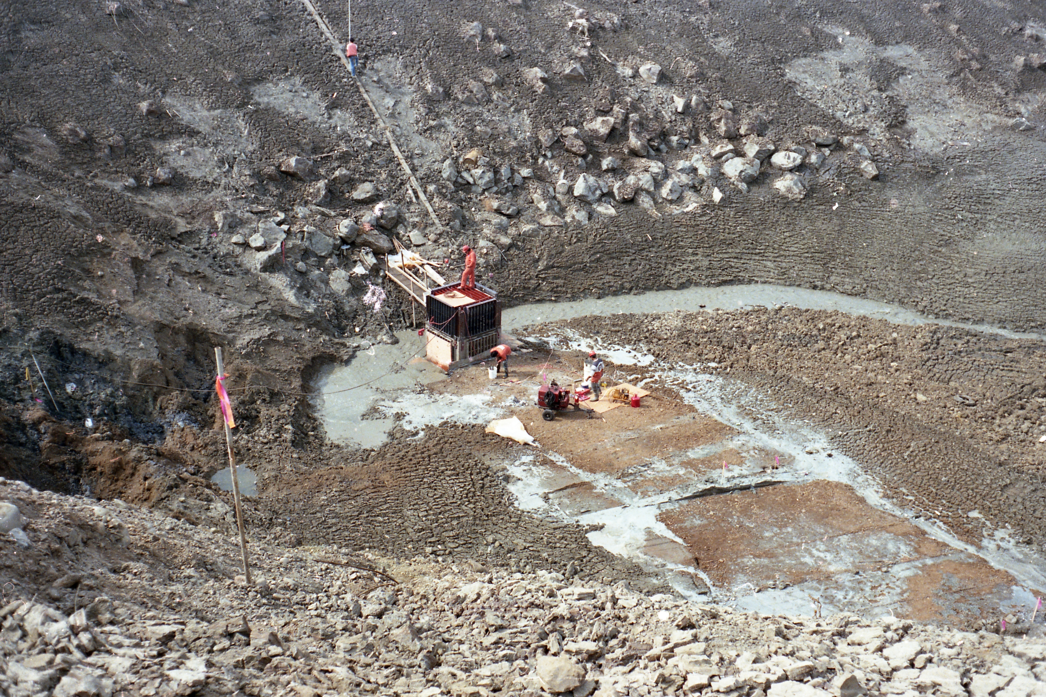
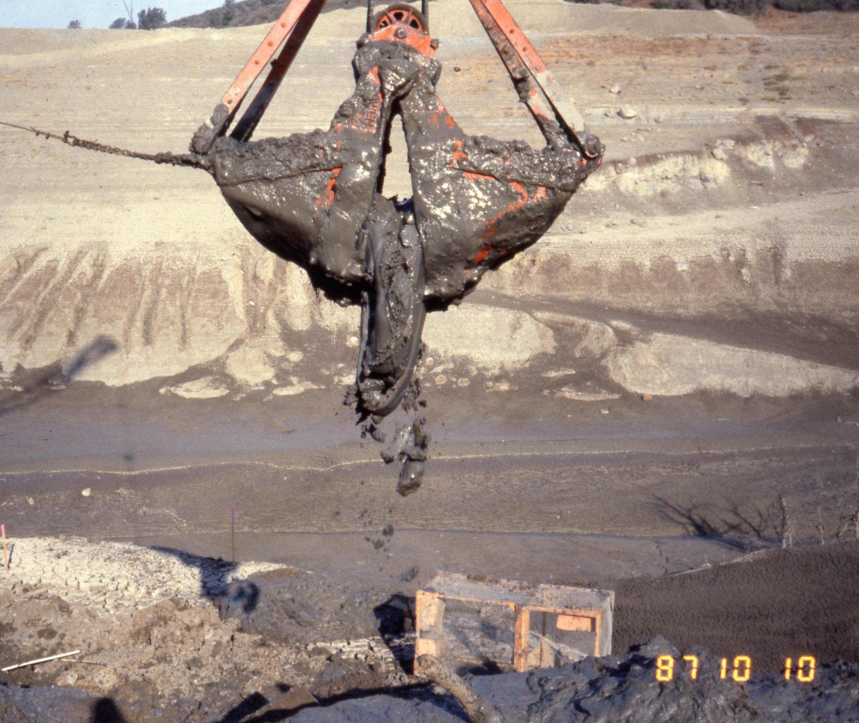
1987 Dewatering Photos
Top: Excavating sediment and debris
Right: Turbid water flowing into original intake to the outlet structure
Insert your secondary topic here
DRAFT – FOR INTERNAL USE ONLY

Slide 7

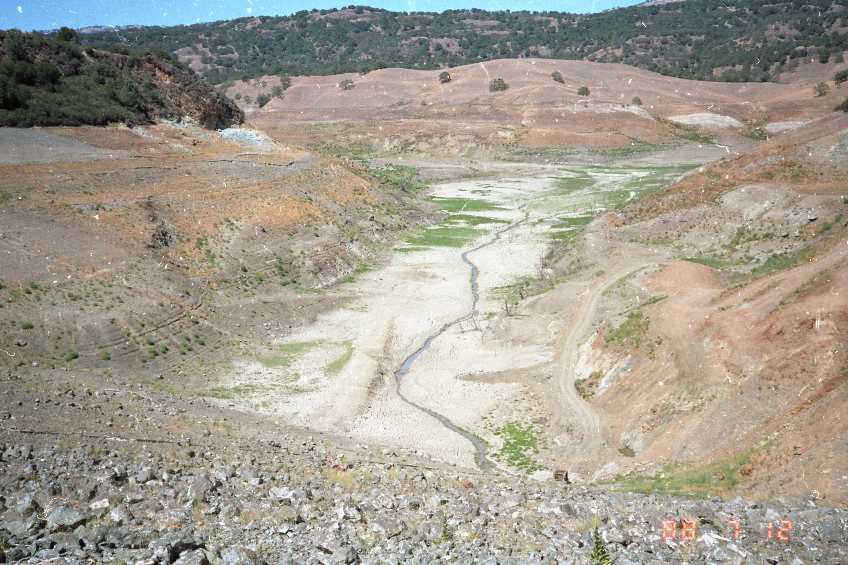
Boating Limitations
DRAFT – FOR INTERNAL USE ONLY

Slide 8
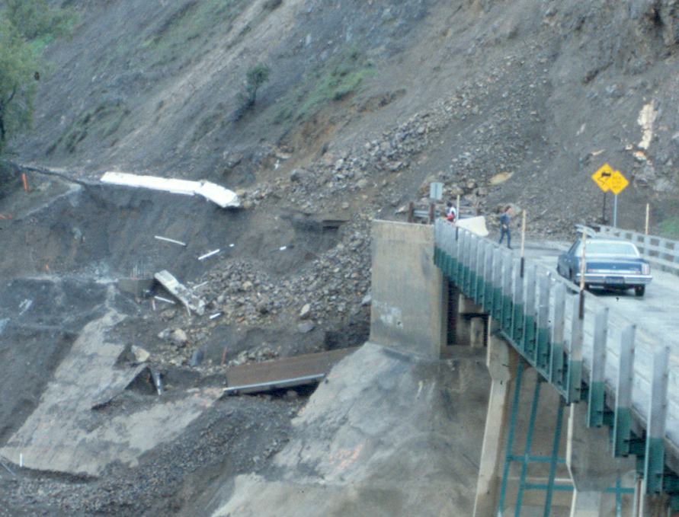
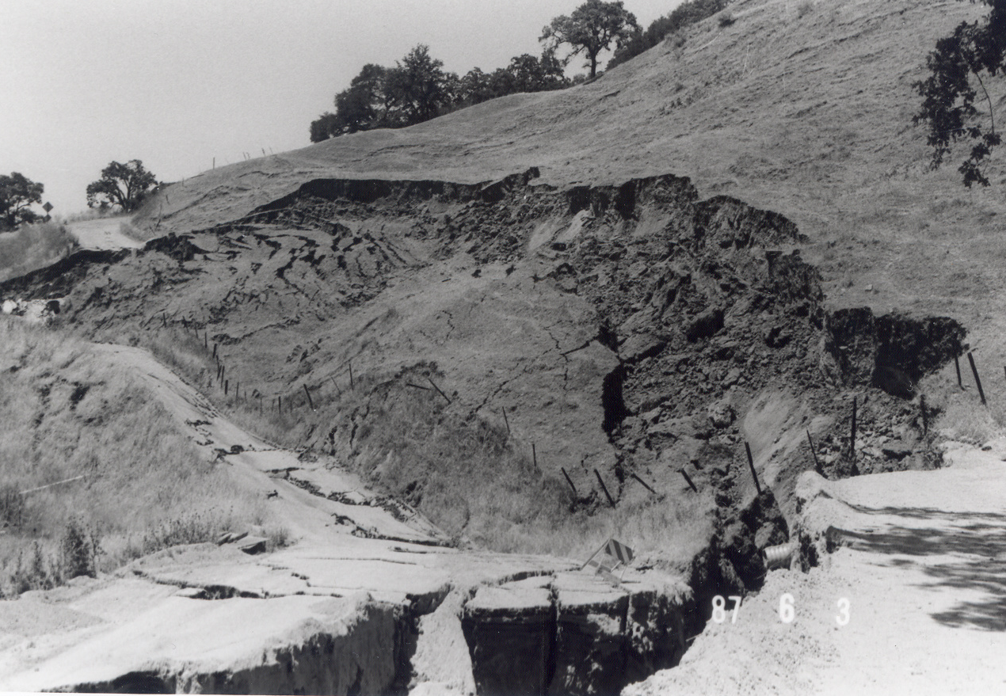
Potential Rim Instability
DRAFT – FOR INTERNAL USE ONLY

Slide 9
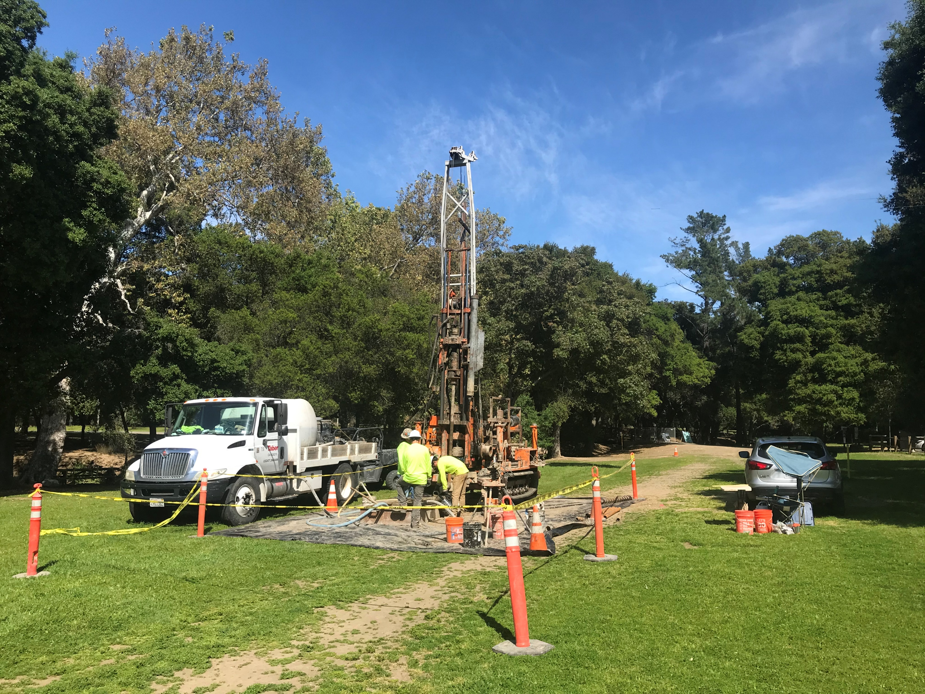
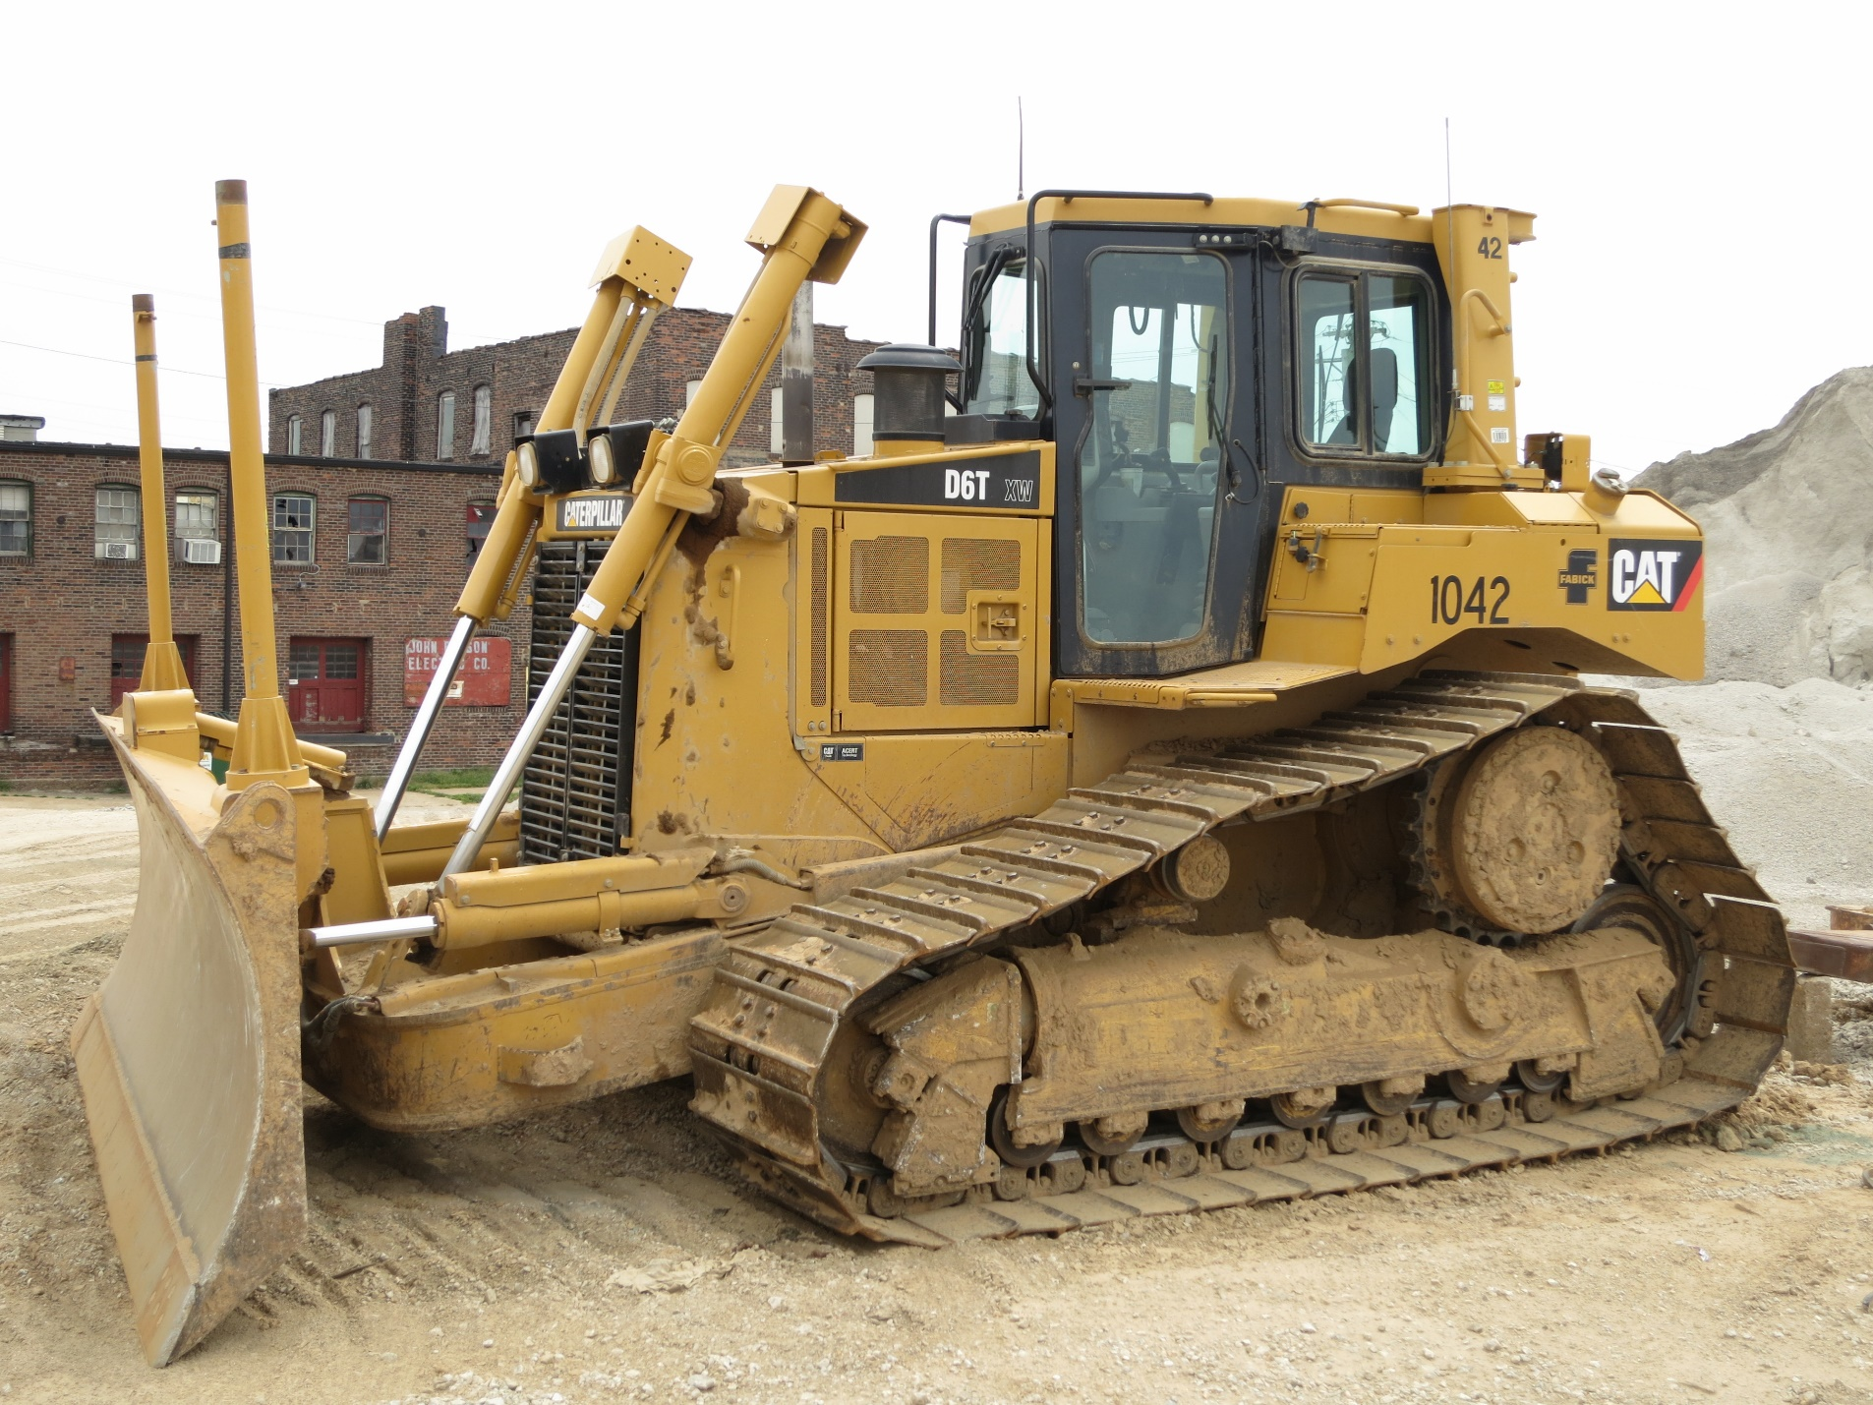
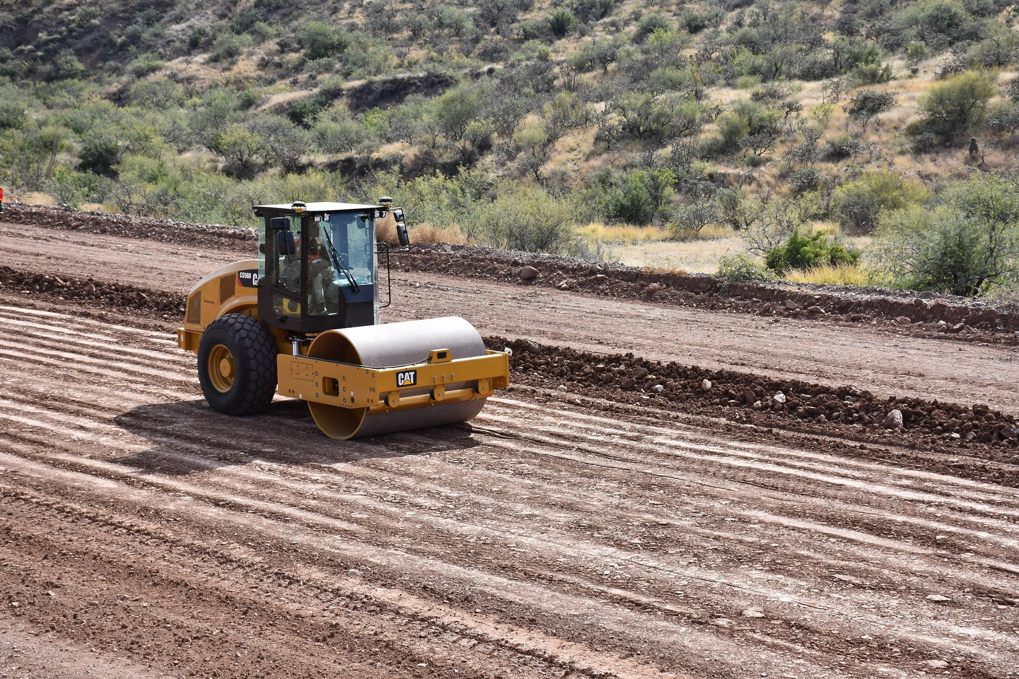
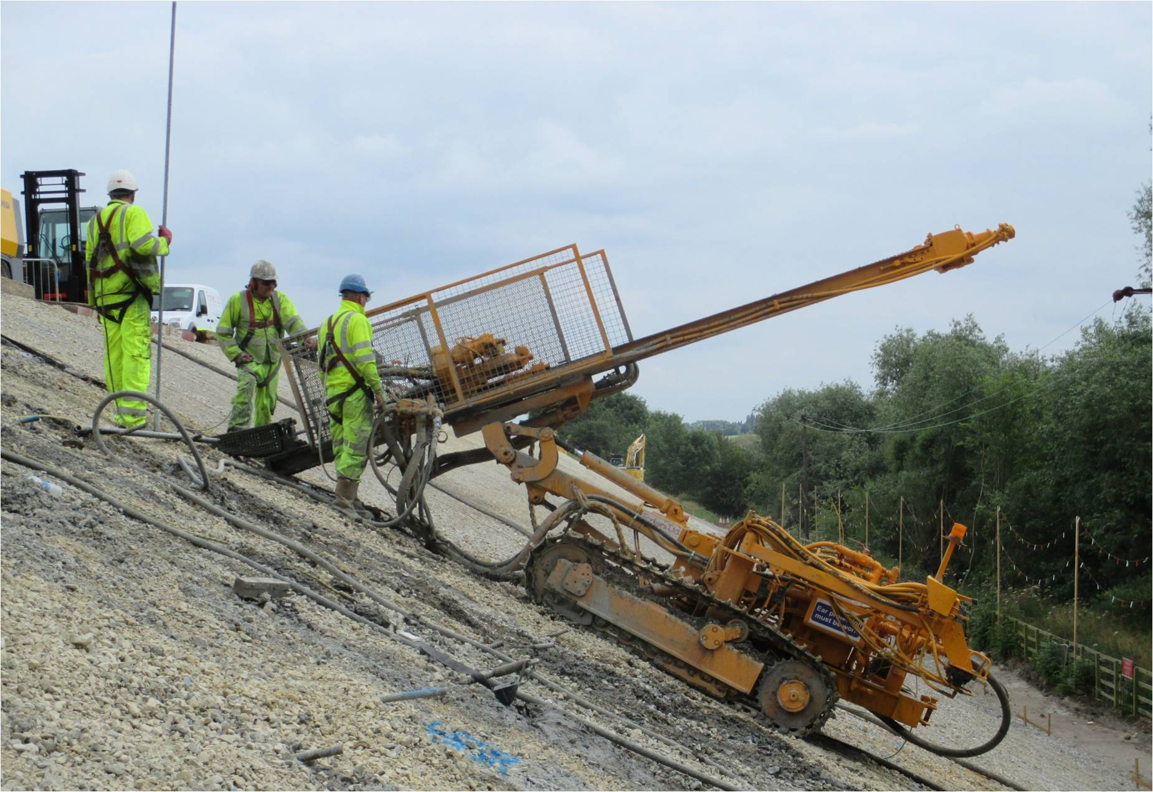
Typical Equipment

Slide 10
Potential Impacts
Potential impacts include:
  After storm events, the water level in the reservoir will rise temporarily
  Increased flows in Coyote Creek, downstream of the dam, after storm events
  Noise from construction equipment running (large diesel engines)and backup alarms
  Work activities will mainly be Monday through Friday during the daytime, but some Saturdays may be required
  Smells caused by elevated levels of algae in the summer. Algal blooms can deplete oxygen levels in the water and produce hydrogen sulfide (rotten egg taste and odor)

Slide 11
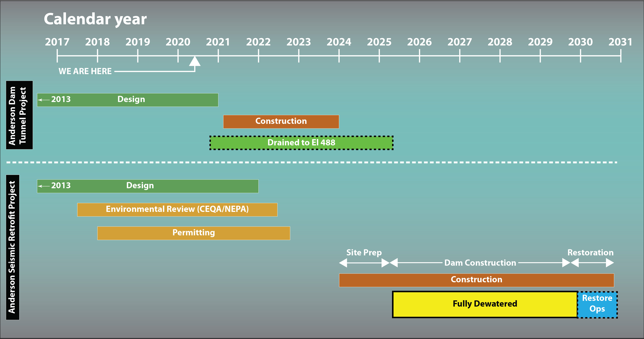
Project Schedule

