Slide 1

Valley Water PPT Template
Version Release v.2.02

Slide 2
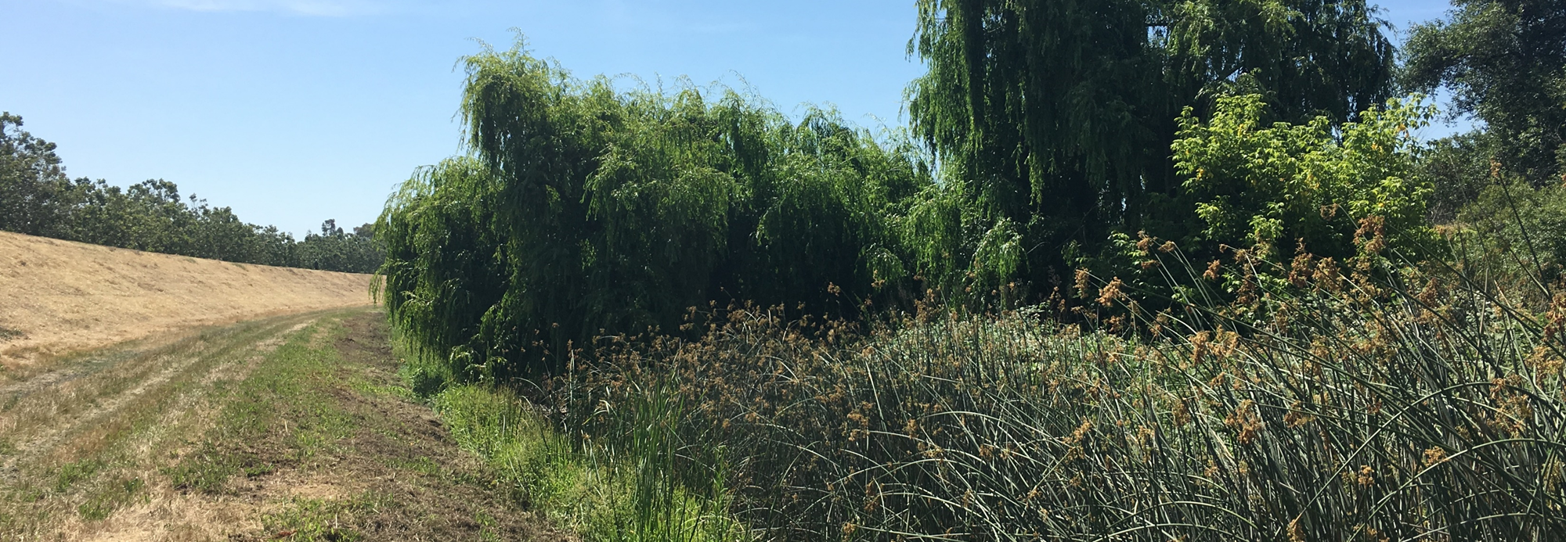
Guadalupe River – Tasman Dr. to I880
Presented by: Katie Muller, Project Manager

Slide 3
Agenda
Guadalupe River Project – Tasman Dr. to I880
Project Background
Recently Discovered Problem
Interim & Permanent Solutions
Next steps
Guided Table Discussions

Slide 4
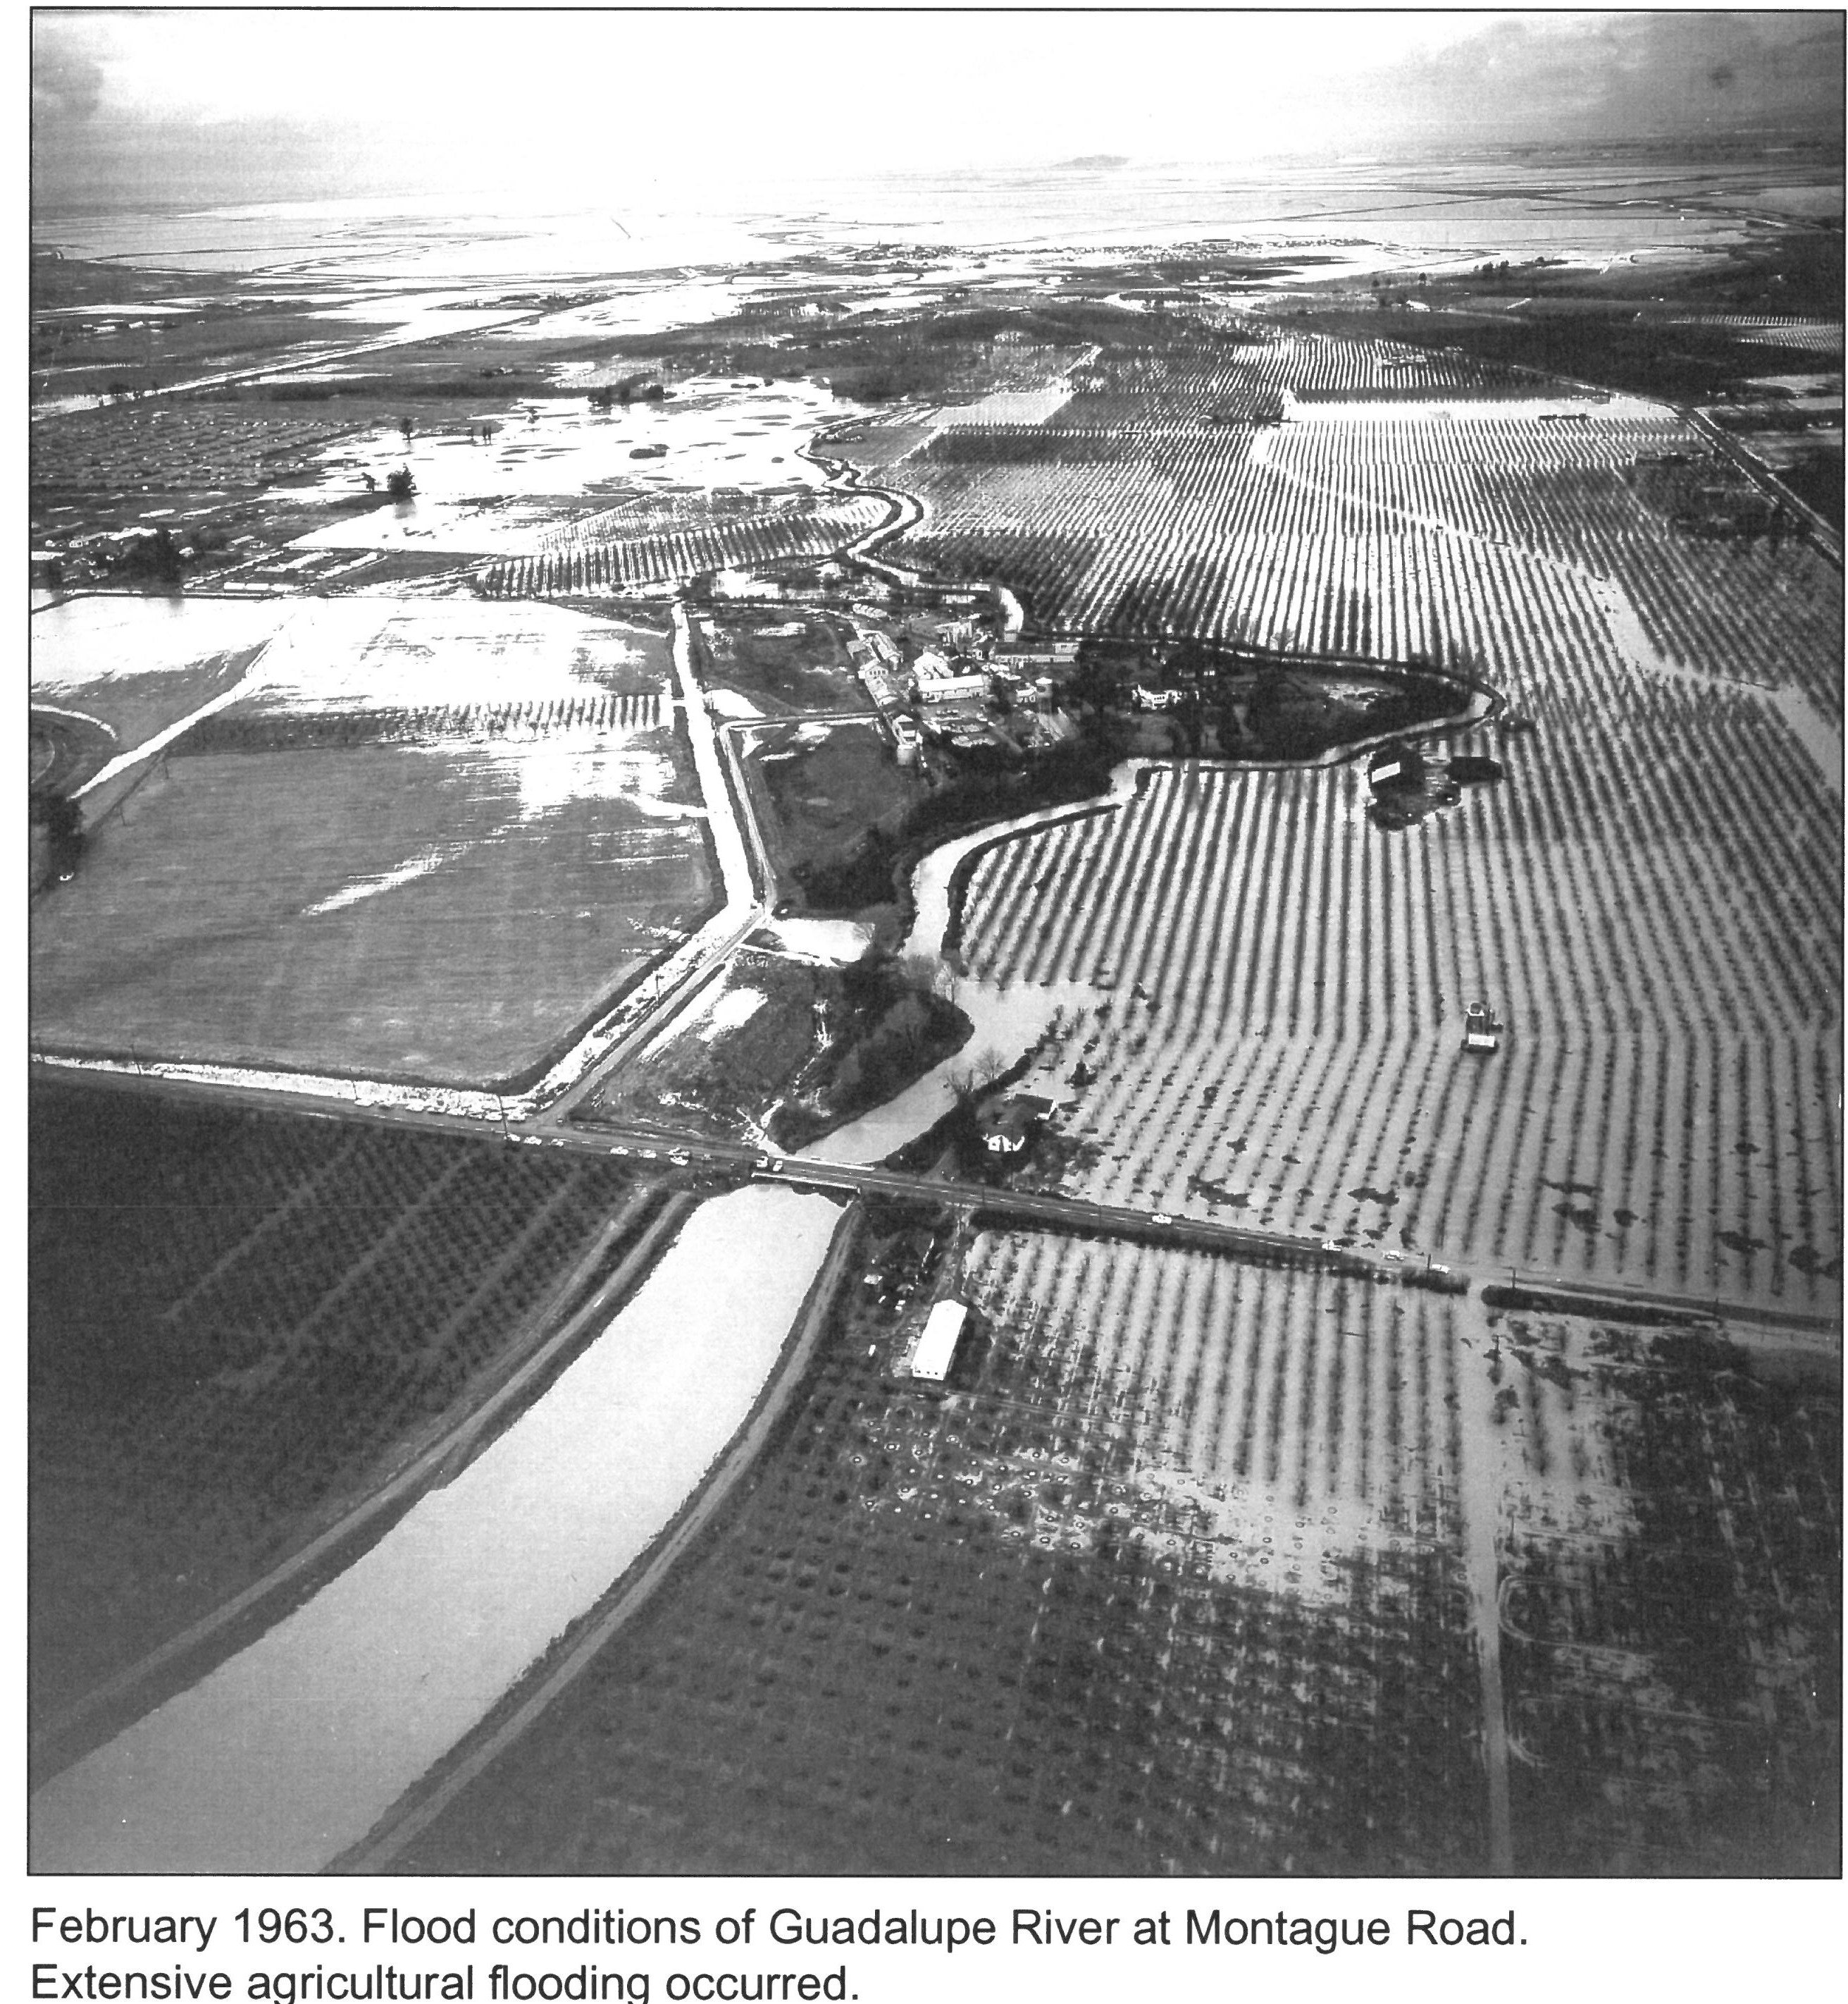
Guadalupe River Background

Slide 5
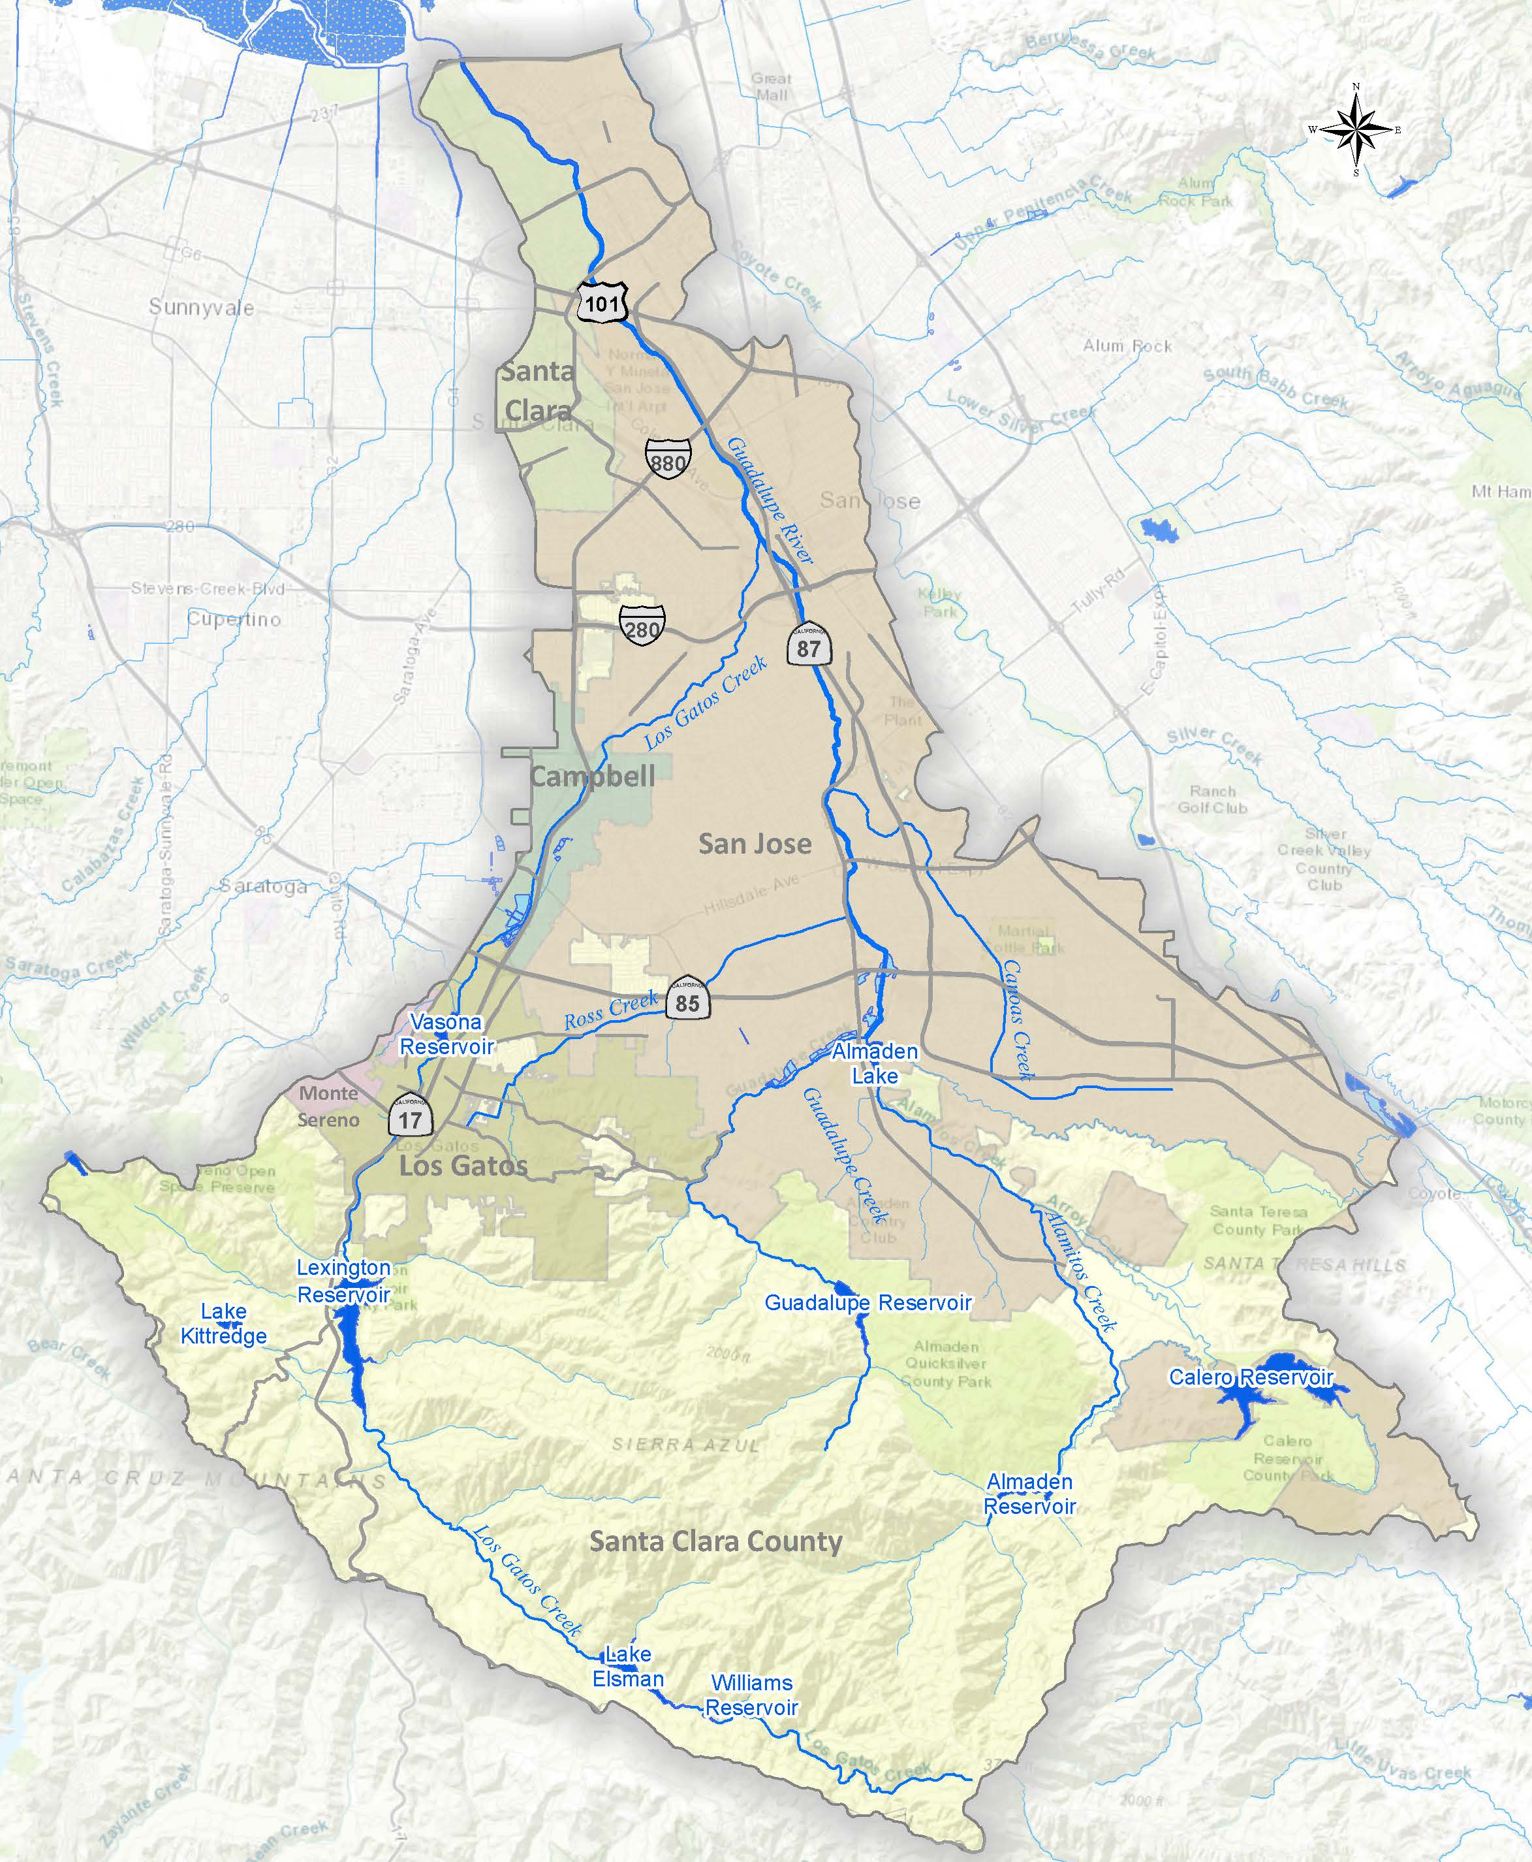
Guadalupe Watershed
Upper Watershed Reservoirs
Tributaries
Upper Guadalupe River
Downtown Guadalupe River
Lower Guadalupe River
`

Slide 6
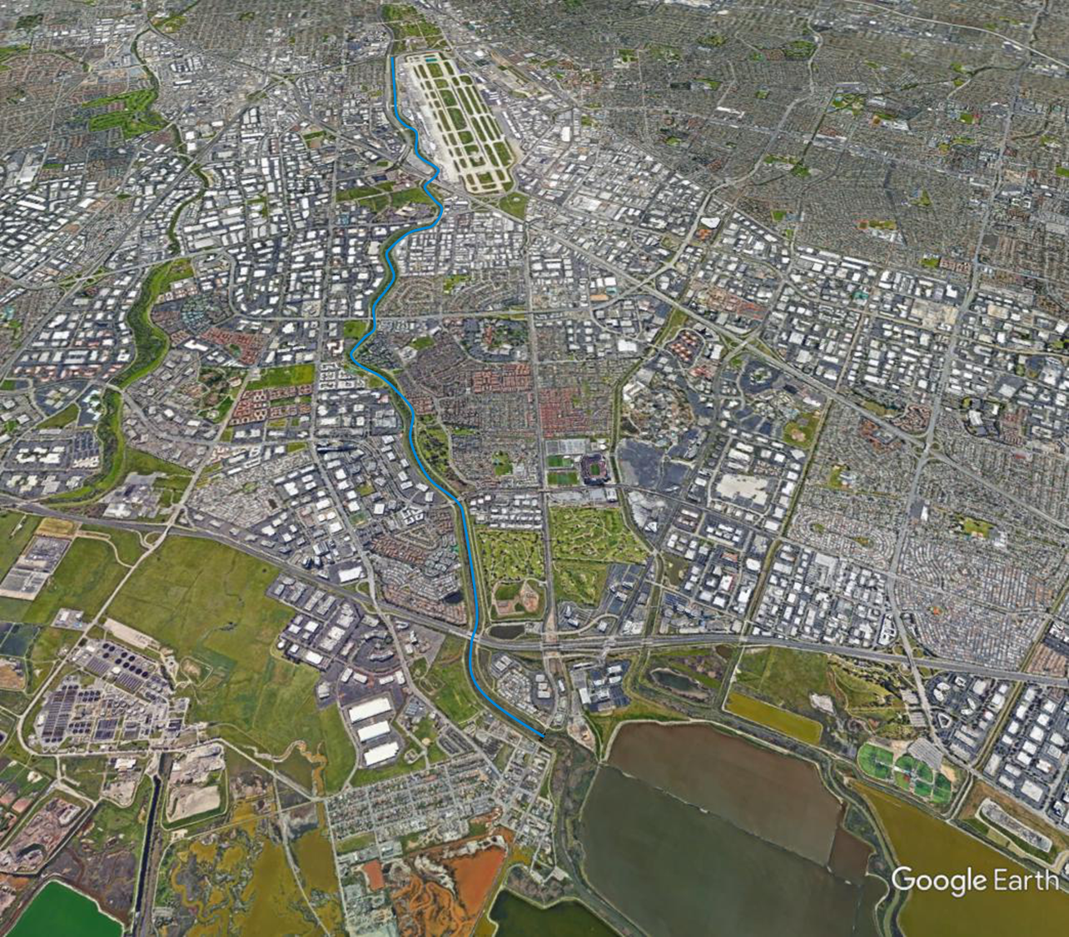
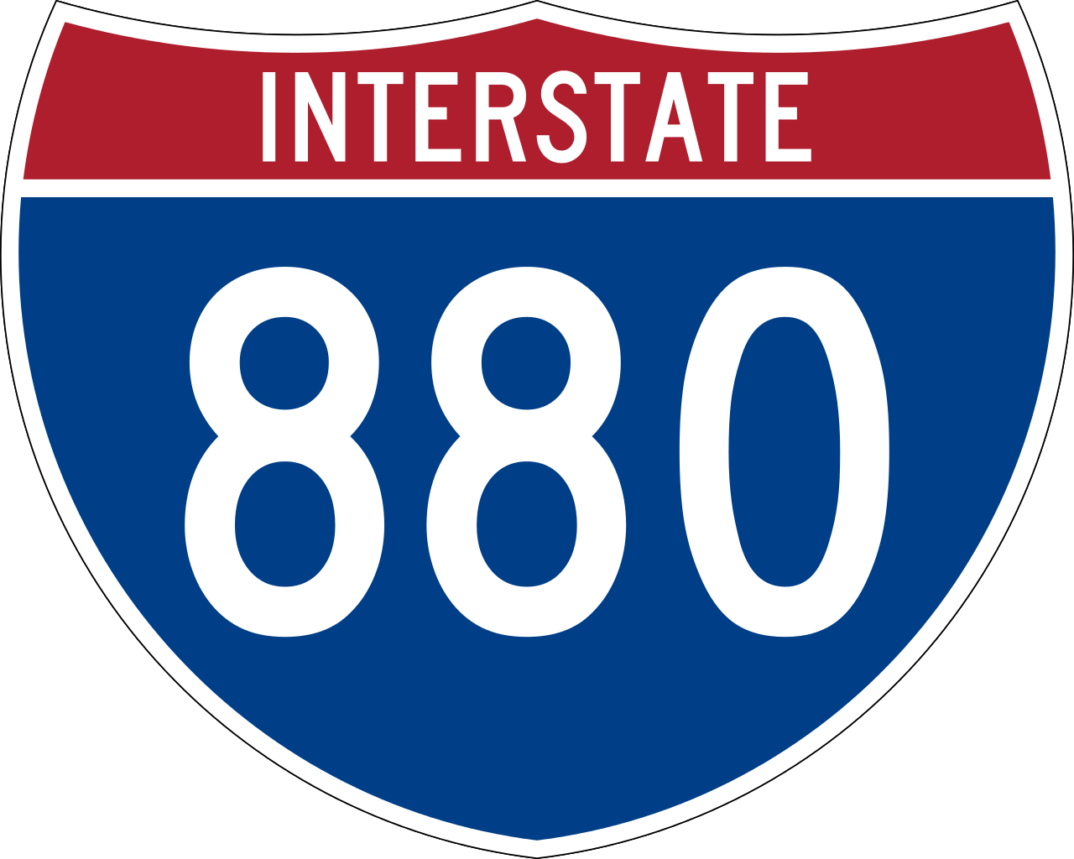


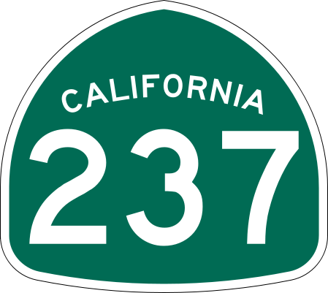
Lower Guadalupe River Project
Completed 2004
100-Year flood protection
Levees and Floodwalls
Bridge Improvements

Slide 7
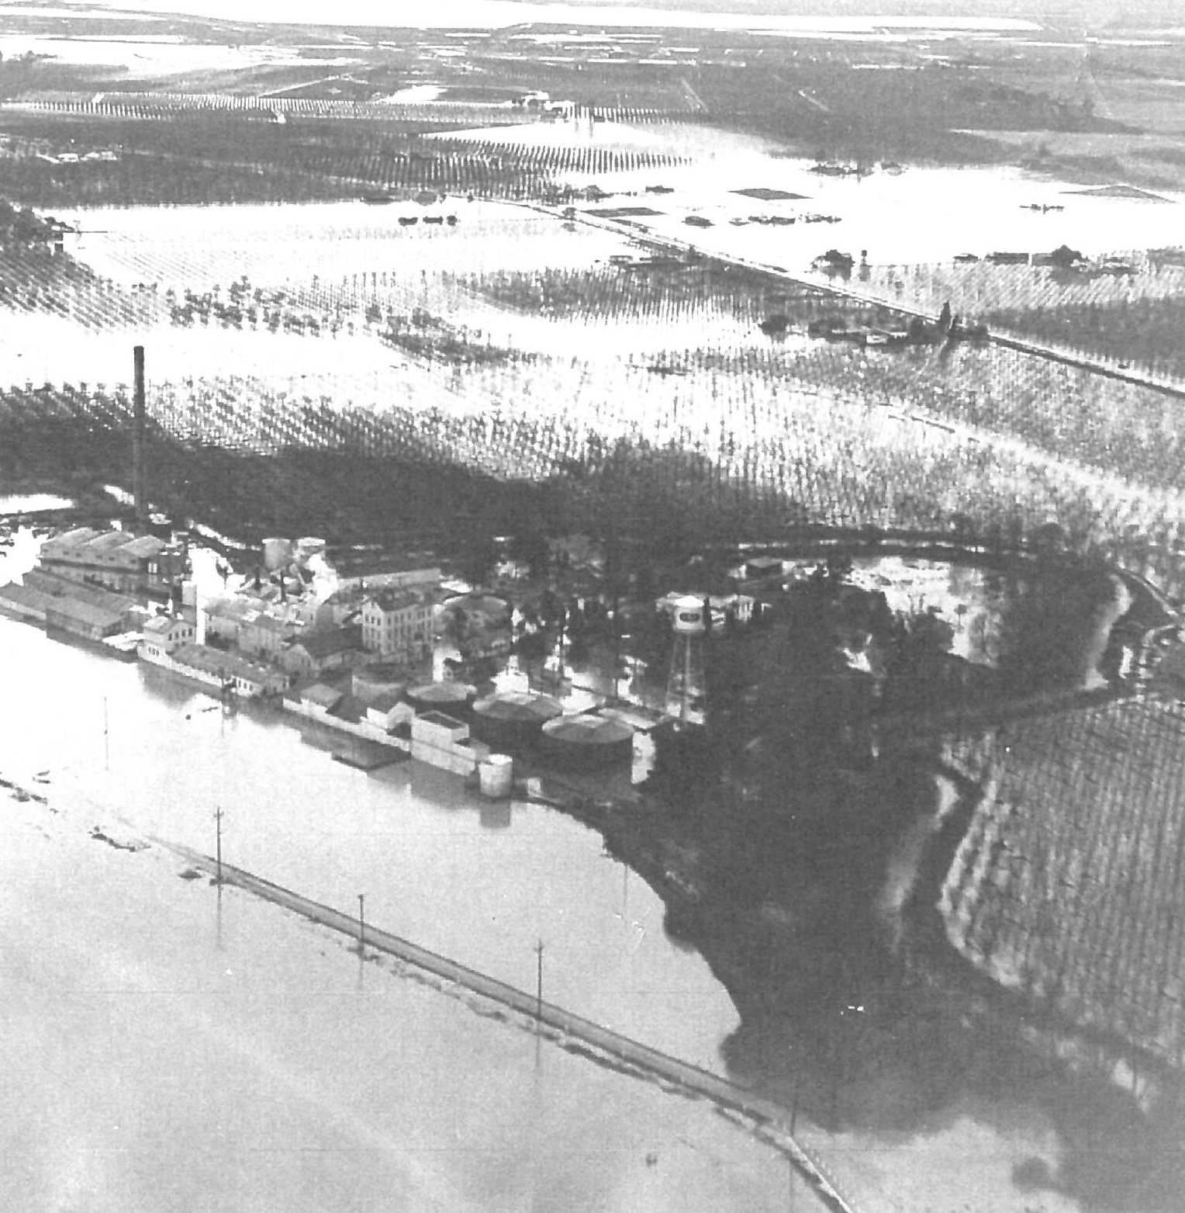
What is 100-Year?
1% probability of occurrence in a given year
1 in 100 chance
26% chance over life of 30-year mortgage
Why 100-Year?
FEMA National Flood Insurance Program Maps
Note: Does not eliminate all flood risk!

Slide 8
Recently Discovered Problem

Slide 9
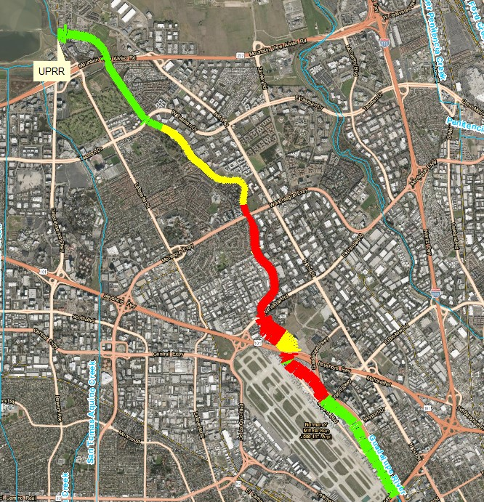
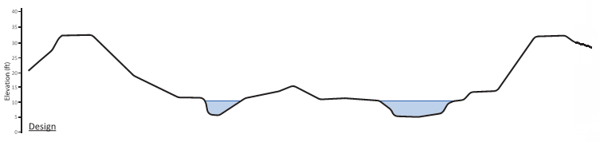
Maintenance & Monitoring
Annual maintenance
High-water mark collection
Hydraulic model calibration
100-year – 18,300cfs
25-year – 10,800cfs
Base Flow

Slide 10
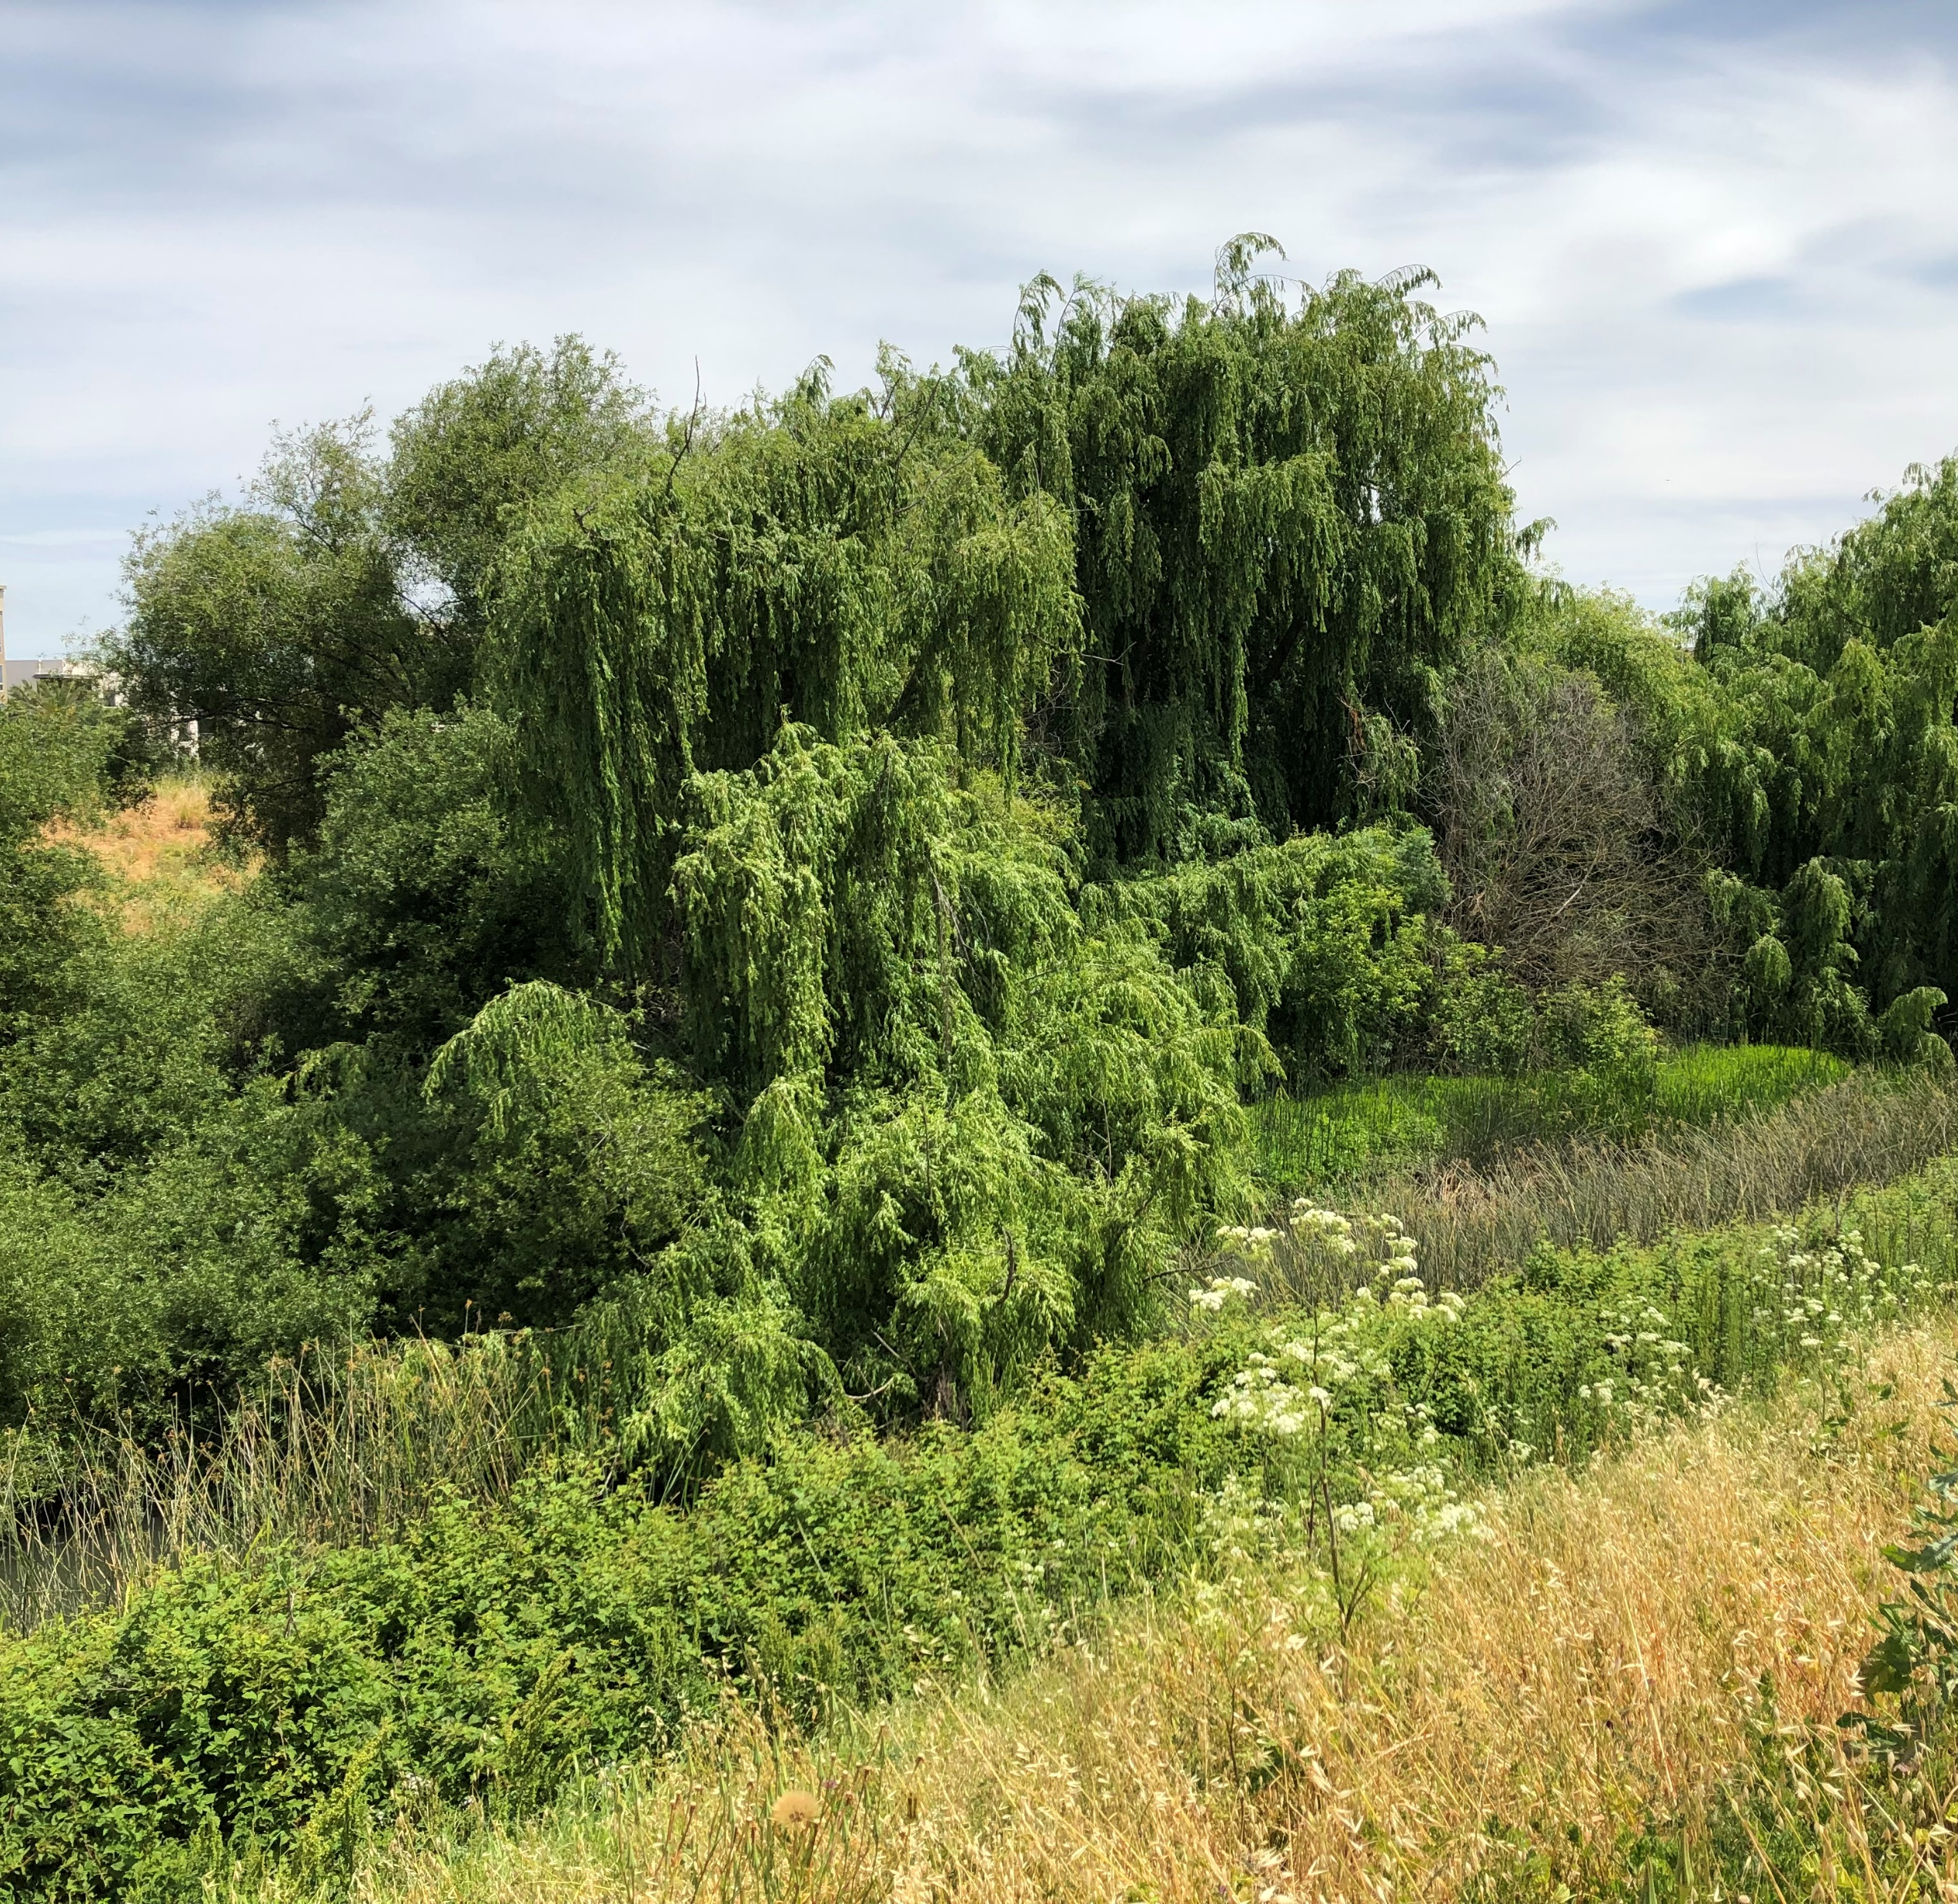
Causes
High vegetation growth
Permit Restrictions
Mitigation Planting

Slide 11
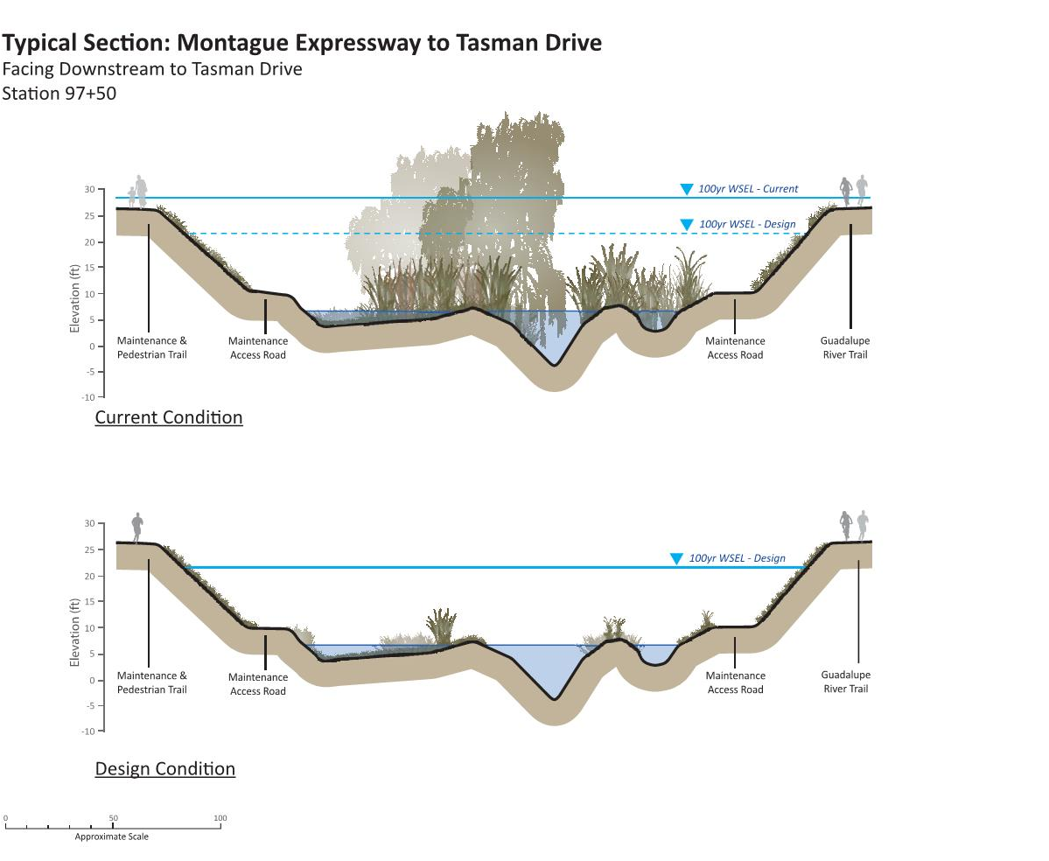
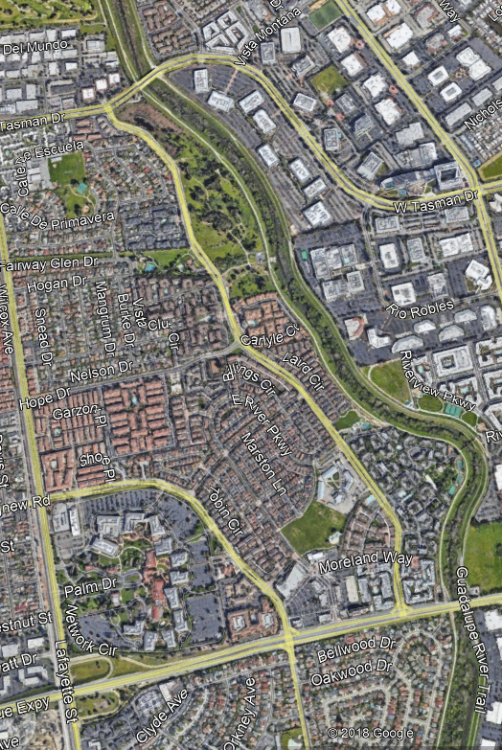
Tasman Dr
Cross-Section Location
Current Condition
Design Condition
Montague Expressway

Slide 12
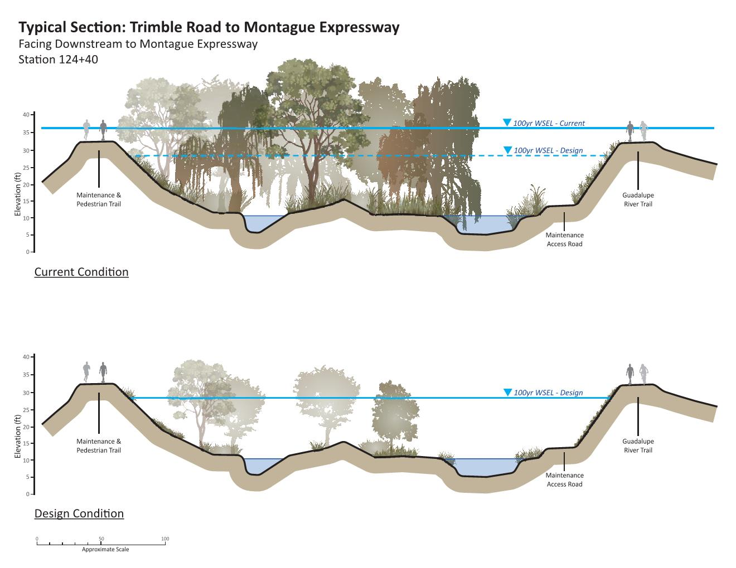
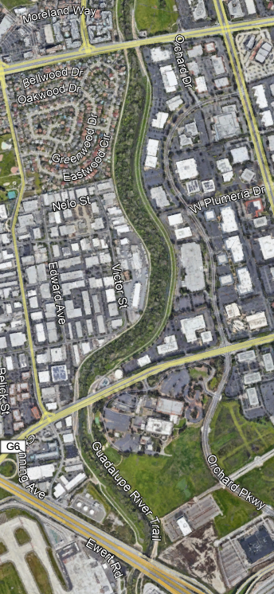
Montague Expressway
Cross-Section Location
Current Condition
Trimble Road
Design Condition

Slide 13
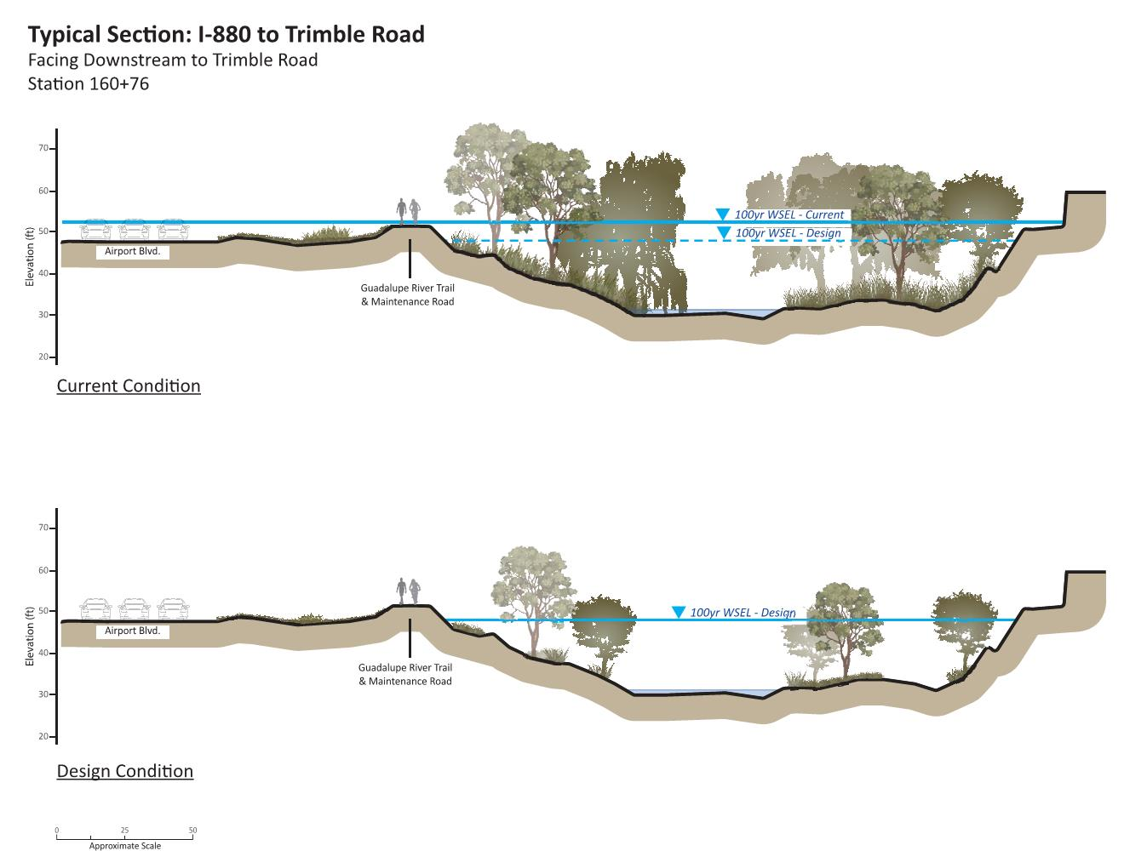
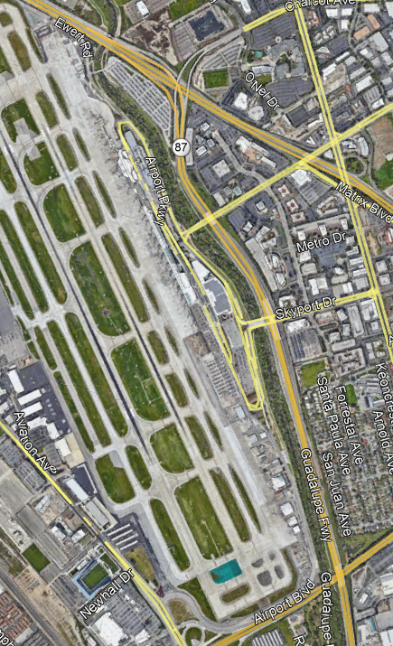
Current Condition
Cross-Section Location
Design Condition

Slide 14
Interim Solutions

Slide 15
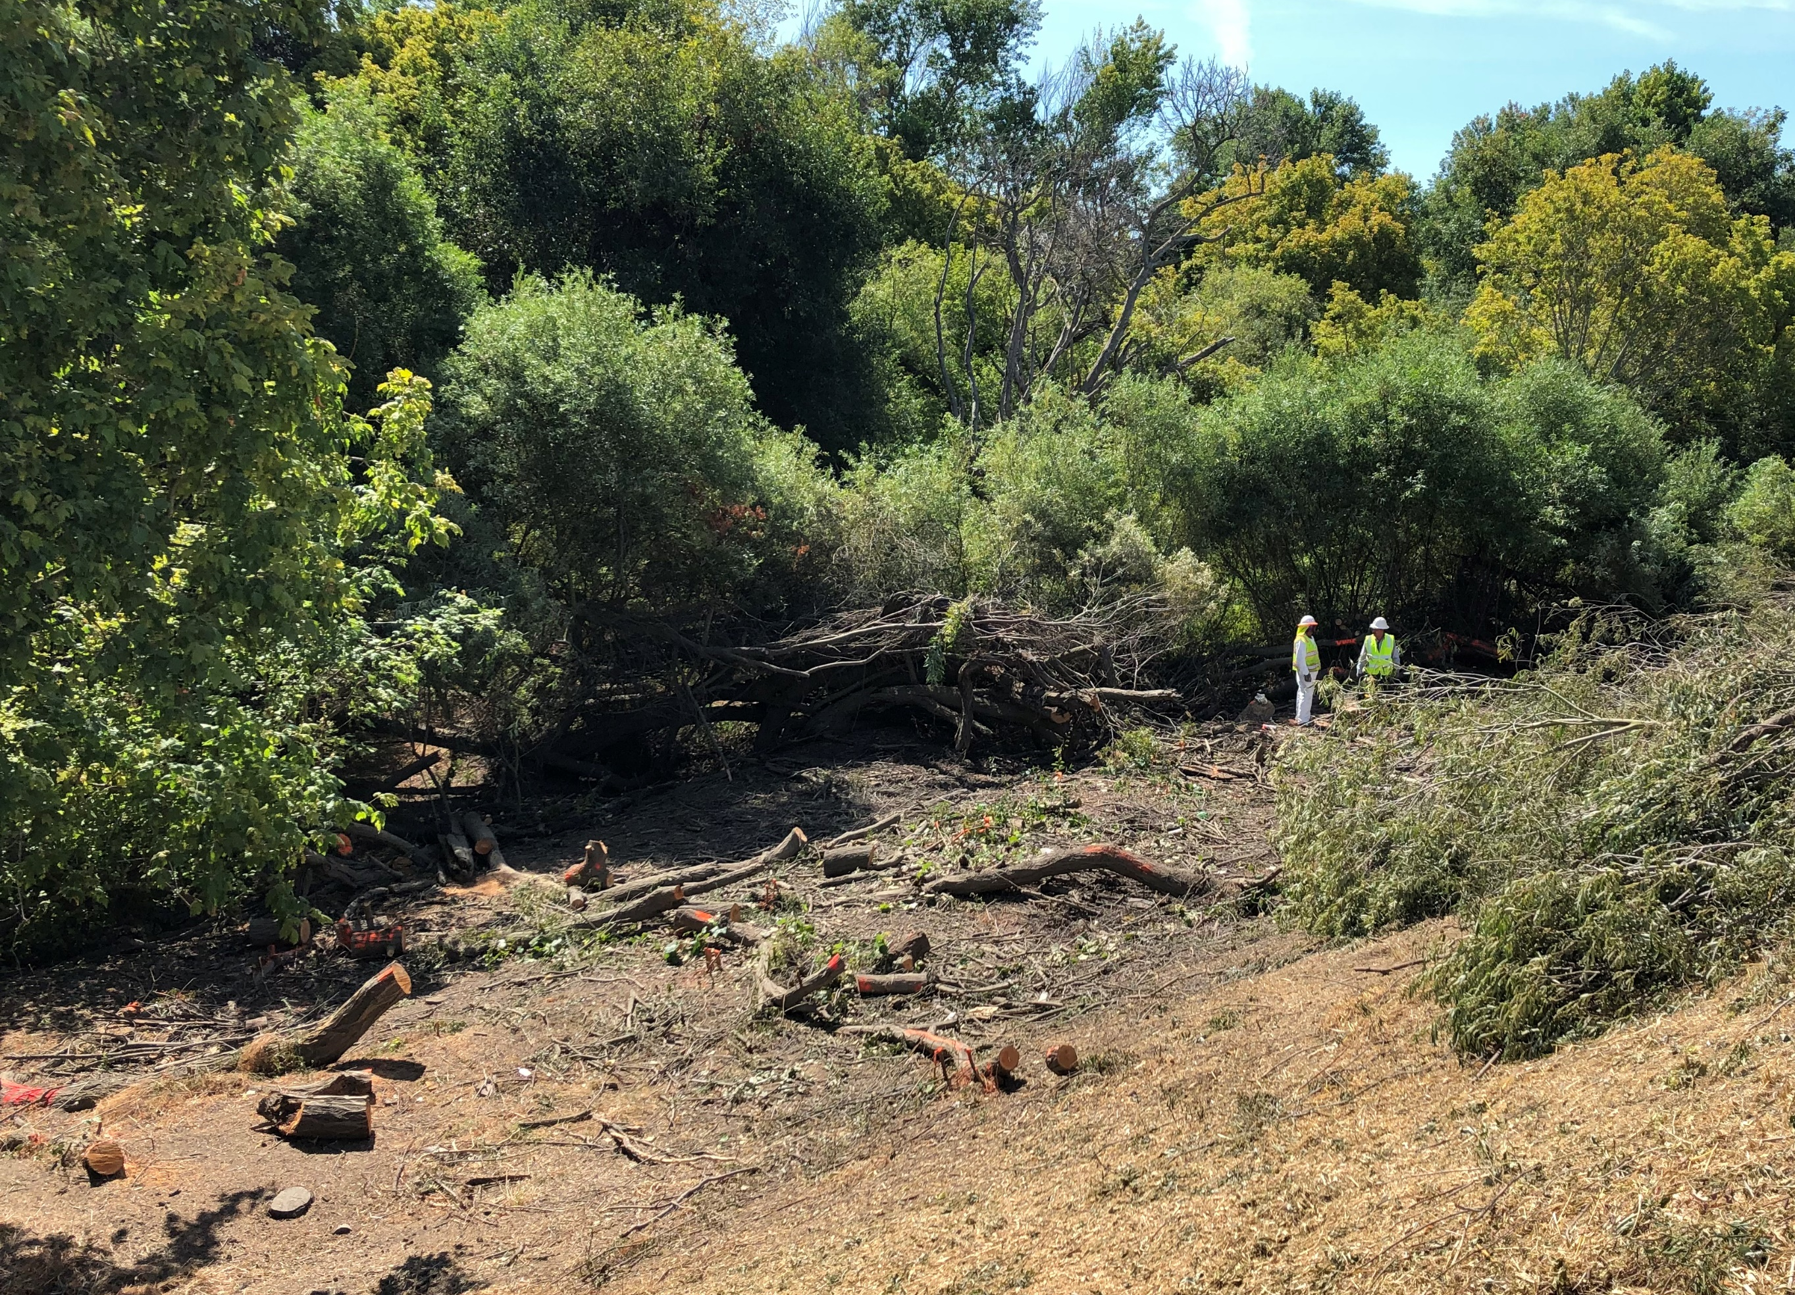
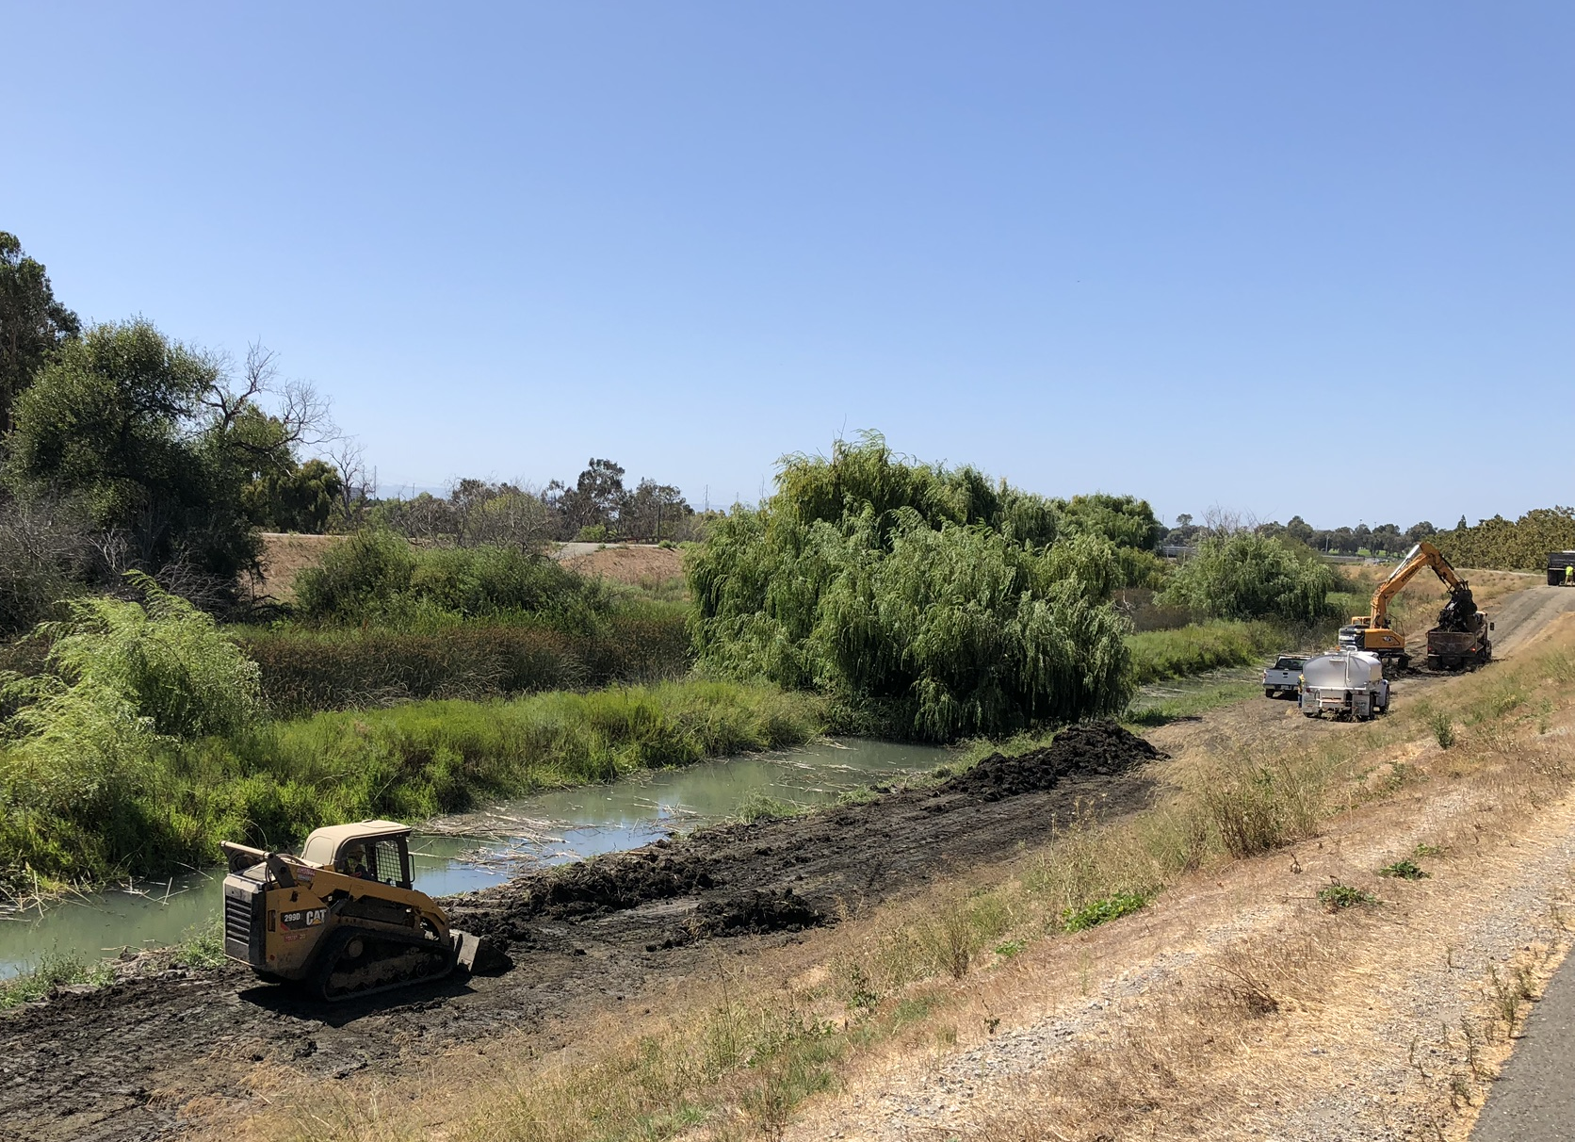
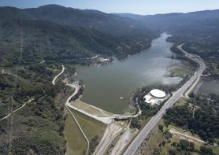
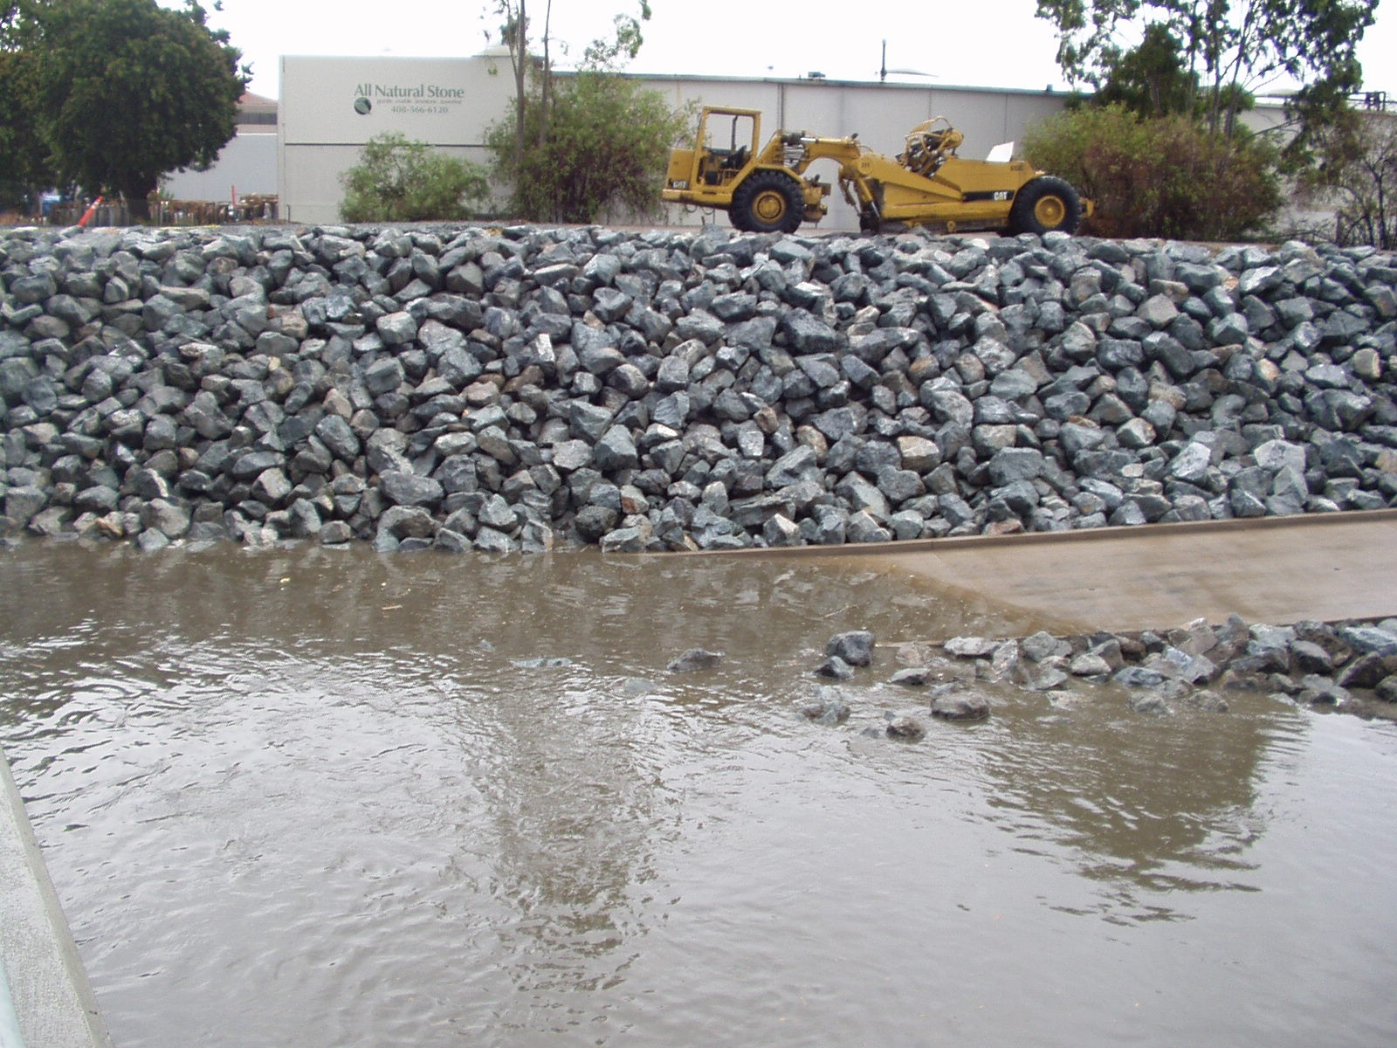
Preparations for This Winter
Sediment Removal
Sediment removed from side channels to return to design condition
Lexington Operations
Operate Reservoir for Flood Risk Reduction
Storm Preparedness
Vegetation Removal
Valley Water Field Information Teams (FIT), City Coordination, and Emergency Action Plans
Trees cleared from levees and 15 feet from levee toe

Slide 16
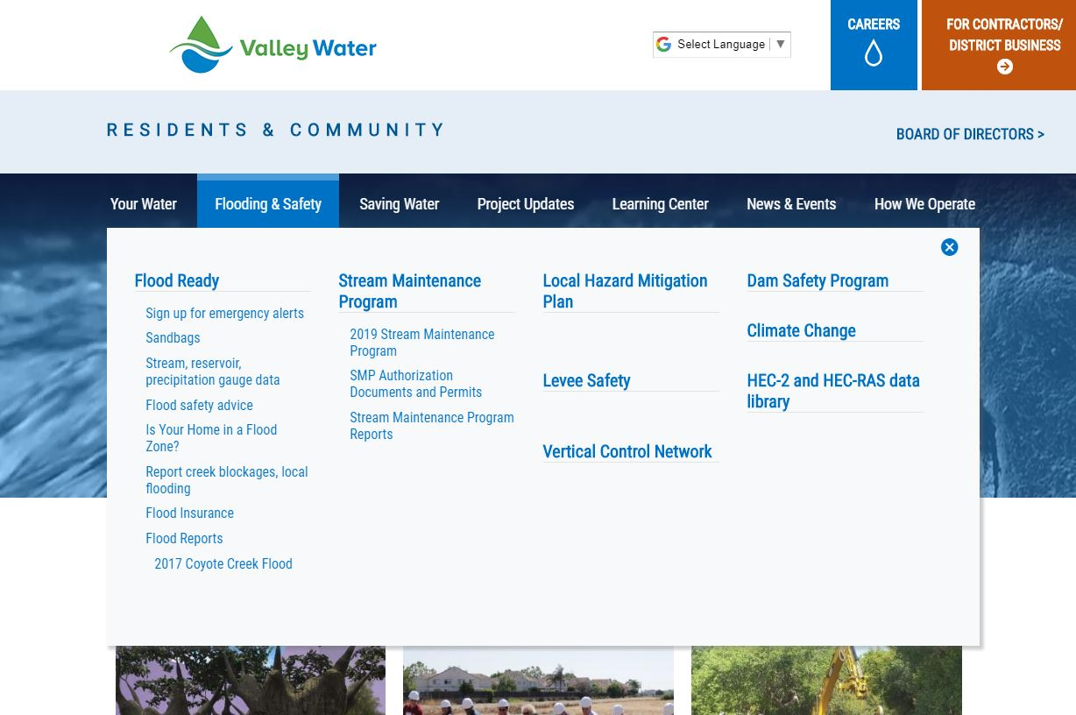
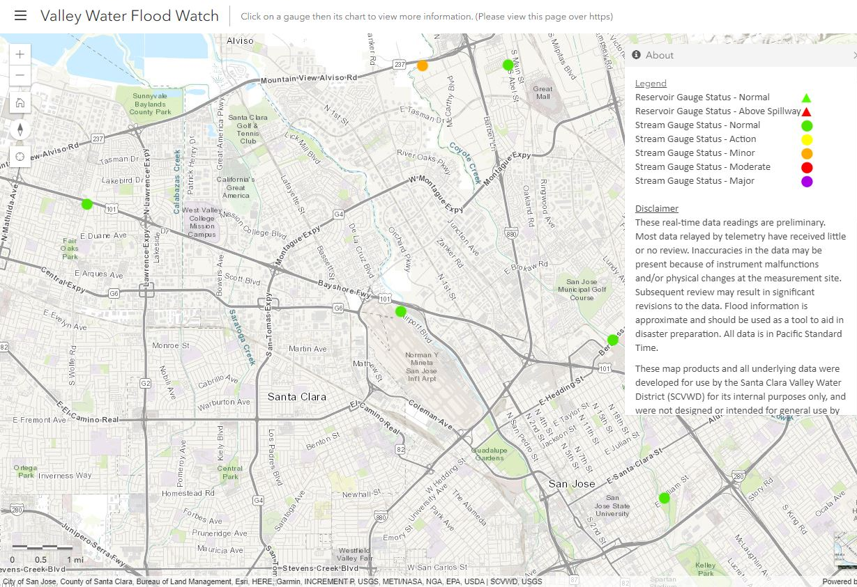
Valley Water Flood Watch
valleywater.org/floodready
Monitor stream gage levels
Sandbag distribution sites
Flood safety advice

Slide 17
Permanent Solutions

Slide 18
Conceptual Alternatives
Inboard Floodwalls – up to 6 feet

Slide 19
Conceptual Alternatives
Outboard Floodwalls – up to 6 feet

Slide 20
Conceptual Alternatives
Replace Levee with Floodwall

Slide 21
Conceptual Alternatives
Raise Levees– up to 6 feet

Slide 22
Conceptual Alternatives
Widen River Channel/Setback Levee

Slide 23
Conceptual Alternatives
Bypass Channels

Slide 24
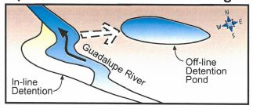
Conceptual Alternatives
Off-Stream Detention

Slide 25
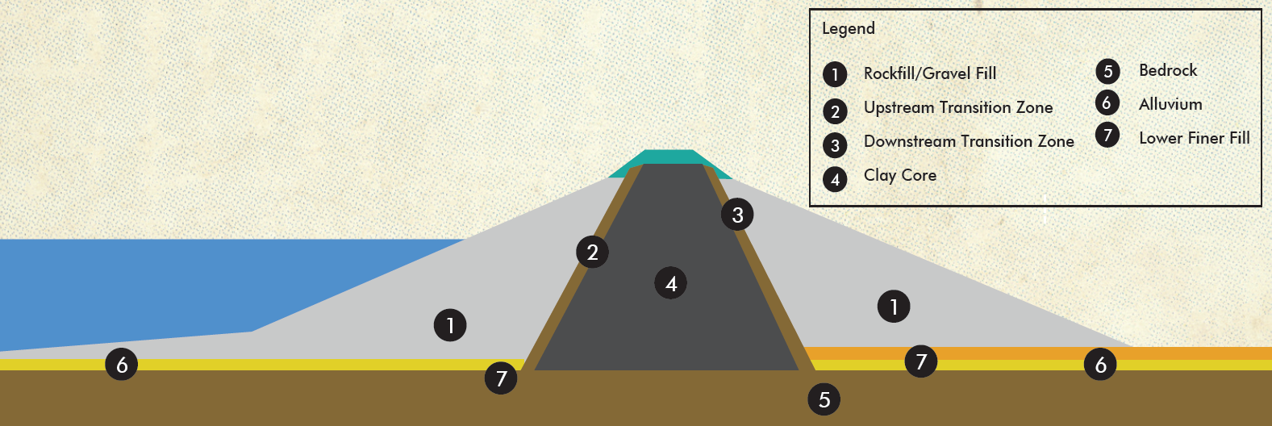
Conceptual Alternatives
Raise or Re-Operate Dams

Slide 26
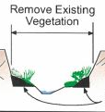
Planning Study Timeline
Start
March – May 2019
Problem Definition
Gather Information
Define Problem
Refine Objectives
Conceptual Alternatives
June – September 2019
Identify Design Options
Initial Cost Estimate
Project Objectives

Slide 27
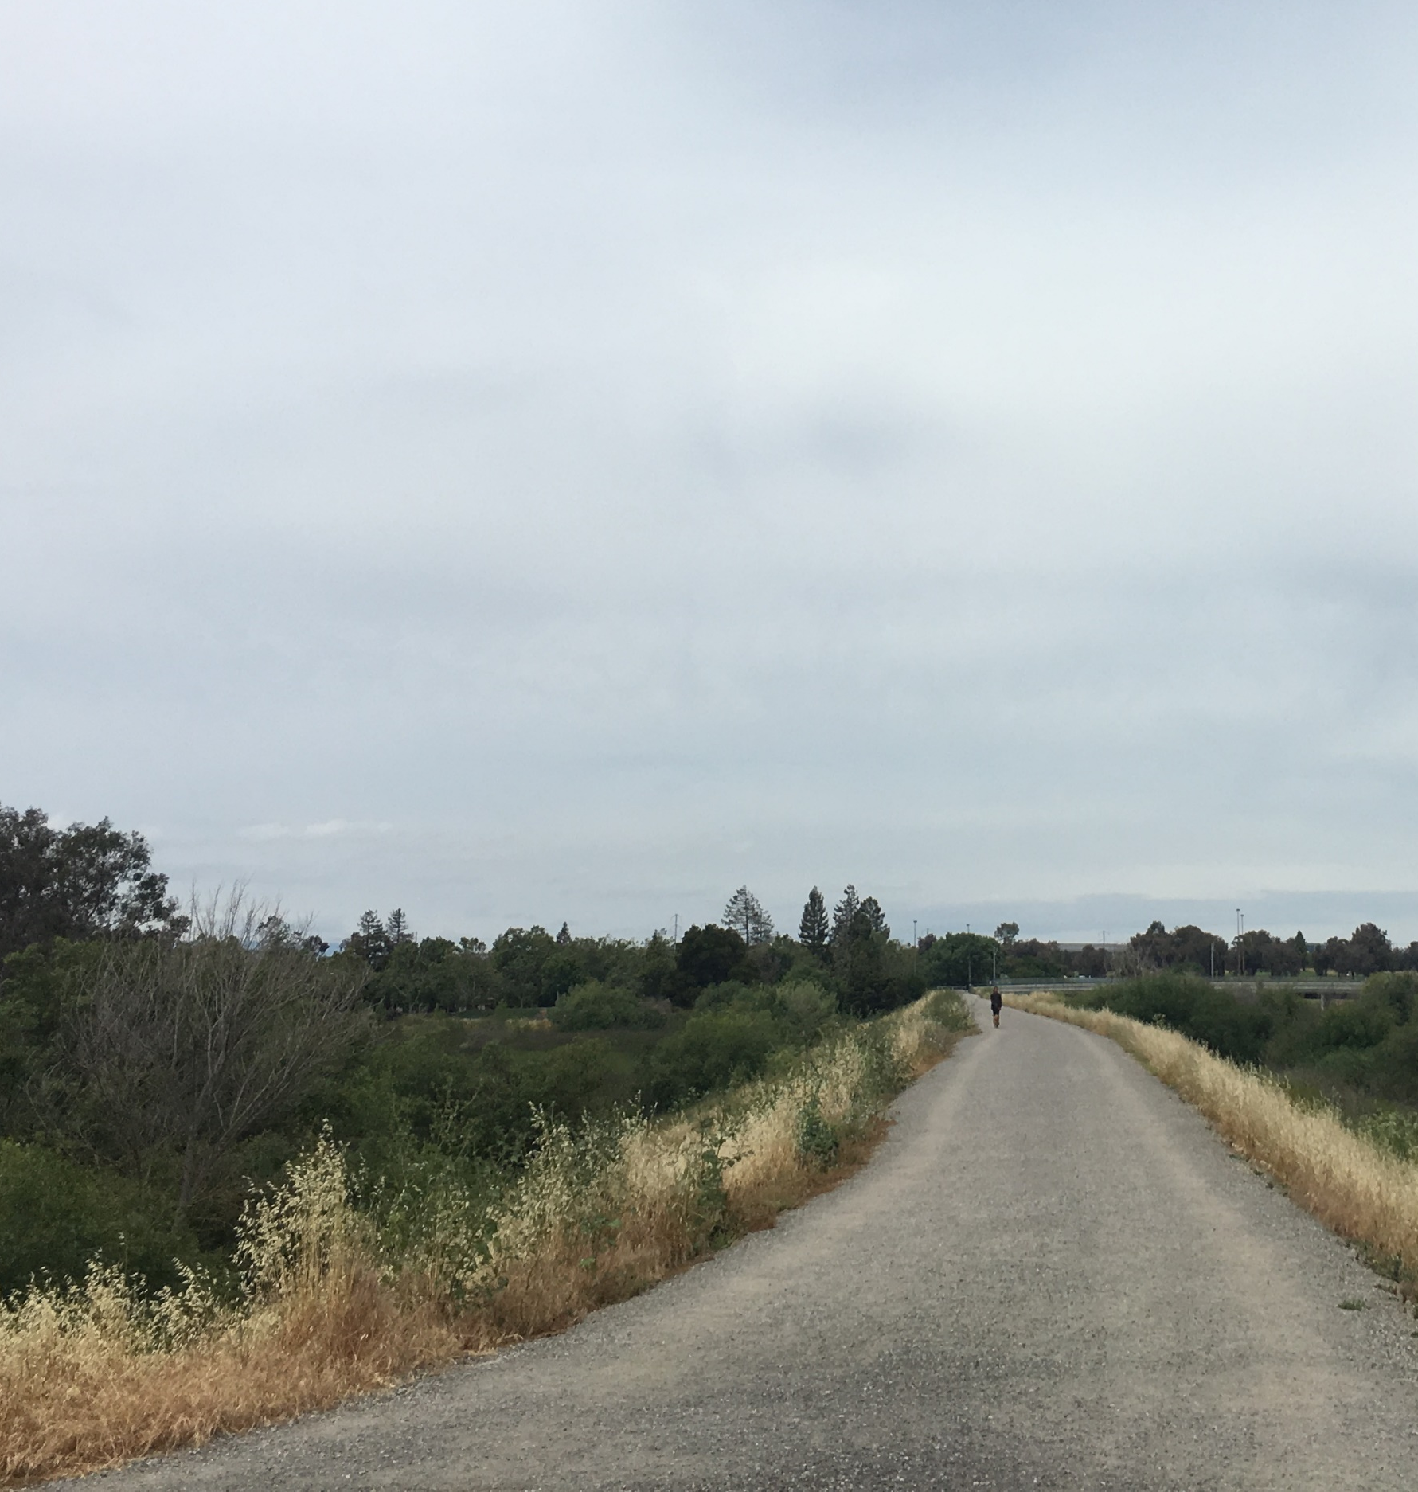

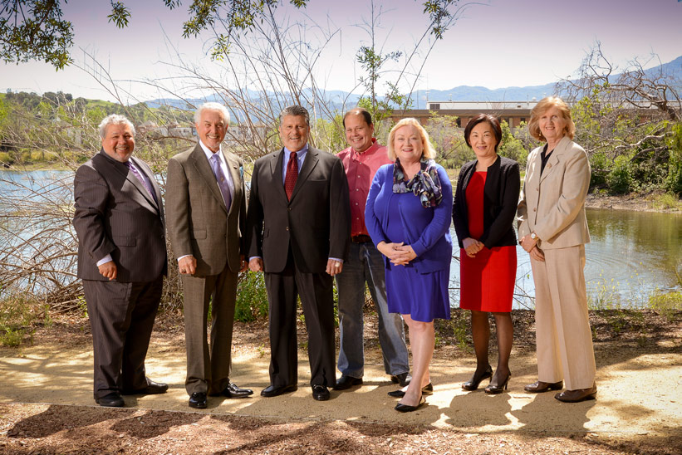
October 2019 – March 2020
Feasible Alternatives
Refine Design
Refine Cost Estimate
NFP Analysis
Staff-Recommended Alternative
April – June 2020
Start CEQA and other permits
Best meets Project Objectives
June 2020
Board of Directors Approval
Proceed to Design Phase

Slide 28

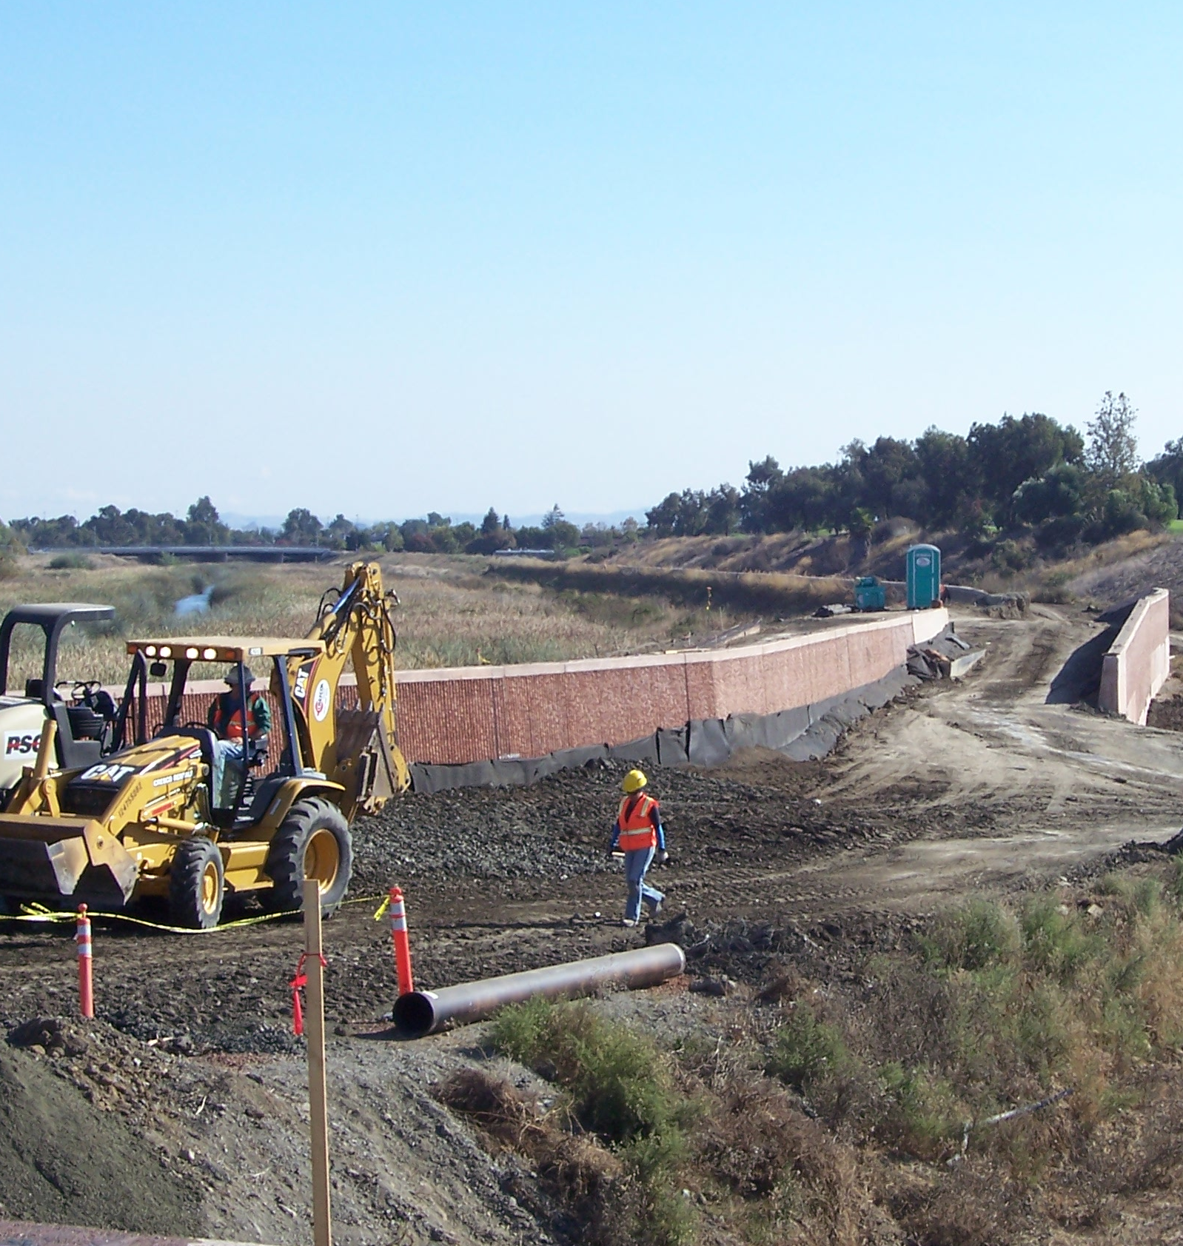
Design Phase
Summer 2020 – Spring 2022
All environmental permits approved
30%, 60%, 90%, Final Design
Spring 2022-Spring 2024
Construction Phase
End

Slide 29
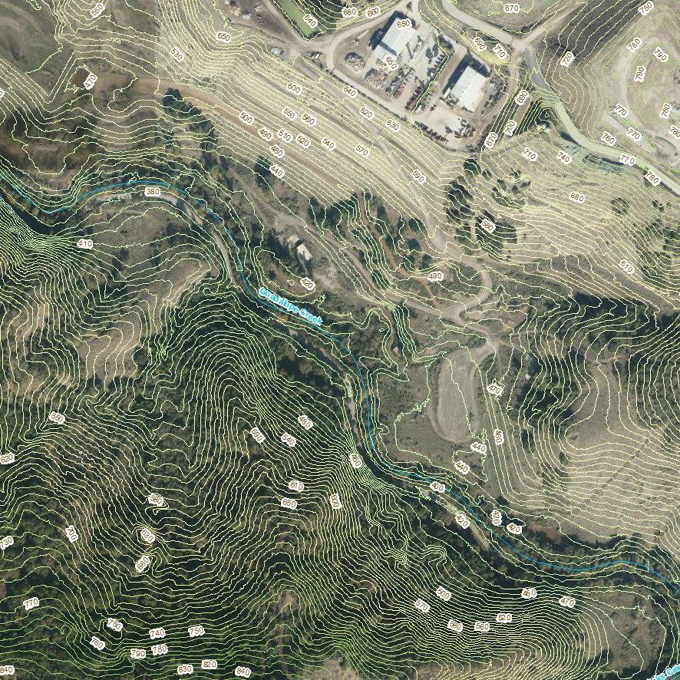


Public Meeting #2
Staff will present feasible alternatives
Guadalupe River Planning Project
Public Meeting #3
Staff will present recommended alternative
Next Steps:
Project team will gather all the information from this meeting and use it to guide the alternatives analysis
Planning Study Report and Board Approval

Slide 30
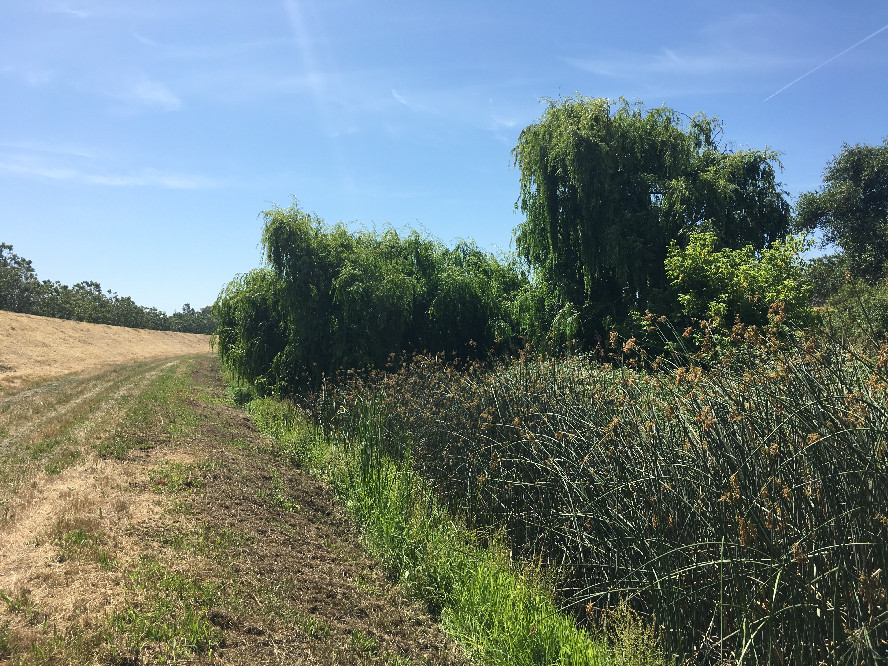

QUESTIONS

Slide 31
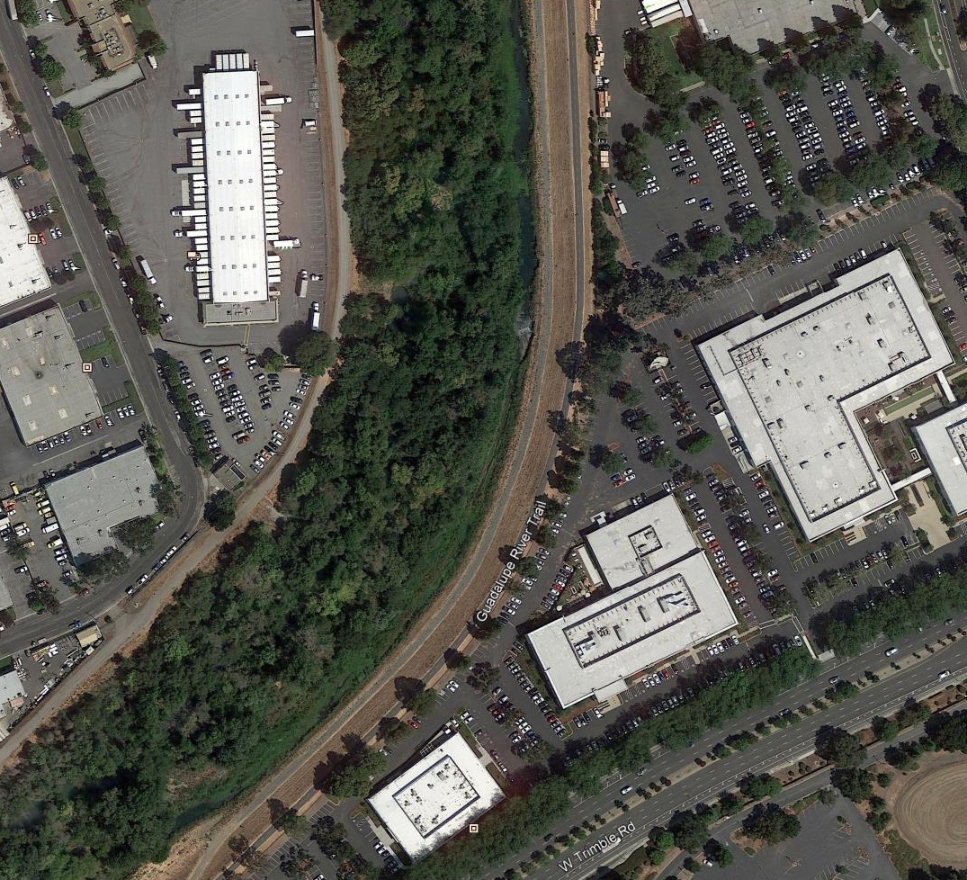

Subscribe and Follow
@valleywater
@valleywater
@valleywater
Social
media

Slide 32


Slide 33
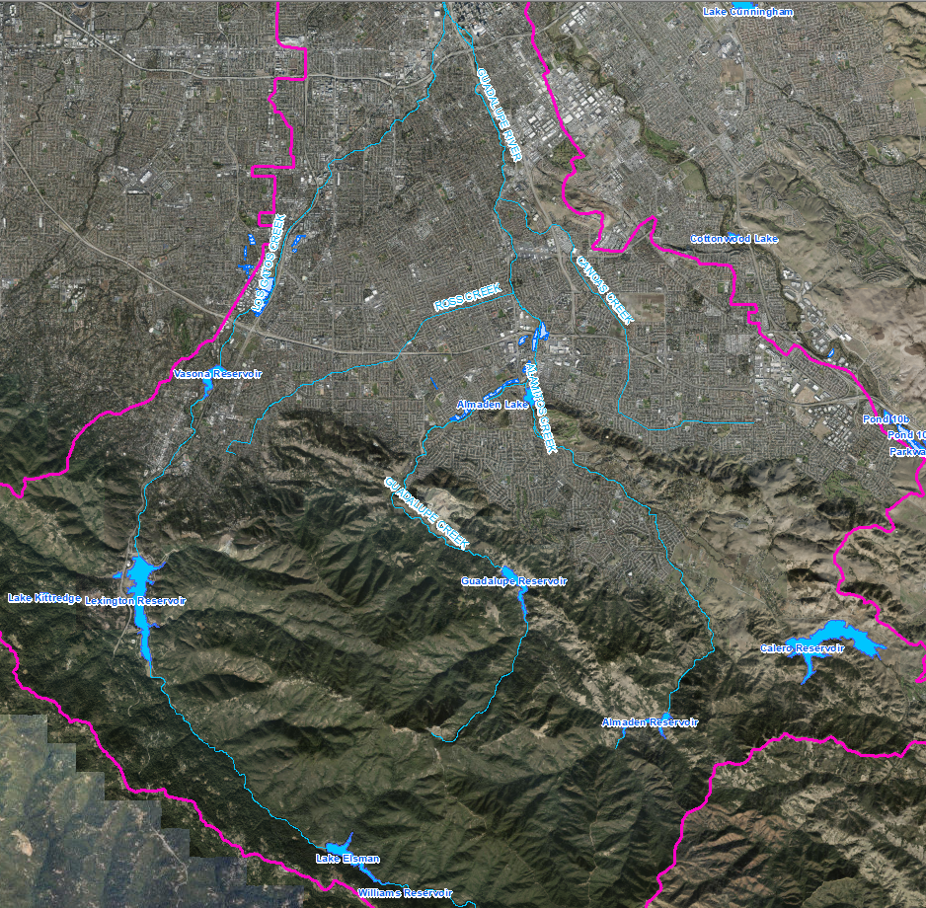
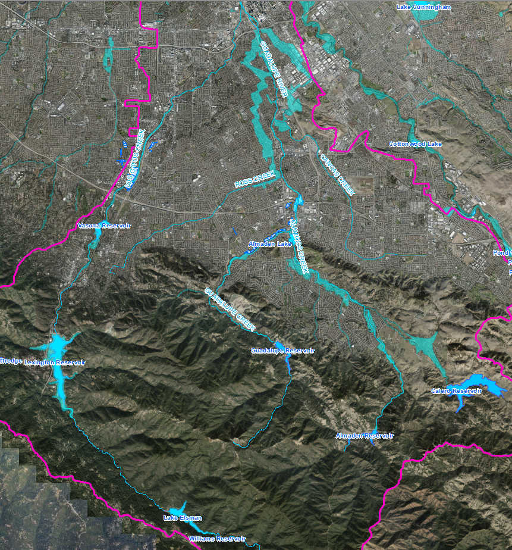

Hydrology
How we estimate 100-year design flows
8,000 cfs
Two 72-hr storms
Guadalupe sub-watershed produces higher flows
Current Condition: higher flows from Lexington sub-watershed

Slide 34
Design Criteria
Operate and manage Lower Guadalupe “in such a way to convey design flood flows”
100-Year Design Flows
Location | USACE/LGRP Flows | 2009 USACE Update | Current Condition
D/S of Los Gatos Creek | 16000 | 17970 | -
Highway 101 | 17000 | 18600 | 16000
Montague Expressway | 17864 | - | 16102
Highway 237 | 18325 | 19020 | -
Comply with freeboard requirements
Comply with FEMA certification requirements

Slide 35
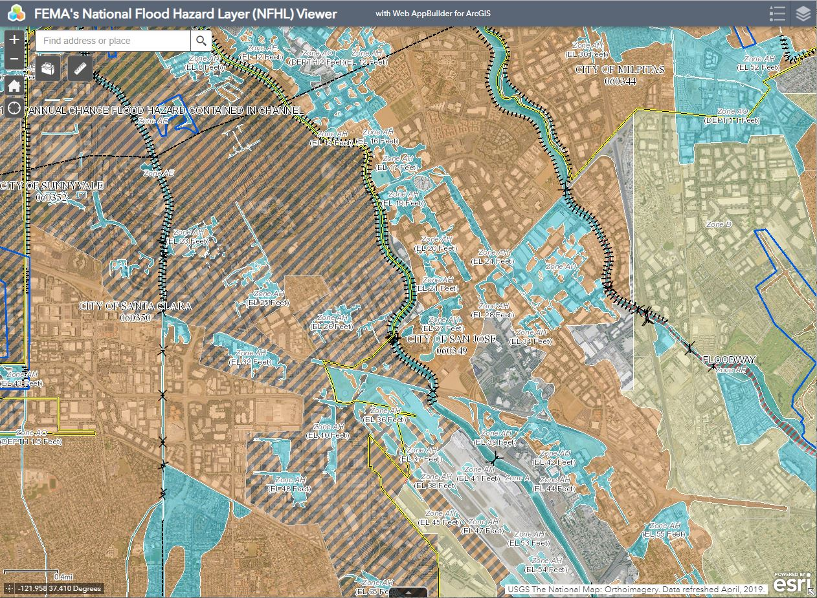
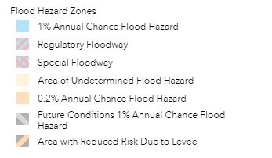
FEMA National Flood Hazard Layer (NFHL)
https://www.fema.gov/national-flood-hazard-layer-nfhl

